Slide 1




EXPEDITED LOSS REPORTING AUTO, GENERAL LIABILITY & PROPERTY CLAIMS
Duplication, reproduction and/or dissemination of this material, either in whole or in part, without the express written consent of Gallagher Bassett Services, Inc. is strictly prohibited. By acceptance of these materials, prospective client acknowledges its consent to the foregoing.

Slide 2

Accessing GBGO FirstConnect Expedited Loss reporting system
Familiarize the screens used when entering loss data
Auto Liability instructions - page 4
General Liability instructions - page 8
Property Damage instructions - page 11
Attaching files to a loss - page 14
Who to reach out to for support
Agenda

Slide 3

AVAILABLE FEATURES
Easier access to reporting system
Simplified intake form for quicker reporting
Real-Time Notifications
Mobile and Web Accessibility
Attachment Uploads
Session Timeout
Electronic confirmation of submitted loss report
All rights reserved. ©
3

Slide 4

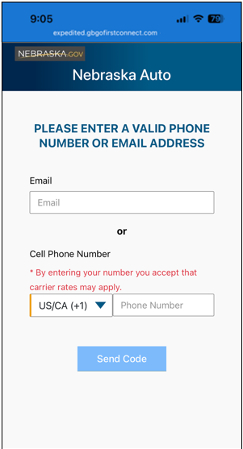
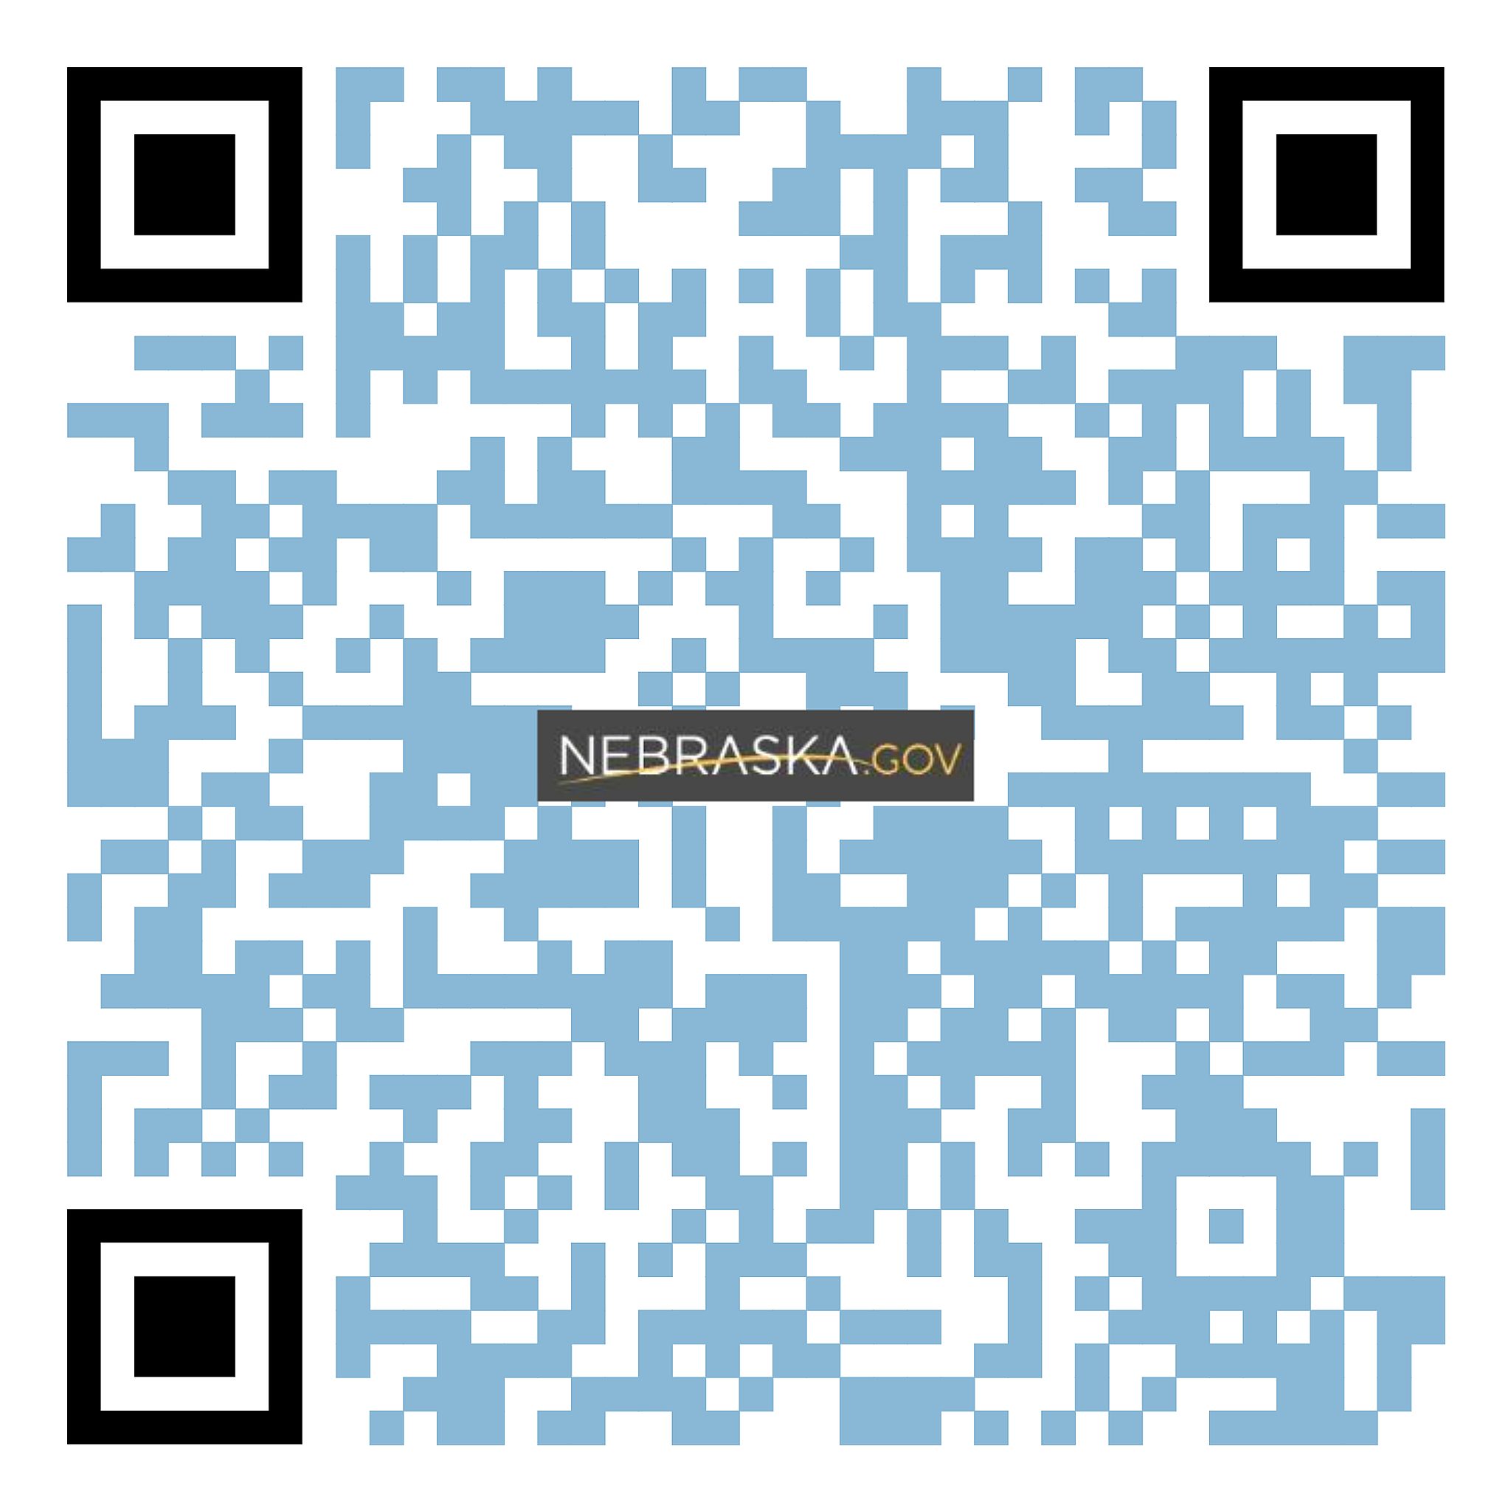
STARTING AN AUTO EXPEDITED LOSS REPORT
AUTO LIABILITY
expedited.gbgofirstconnect.com/DASNEAuto
Enter the website above to report an Auto Loss
OR
Scan the QR Code
Enter your email or cell phone number to receive a verification code via email or text

Slide 5
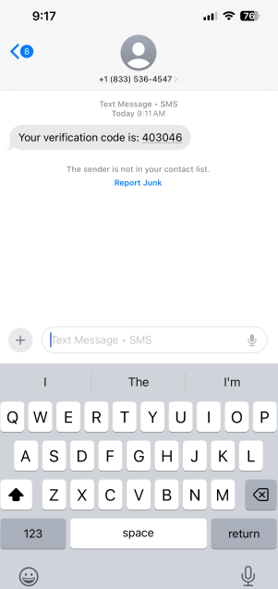
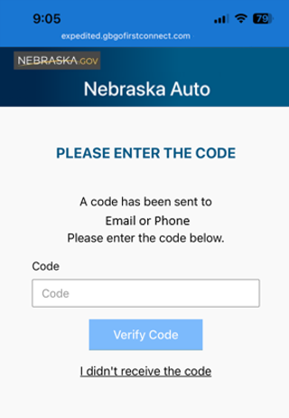
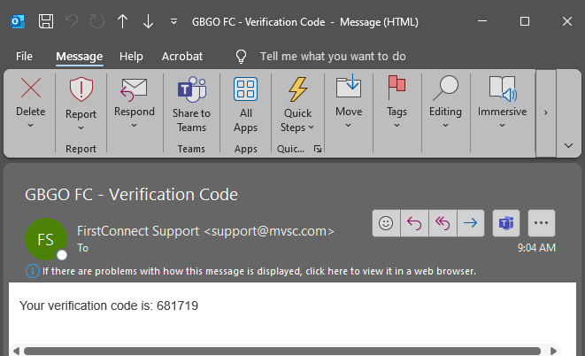
RECEIVING THE VERIFICATION CODE
After sending the code via email or text you will be directed to the page to enter the code
If the verification code isn’t received when using the email option, remember to check the spam/junk folder to ensure it is not being redirected as an unknown sender.

Slide 6
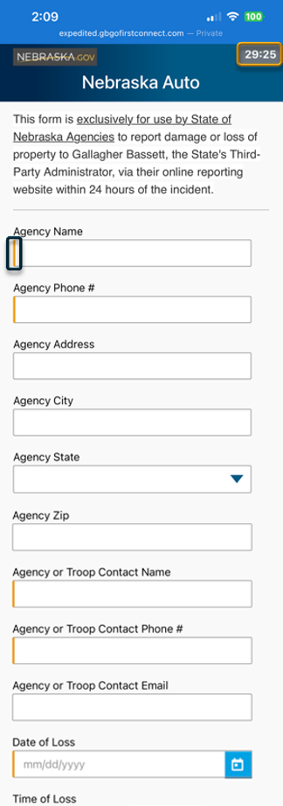
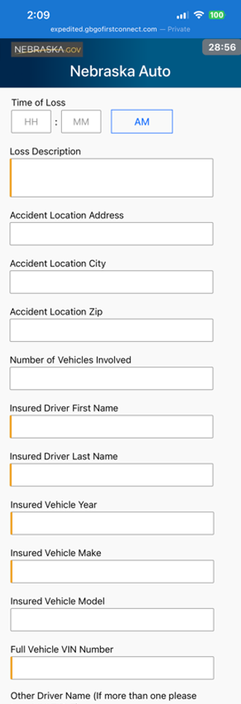
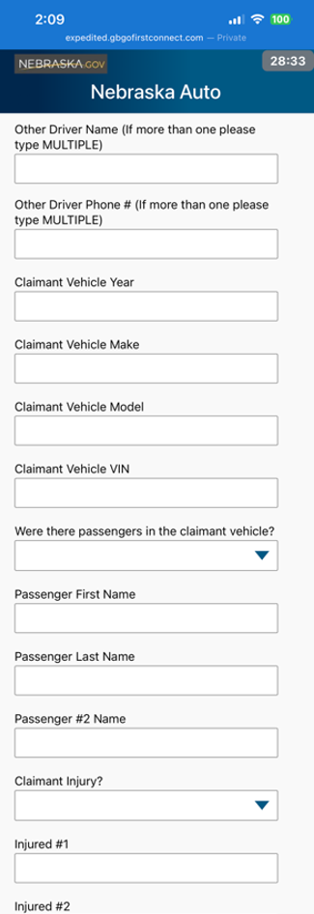

ENTERING AN AUTO LIABILITY LOSS
Timer
On the top right corner of the page a timer will count down until the report will time out and rest.
Required/Mandatory Fields
Easily identify the required fields by the orange bar on the left of the text box.
You will be unable to submit the loss report until all the required fields have been answered.
Required information to have on hand before reporting the loss:
*Please note: Insured Driver will be State of Nebraska Employee
Agency Name
Agency Phone #
Agency or Troop Contact Name
Agency or Troop Contact Phone #
Date of Loss
Loss Description
*Insured Driver First Name
*Insured Driver Last Name
Insured Vehicle Year
Insured Vehicle Make
Full Vehicle VIN Number
Preparer Name
Preparer Phone

Slide 7
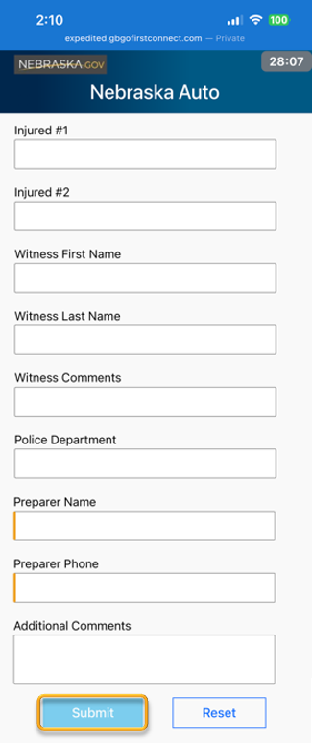
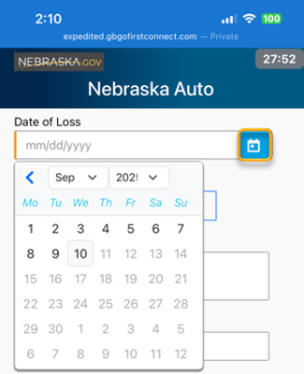
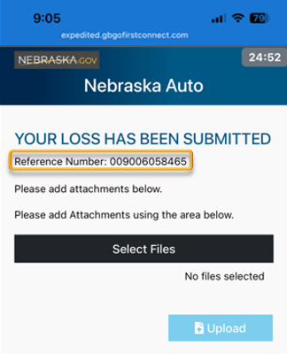
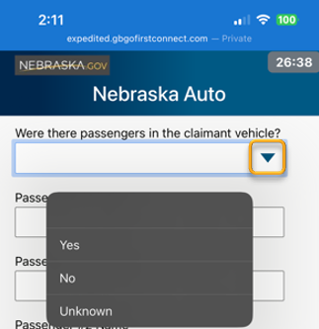
ENTERING AN AUTO LIABILITY LOSS
Calendar Feature
Click on the calendar icon for the quick click calendar pop up
Drop Down Feature
Click on the arrow to open the dropdown list.
The Additional Comments Field
Information entered in this field will not be entered on the FROI. And can contain
Submit the loss
Once the loss report has been submitted a Loss Reference Number will be provided

Slide 8
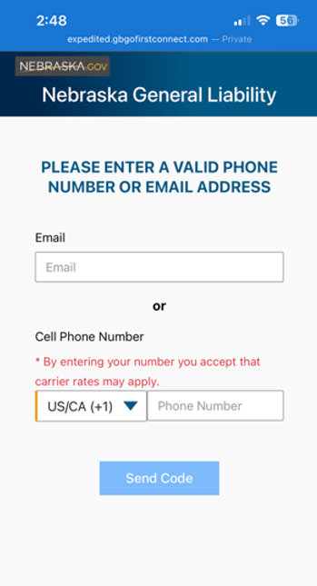
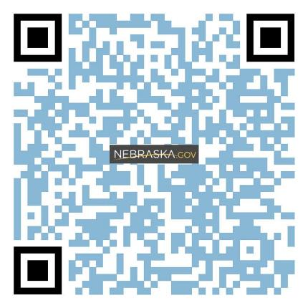
STARTING A GENERAL LIABILITY EXPEDITED LOSS REPORT
GENERAL LIABILITY https://expedited.gbgofirstconnect.com/DASNELiability
Enter the website above to report an Auto Loss
OR
Scan the QR Code
Enter your email or cell phone number to receive a verification code via email or text

Slide 9

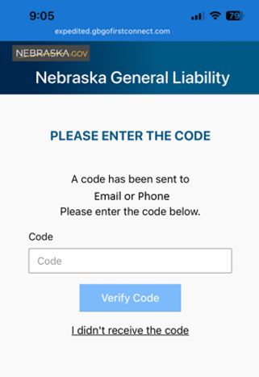

RECEIVING THE VERIFICATION CODE
After sending the code via email or text you will be directed to the page to enter the code
If the verification code isn’t received when using the email option, remember to check the spam/junk folder to ensure it is not being redirected as an unknown sender.

Slide 10
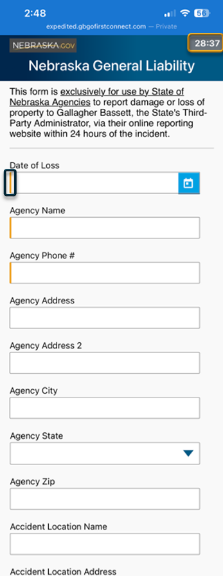
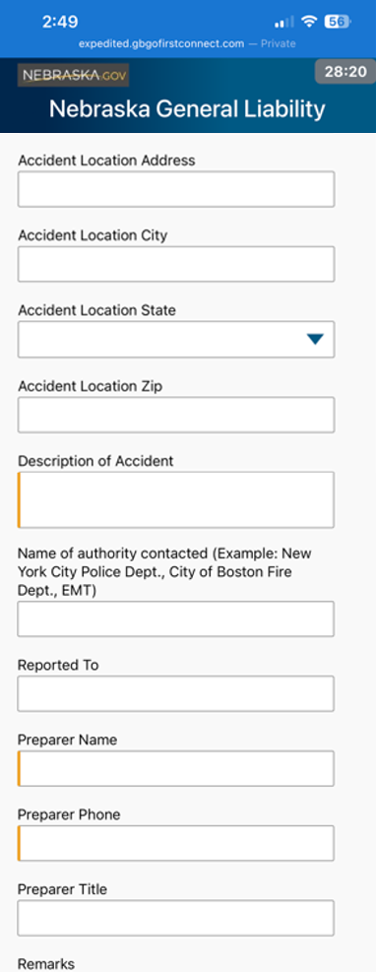
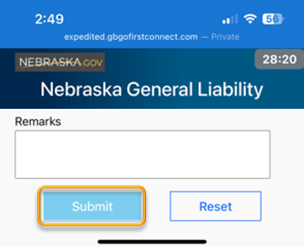
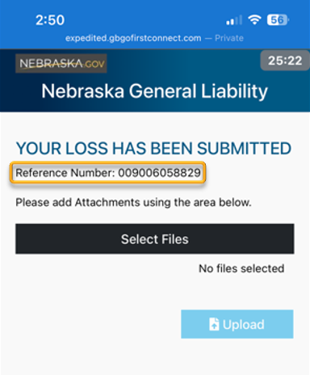
ENTERING A GENERAL LIABILITY LOSS
Timer
On the top right corner of the page a timer will count down until the report will time out and rest.
Required/Mandatory Fields
Easily identify the required fields by the orange bar on the left of the text box.
You will be unable to submit the loss report until all the required fields have been answered.
Required information to have on hand before reporting the loss:
Date Of Loss
Agency Name
Agency Phone #
Loss Description
Preparer Name
Preparer Phone
The Remarks Field
Information entered in this field will not be entered on the FROI. And can contain
Submit the loss
Once the loss report has been submitted a Loss Reference Number will be provided

Slide 11
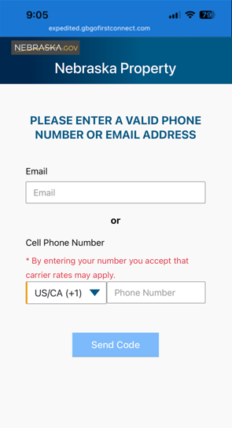
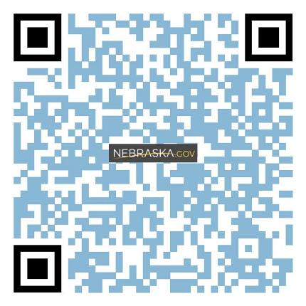
STARTING A PROPERTY EXPEDITED LOSS REPORT
PROPERTY DAMAGE expedited.gbgofirstconnect.com/DASNEProp
Enter the website above to report an Auto Loss
OR
Scan the QR Code
Enter your email or cell phone number to receive a verification code via email or text

Slide 12
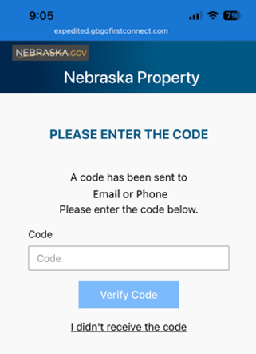
RECEIVING THE VERIFICATION CODE
After sending the code via email or text you will be directed to the page to enter the code
If the verification code isn’t received when using the email option, remember to check the spam/junk folder to ensure it is not being redirected as an unknown sender.

Slide 13
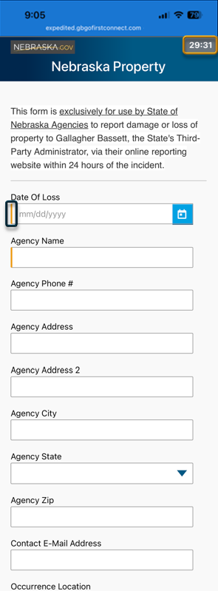
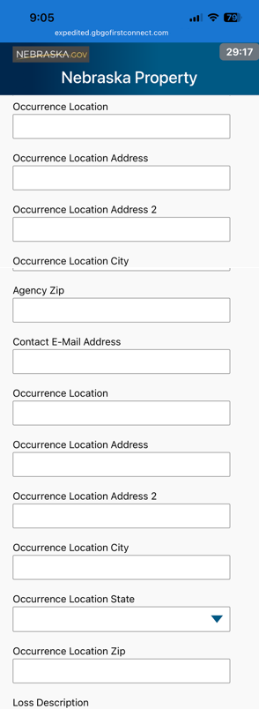
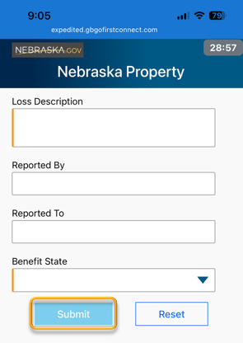
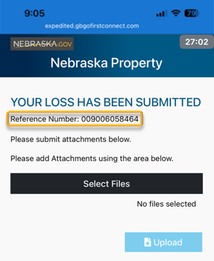
ENTERING A PROPERTY DAMAGE LOSS
Timer
On the top right corner of the page a timer will count down until the report will time out and rest.
Required/Mandatory Fields
Easily identify the required fields by the orange bar on the left of the text box.
You will be unable to submit the loss report until all the required fields have been answered.
Required fields to have on hand before reporting the loss:
Date of Loss
Agency Name
Loss Description
Benefit State
Submit the loss
Once the loss report has been submitted a Loss Reference Number will be provided

Slide 14
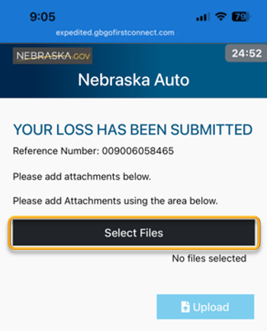
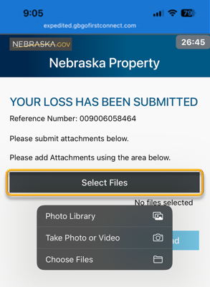
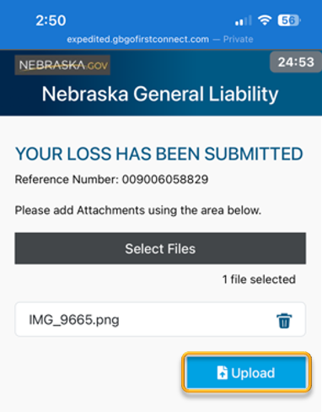

ATTACHING FILES TO THE LOSS
Adding Attachments
To attach photos, documents, or reports to the loss click Select Files
I dropdown list will appear with options of where to choose the files from or to take a photo or video
After choosing the file click Upload
Multiple files can be attached to the loss
Once the files have been attached or if no files are needed, the loss reporting process has been completed.
All rights reserved. 14

Slide 15

EXPEDITED LOSS REPORTING AUTO, GENERAL LIABILITY, & PROPERTY CLAIMS
For any questions regarding expedited loss reporting or for general inquiries, please contact:
GB-MVSC-Claimline@gbtpa.com
Thank You
Duplication, reproduction and/or dissemination of this material, either in whole or in part, without the express written consent of Gallagher Bassett Services, Inc. is strictly prohibited. By acceptance of these materials, prospective client acknowledges its consent to the foregoing.

