Slide 1
State Accounting Business User Group (BUG)
Wednesday, March 6, 2024
9:00 AM – 11:30 AM
1526 K Street basement, Training Room/Development Center

Slide 2
Agenda
Welcome
Announcements
Payables Accounting Policy (#18)
O Batches & Received Not Vouchered (RNV)
Fixed Assets
Business Unit Setup & New/Change to Fund Requests
Month End E1 Close Process
SBITA & Lease Reporting

Slide 3
Announcements
Introduction of Accounting Staff
Online attendees enter questions in the chat
Next BUG Training – Late May
ACFR Accrual Response Package to come early July
ACFR in-person review sessions
Deposit Batch Changes
Mreport (Open Payables, Personal Service Limitation Status, Allotment Status)

Slide 4
Payables Accounting Policy #18

Slide 5
Payables Accounting Policy #18
An Accounts Payables (AP) policy was issued in January to assist agencies in determining whether a payment should be recorded as a current year expense (PV) or prior year expense (P9):
For financial reporting purposes, accounts payable and grants payable are short-term liabilities representing amounts owed by the State to individuals, other governmental units, grantees, etc.
Accounts payable include amounts for services provided or goods received by the State before the end of the fiscal year, for which payment has not yet been made. In general, goods and services must be charged to the year in which the goods were received, or the service was provided.
Grants payable include amounts to be reimbursed because a recipient has met eligibility requirements and incurred allowable costs.

Slide 6
Payables Accounting Policy #18
Recognition of a payable should meet the following requirements:
Exchange transactions and exchange-like transactions – Transactions in which each party to the transaction receives and gives up essentially equal values (e.g., purchases of goods and services).
Nonexchange Transactions – Transactions in which one party gives value or benefit to another party without receiving equal value in exchange. There are two types of nonexchange transactions relevant to recognition of expenditures.

Slide 7
Payables Accounting Policy #18
Government-mandated nonexchange transactions result when a government at one level provides resources to a government at another level. The provider government requires the recipient government to use those resources for a specific purpose or program. Examples of government-mandated nonexchange transactions include grants to local governments.
Voluntary nonexchange transactions that result from legislative or contractual agreements other than exchanges entered into willingly by two or more parties. The provider frequently establishes purpose restrictions and eligibility requirements. Examples include certain grants, entitlements, and donations.

Slide 8
Payables Accounting Policy #18
Recognition Criteria:
Measurable – when the amount can be determined or reasonably estimated. For instance, when you have the invoice or request for reimbursement.
Incurred – when the reporting organization has substantially acquired the benefit for which it is consuming.
For exchange transactions this is when the goods or services have been received.
For nonexchange transactions, a distinction is made between the two parties to a nonexchange transaction, the recipient and the provider. State agencies can be a recipient, for example, of revenues from a federal grant award. State agencies can also be a provider, for example, expenditures of grant funds to a grantee.

Slide 9
Payables Accounting Policy #18
When a State agency is a recipient (of revenues), expenditure recognition (by the provider) is dependent on the State agency meeting all eligibility requirements, including incurring allowable expenditures, if applicable.
When a State agency is a provider (of expenditures), the State agency expenditure recognition is dependent on the recipient of the grant, entitlement, etc. meeting all eligibility requirements, including incurring allowable expenditures, if applicable.

Slide 10
Payables Accounting Policy #18
Example: A State reimburses local governments for certain grant expenditures. Should the State accrue a liability for reimbursements based on (a) claims submitted or (b) claims submitted and claims incurred but not reported?
For reimbursement-based (expenditure-drive) grants, providers are to recognize liabilities (or decreases in advances) when all eligibility requirements are met. Reimbursement eligibility requirements are met when recipients incur allowable costs, not when those costs are submitted for reimbursement. Therefore, the State should recognize a liability for the estimated amount of allowable costs incurred by potential recipients, based on both claims submitted and estimated claims incurred but not reported, provided that all other eligibility requirements are met.

Slide 11
Payables Accounting Policy #18
Expenditures which have been incurred are generally offset by accounts payable (unless payment has already taken place.) Within the State’s accounting system, a State agency will identify payables by using a ‘P9’ transaction type, when the requirements are met for a fiscal year previous to the current fiscal year.
Please include the fiscal year the P9 is applicable to, for instance if you are recording an expense in FY24 and it relates to FY22, include FY22 in the description/remark of the payment in E1. This will be used by State Accounting when compiling the ACFR.
When estimates need to be made, as a request for payment has not yet been received, these should be reported on the accrual response form for the Annual Comprehensive Financial Report (ACFR).

Slide 12
Payables Policy #18
Questions?

Slide 13
O Batches & RNVs

Slide 14
O Batches
Link User Guides – Procurement Lesson 8: Receipt Processing on LINK.nebraska.gov: go to Resources > LINK User Guides > Payroll & Financial Center
E1 Training Guides > Procurement > Lesson 8: Receipt Processing
Entering Receipts by PO
Reversing Receipts
Notes:
There are User Guides to help learn the process of how to do these two procedures.
Link.Nebraska.gov > Resources > LINK User Guides
Then scroll down to the System User Guides, and click on link for Payroll & Financial Center
Then scroll down to EnterpriseOne (Payroll and Financial Center) Training Guides,
click the Plus sign to open up the list of subject areas.
Click the Plus sign for PROCUREMENT
Scroll down to Lesson 8: Receipt Processing
This is where the two guides for receipting O batches is located.

Slide 15
O Batches - Receipts
When Receiving on Purchase Orders:
Review the Quantity Open listed on the PO prior to entering a receipt
After entering the receipt quantity, check the Amount field for the calculated total for the line. Is it for an appropriate amount?
O Batches need to POST prior to entering a Voucher
Notes:
When Receiving on O batches, there are some things that we need to watch out for to reduce the amount of errors or issues.
When we first bring up the purchase order and before clicking the Plus button to create a receipt, take a look at how the PO is written. Is it made out for Dollars or is it for Quantity of 1 or more?
After you enter a receipt quantity and move out of that field, the total $ amount will calculate the price x quantity for that PO line. You can glance at it to see if that is a reasonable number. If it is not, you can still change the receipt quantity. Once the screen is closed out, no changes can be made to the receipt.
When vouchering, it is important to make sure that the receipt has POSTED prior to creating a payment voucher. If it has not yet posted and payment voucher is created, the receipt cannot be fixed until the voucher has been voided or deleted. If a voucher has posted and paid, voucher cannot be voided.

Slide 17
Unposted O Batches
Unposted batches are any batches that are not in POSTED status
Approved – E1 default status when a new batch is created
Pending – manually set
In USE – E1 shows this batch currently being used. If after a day has passed and the batch is still In Use, notify State Accounting
Error – This will need to be set back to “Pending” status by State Accounting and corrected by the agency
Do NOT reverse or voucher an unposted batch
Notes:
Batches in unposted

Slide 18
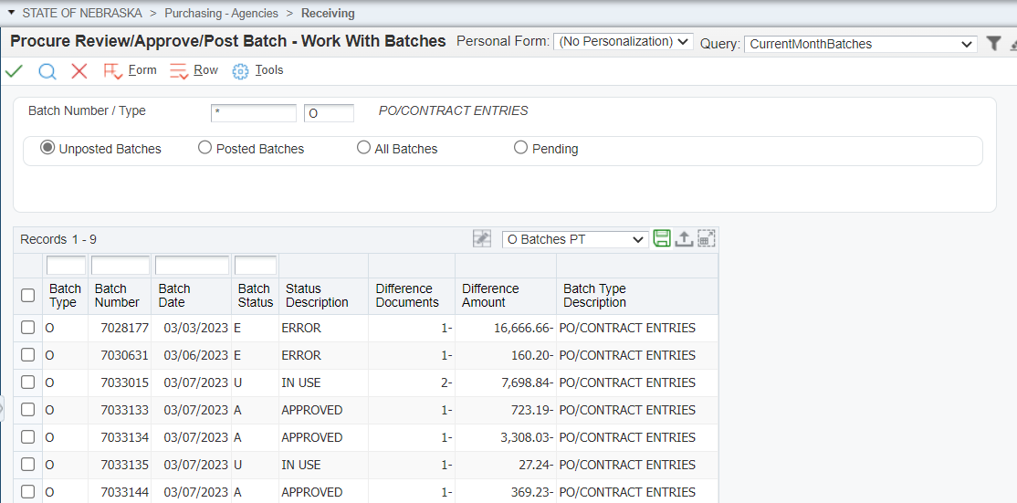

Slide 19
O Batches – Reversing
When Reversing an O batch:
Review the User Guide to determine the appropriate procedure for various scenarios
Allow time for the reversing receipt to POST before making any changes on the Purchase Order
Do NOT reverse an unposted batch

Slide 20
Batches in ERROR status
Report R5514001 ‘G/L Post Budget Failure Report’:
You should run this report before contacting State Accounting for assistance
The report provides the error code and explanation
E1 Menu path: Accounting > Manage Journal Entry > JE Review/Approve/Post
Review the Budget Failure Manual E1 Training Guides > Accounts Payable > Lesson 4 AP reports > GL Post Budget Failure Report
Monitor the report regularly. Errors must be resolved prior to month end.
Notes:
Batches in unposted

Slide 21
p
Batches with an error will show the:
Document Number, BU/Grant #
Budget Failure explanation
Amount holding up the transaction

Slide 22
Requests to State Accounting
Always send requests through as.stateaccounting@nebraska.gov
Put “Reversing PO” in the email subject line
O Batch number must be included.
PO number is helpful, but not required.
A link to email State Accounting is on the website under “Contact Us”
Notes:
There are User Guides to help learn the process of how to do these two procedures.
Link.Nebraska.gov > Resources > LINK User Guides
Then scroll down to the System User Guides, and click on link for Payroll & Financial Center
Then scroll down to EnterpriseOne (Payroll and Financial Center) Training Guides,
click the Plus sign to open up the list of subject areas.
Click the Plus sign for PROCUREMENT
Scroll down to Lesson 8: Receipt Processing
This is where the two guides for receipting O batches is located.

Slide 23
Received Not Vouchered (RNV)
When an agency receives against a purchase order, the debit is to the expense account (5xxxxx), and the credit is to the RNV account 211700 (liability account)
When the agency processes the payment voucher an automatic entry (AE) is created in E1 to debit account 211700 and the credit 211900 (Due To Vendor)
Problems can occur during both the receiving and payment processes within the RNV account
The Received Not Vouchered report is used to identify problems encountered that need to be addressed/fixed

Slide 24
Received Not Vouchered (RNV)
E1 Menu :
Accounting > Inquiries & Reports > Accounting Reports > Received-Vouchered Reports > Received Not Vouchered Report
Purchasing – Agencies > Inquiries & Reports > Accounts Payable Reports > Received Not Vouchered Report

Slide 25
Received Not Vouchered (RNV)
LINK User Guide:
Received Not Vouchered Report E1 Training Guides > Accounts Payable > Lesson 4 AP reports > Received Not Vouchered Report

Slide 26
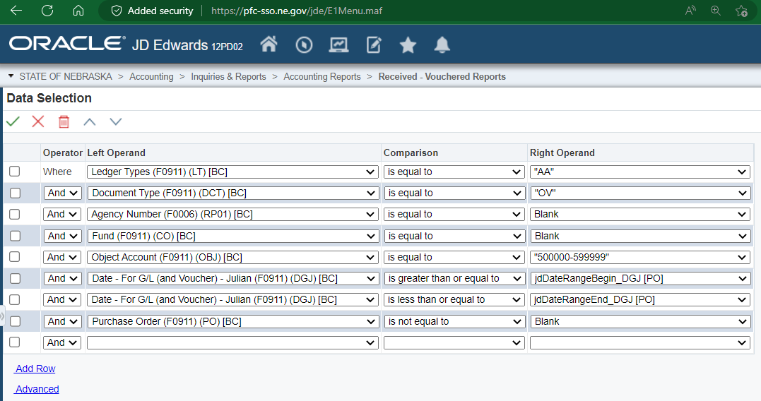
Received Not Vouchered (RNV)

Slide 27
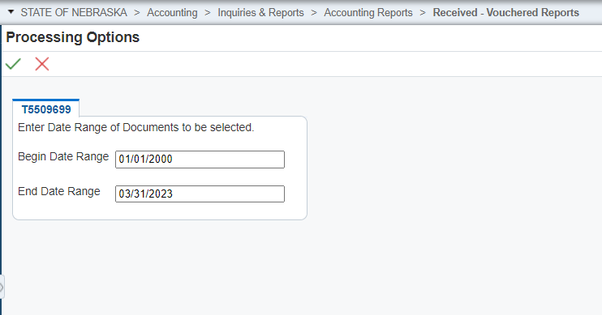
Make sure the
“Begin Date Range” is
ALWAYS 01/01/2000

Slide 28
Correcting RNV Issues
Expense Valid
Expense valid - Use in Voucher to pay Invoice
Expense No Longer Valid
Receipt entered in same Fiscal Year – Reverse receipt, allow reversal to Post, Close PO
Receipt entered in Prior Fiscal Year – Reach out to State Accounting for assistance

Slide 29
Correcting RNV Issues
If your agency’s Received Not Vouchered report shows small variances, which are often due to rounding differences or paying a different amount than the purchase order, contact State Accounting for assistance in the correction.
For any O batch or RNV issues, email Subject: Reversing PO to AS.StateAccounting@nebraska.gov

Slide 30
Correcting RNV Issues
System User Guides from the LINK User Guides website
Reverse Receipt the Purchase Order
E1 Training Guides > Procurement > Lesson 8: Receipt Processing > Revising a Procurement Document
Cancel the Purchase order
E1 Training Guides > Procurement > Lesson 1: Standard Process for Documents > Revising a Procurement Document

Slide 31
O Batches & RNVs
Questions?

Slide 32
FIXED ASSETS

Slide 33
FIXED ASSET REPORTS
F/A No Cost Integrity
Unposted F/As
Item Code – Object Account Integrity
G/L by Tag Number
Notes:
It is good practice to run these reports monthly. At least run them quarterly to ensure they are clean
E1 Path: STATE OF NEBRASKA > Fixed Assets > Inquiries & Reports > F/A Integrity Reports

Slide 34
Fixed Asset No Cost Integrity Report
This report shows the asset has been added to the system, has a tag number, and is a complete asset record, but the value is $0 because costs haven’t been attached.
The goal is to have this report blank, keep as short as possible, and with only recently acquired assets
E1 Path: State of Nebraska > Fixed Assets > Inquiries & Reports > F/A Integrity Reports > F/A No Cost Integrity
Notes:
If you discover that this report has multiple assets listed, it is possible that an error may have occurred such as: Cost might have been “passed” on, and not posted to the asset. Need to review the Asset Master Record, and purchase order to determine if costs need to be posted.
*The F/A No Cost Report & Unposted FA Report should be reviewed monthly.

Slide 35
Unposted Fixed Asset Report
This report shows expenses which have been posted to an object code beginning with “58”, but have not yet been posted to a fixed asset tag number
E1 Path: State of Nebraska > Fixed Assets > Inquiries & Reports > F/A Integrity Reports > Unposted F/As
Notes:
The Unposted fixed asset report should be cleared at end of every month.

Slide 36
Item Code – Object Account Integrity
This report shows assets with discrepancies between the item code and related object accounts.
To fix this, an asset transfer must be done. The E1 training guide can be found on State Accounting’s website under “Payroll And Financial”
E1 Path: State of Nebraska > Fixed Assets > Inquiries & Reports > F/A Integrity Reports > Item Code – Object Account Integrity

Slide 37
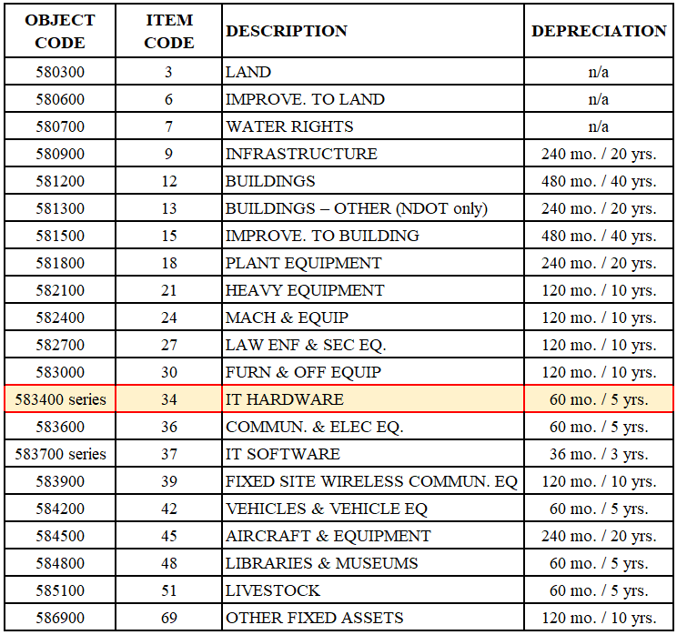
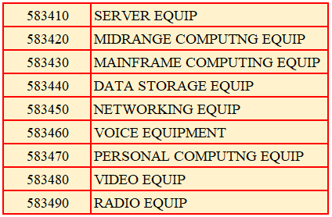
Current Item Codes
Item code 33 along with object code 583300 should not be used any longer, item code 34 should be used instead.
Notes:
Item code 33 (Comp Hard Equip & Software)

Slide 38
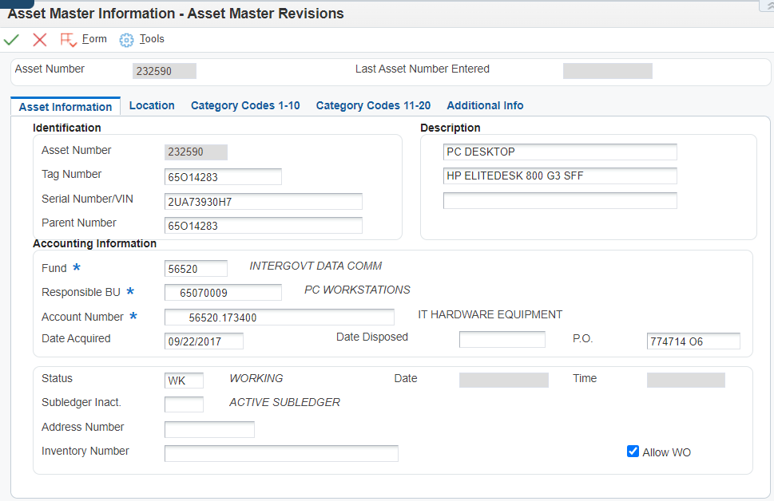
Creating an Asset Master
The Fixed Asset tag number should be unique and match the agency’s established naming convention.
The fund should be the fund which purchased the asset.
The responsible BU should be the BU used to purchase the asset.
Account Number:
The account “17xx00” correlates to the expenditure account used. For example, a purchase recorded to 65070009.583470 should use for the account number 56520.173470
Date Acquired:
This should be the date you received the asset, date the asset was put into service, or substantially complete.
Notes:
Date Acquired: This field drives the depreciation calculation. When creating asset master records and dating assets for prior fiscal years, this creates issues with the depreciation calculation. State Accounting runs depreciation quarterly, E1 doesn’t calculate depreciation in real time.
Example: On July 14, 2023 (FY24) you add an asset with a date acquired of May 23, 2023 (FY23). Since depreciation was already run for all assets in the system as of June 30, 2023, if you run a report, the asset will not show any depreciation. It will have to be manually adjusted.

Slide 39
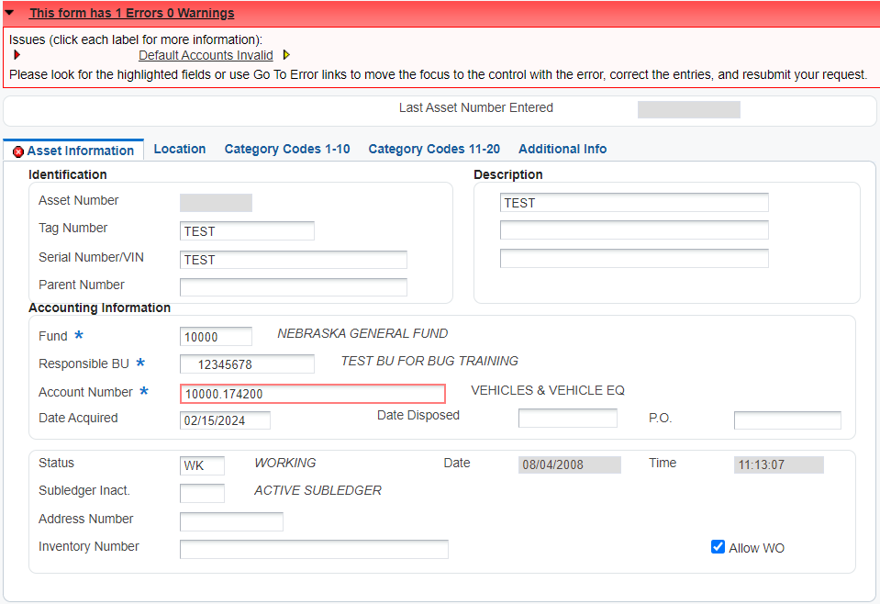
Common Error When Creating an Asset Master
This error is generally due to either depreciation expense (56xxxx) or accumulated depreciation (18xxxx) needing to be attached to the business unit. The following accounts must be set up before creating an asset master record:
Fund.17xx00
Fund.18xx00
Business Unit.56xx00
Business Unit.58xx00

Slide 40
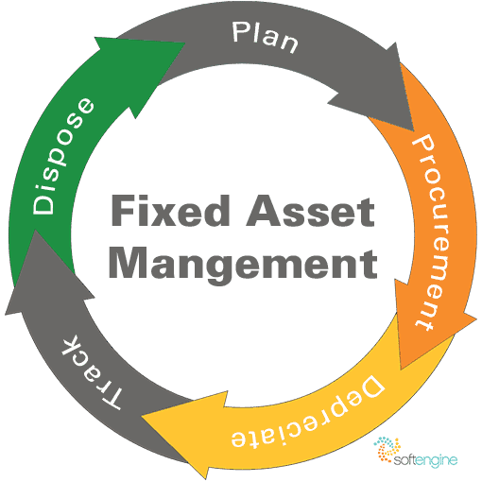
POSTING COSTS TO AN ASSET

Slide 41
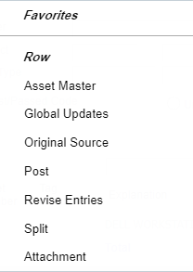
Posting Costs To An Existing Tag Number
3) Post and save the changes
1) Search the document number found on Unposted Fixed Asset Report
2) Add the tag number to asset by selecting “Row - Revise Entries”
E1 Path: State of Nebraska > Fixed Assets > Post Fixed Asset Transactions > Revise Unposted F/A Entries
Notes:
*Master Asset Record must be created before you can post the cost to the assets.
*Doc number from Unposted Fixed Asset report, will pull up receipt entry.
*Row, revise entries to add tag # to entry
**Row, Post, and Save.
Hit hourglass to refresh this screen, your unposted should disappear.

Slide 42
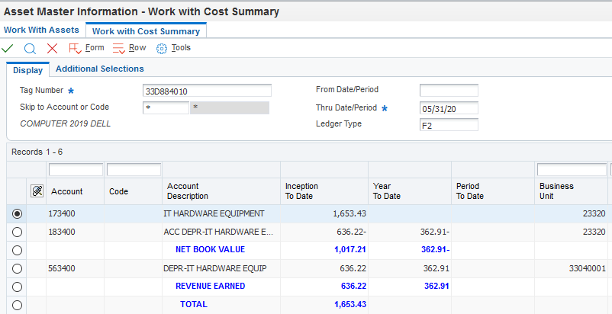
State of Nebraska > Fixed Assets > Add Fixed Asset > Cost Summary
Complete and Correct Asset Record
Asset & Depreciation accounts list the “34”
Value of asset posted
Notes:
This is what your asset should look like in E1 when costs are posted to the asset and depreciation has been run

Slide 43
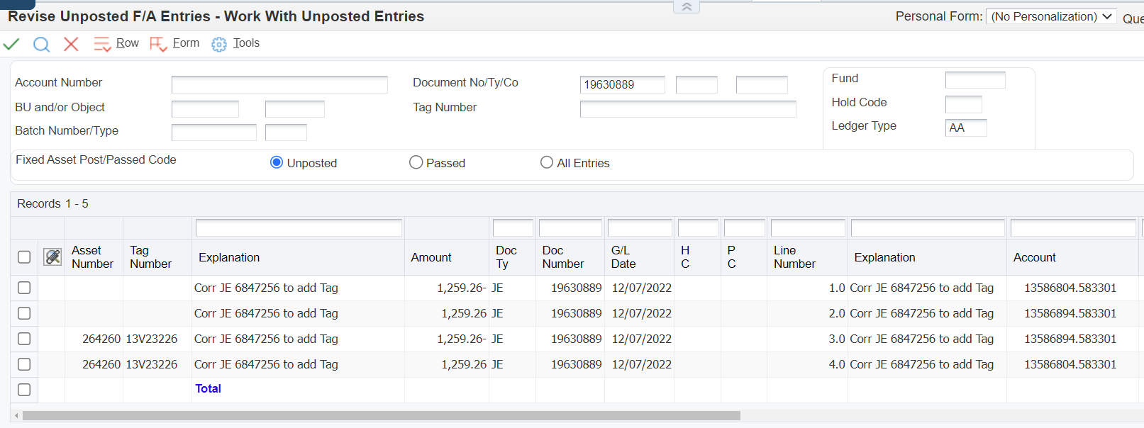
Fixed Assets: Prior Month Cost Posting
Step 1: Select all DR entries; these costs will be posted.
Step 2: Select CR entries and revise.
E1 Path: State of Nebraska > Fixed Assets > Post Fixed Asset Transactions > Revise unposted fixed asset entries
Notes:
Tag numbers should be listed on this screen, if not, verify that an Asset Master was created
Once the Dr have been posted, refresh screen. Only CR should show.

Slide 44
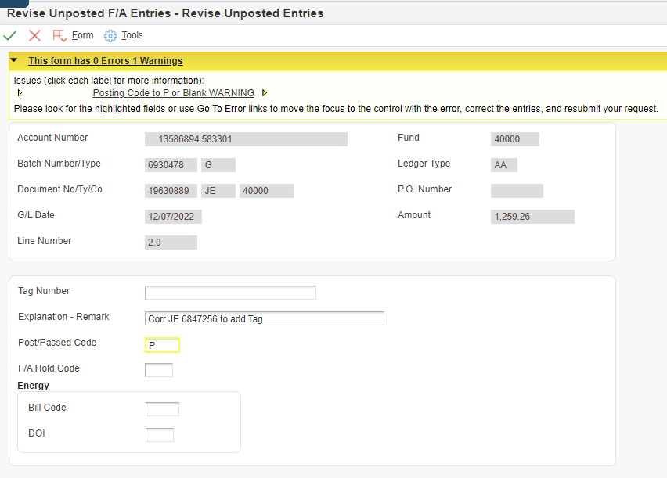
Passing on Credit Entries
Notes:
When passing on CR, yellow message box appears, this is okay. Changing from “blank” to “P” E1 will ignore this record. OK to hit OK again, this is what we want it to do.
Using the Revise Unposted FA Entries screen, pull up the original OV doc #. Pass on these costs. Notate in description reason for passing on costs.
This will remove the OV receipt entries items from the unposted FA report.
The JE that was created to post costs to the asset replaces the OV Receipt. This is why we are passing on the costs.

Slide 45
Oops! I posted both my DEBIT and CREDIT transactions, now what?
If you zero out the costs for your fixed asset by posting the debit and credit, you’ll need to create a new journal entry and post just the debits and pass on the credits.
State Accounting CANNOT undo this mistake if the costs are posted incorrectly. You will have to complete a NEW journal entry.

Slide 46
Fixed Asset Summary
Fixed Assets have a direct relationship with Procurement and Accounting functions
Asset Master must be created before costs can be posted to an asset
Integrity reports should be reviewed timely and cleaned up before fiscal year end

Slide 47
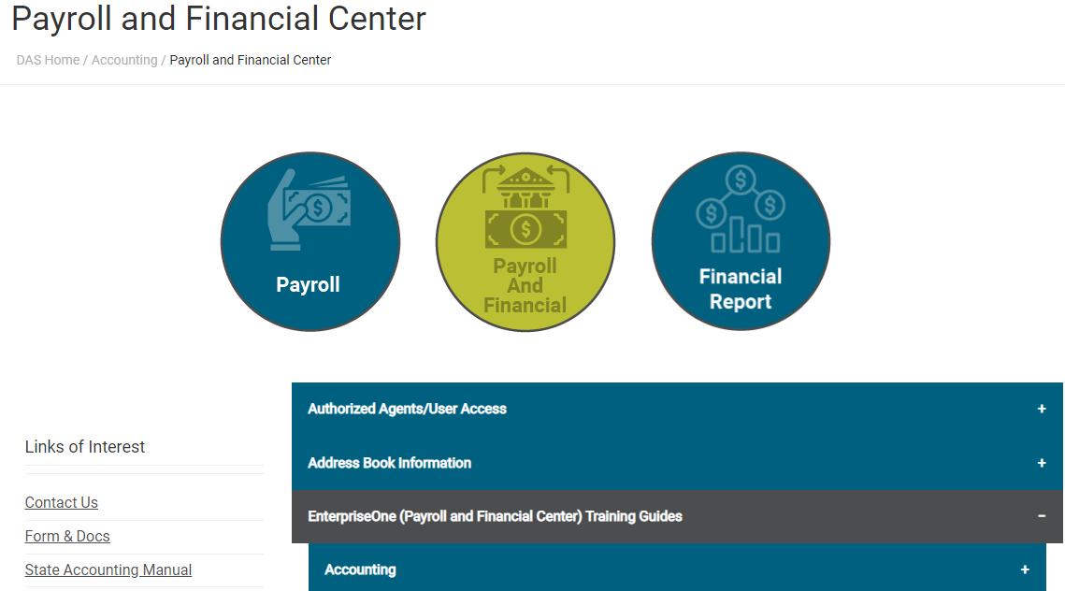
Asset Management Resources
State Accounting Manual Policy #28
Asset Management Manual
Entering an Asset Master
Fixed Asset Journal Entry
Post Costs To A Fixed Asset
Notes:
State Accounting Manual – Equipment, Land, Land Improvements, Buildings, Building Additions, Building Improvements, Infrastructure, CIP
Asset management manual contains the CAPITALIZATION THRESHOLD -- Items at $5,000 or more are required to be entered in the EnterpriseOne (E1) Fixed Assets Module. Please see the Capital Outlay section of the State Accounting Manual for additional guidance. Agencies may establish policies with capitalization thresholds lower than $5,000 per item at their own discretion. ($5,000 threshold effective 3/27/2019)
Entering an

Slide 48
Fixed Assets Questions?

Slide 49
Business Unit Setup

Slide 50
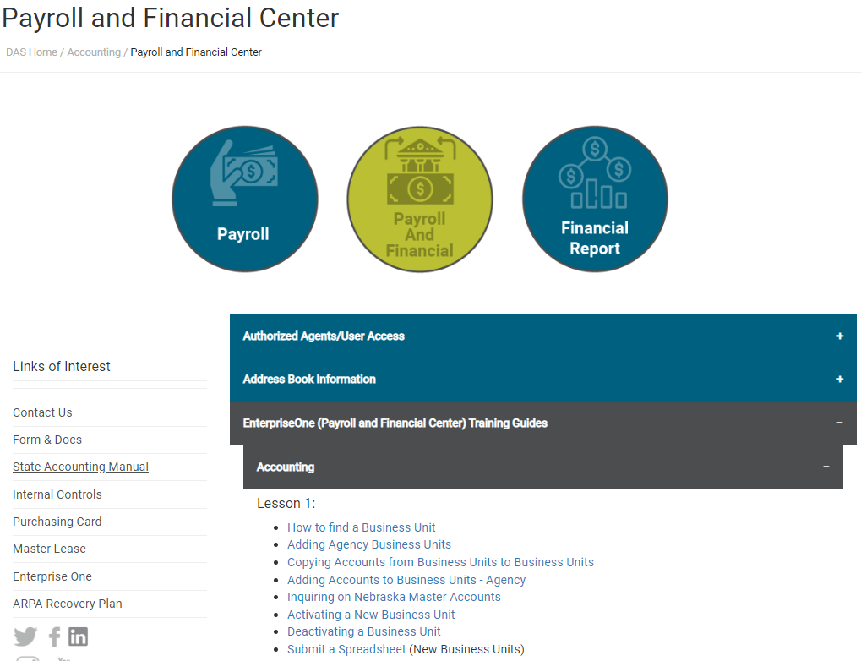
E1 Training Guides
Detailed training for business unit setup can be found on State Accounting’s webpage.
Notes:
https://das.nebraska.gov/accounting/pay-fin.html

Slide 51
Federal BU Types
Federal fund business unit types:
GB PARENT BUSINESS UNIT
GX FEDERAL GRANT-BUDGET CHECK
GY FEDERAL GRANT-NO BUDGET CHECK
GS STATE GRANT

Slide 52
Federal BU Types
BU types: GB, GX, and GY are picked up in the SEFA reporting and should be used with fund 40000 and all other federal funds that should be included in the SEFA.
BU type GS should be used by the pass-through agency of Federal funds. If you are the recipient agency of federal funds from another agency this BU is used so the amounts are not reported in the SEFA.

Slide 53
BU Inactivation
Before requesting a BU be inactivated, run the following report to verify it can be inactivated.
E1 String:
State of Nebraska>Accounting>Inquiries & Reports>Accounting Reports>BU Check Before Inactivation, Version NIS0001
The report can be run by BU or Grant
If the report is blank the BU can be inactivated. Go into the E1 Business Unit Workflow Screen to request the BU be inactivated.

Slide 54
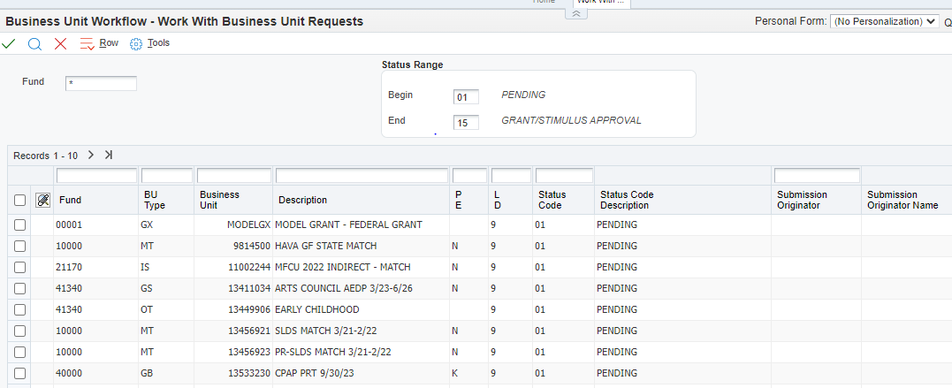
E1 Business Unit Workflow Screen
To get to the Business Unit Workflow in E1: State of Nebraska > Accounting > Business Units > Business Unit Workflow.

Slide 55
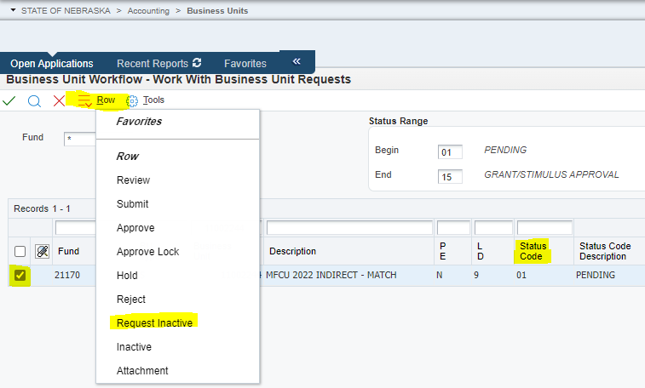
E1 Business Unit Workflow Screen
Enter the business unit you are looking to deactivate. Check the box for that BU and select Row button and click Request Inactivate. The status code will change to “30”
When an agency selects “Request Inactive” in the row selection, E1 sends State Accounting an email to process the change.

Slide 56
Business Unit
Questions?

Slide 57
Requesting New Funds or Changes to Funds

Slide 58
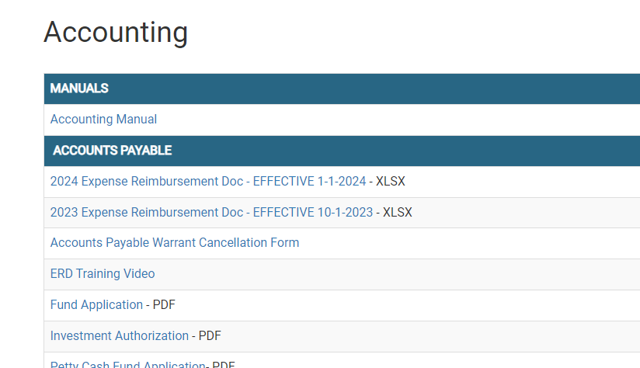
New/Changes to Fund Requests
Obtain the fund application from the State Accounting website. Click on Forms & Docs, which brings you to the listing with the fund application.
Notes:
A screen shot of the State Accounting website after selecting Forms

Slide 59
New/Changes to Fund Requests
The form needs to be completed and signed by the agency, then sent to the agency assigned State Budget Officer. After AS Budget approval it is sent to State Accounting for final approval and processing. The approvals must be in the order of the form.
If the fund can be invested also complete Investment Authorization form on the website under Forms & Docs. to document the business unit the interest revenue should be recorded to. Interest revenue will not be recorded to the fund until this form is received.

Slide 60
Fund Request
Questions?

Slide 61
Month End E1 Close Process

Slide 62
Month E1 End Close Process
The following batches MUST be posted by the end of the month:
P-Card Journal Entries
Purchase Order Receipts (‘O’ batches) – these batches are created in an approved status then automatically posted by the system. Because this is a system post, if a batch errors out, an email doesn’t go to the user that entered the batch.
It’s good practice to regularly review for ‘O’ batches in an Error status since they must all be posted by the end of the month.
Voided Batches – after voiding a batch, the voided batch must be approved and posted again.
Only void entries posted by your agency, do not void entries posted by Central Finance, State Accounting, Building Division, etc.

Slide 63
Month E1 End Close Process
If the following batches are not posted by month end, they will be deleted. The agency will then need to re-enter the transaction.
RB Batches – Deposits
IB Batches – Open IBTs
G Batches – Journal Entries
V Batches - Vouchers

Slide 64
Month End Close
Questions?

Slide 65
SBITA & Lease Reporting

Slide 66
SBITA & Lease Reporting
SBITA & Lease Accrual response forms were sent out to all AS Financial contacts with a requested return date of April 1, 2024. State Accounting will need to start work on leases and SBITAs earlier than the normal ACFR accruals due to the substantial workload they require.
We will send out the accrual forms again in early July for any additional leases/SBITA changes from 4/1/24-6/30/24 and updated accounting GL detail support.

Slide 67
SBITA & Lease Reporting
Where to start your review this year:
Any agencies with SBITAs and/or Leases, included in the ACFR last year (FY23), received an accrual form with those agreements pre-filled for review and updating.
Updates include:
New renewals/amendments to the agreements since 6/30/23. This could be extending the contract dates, amending language within the agreement, etc. The renewal/amendment documents will need to be submitted for our review with your form.
Terminations to the agreements during the current fiscal year.
Accounting GL detail support for changes to funding sources, etc. (It is easiest if this is documented by providing the GL detail you ran.)

Slide 68
SBITA & Lease Reporting
Next you will review for any new or revisions to SBITAs/Leases not reported in FY23.
Compile a listing of all agreements applicable to the GASB definitions contained in the accrual response forms. A good place to start is a review of your GL detail for accounts 522100, 521400, 543500, 555000, 555500’s, etc. for SBITAs, 524100 through 525500’s for lessee expenses, and 482000-483000’s for lessor revenue.
After the SBITA review was performed in FY23 all agencies received an email listing the final determination of the agreements reviewed and the reason they were or were not in-scope. These agreements are a good starting point for your current year review.
Most of the agreements that were not in-scope in FY23 were short-term (less than 12 months) and could be canceled at any time without mutual consent or were only annual subscriptions that could be terminated at the end of the 12-month period. Any changes to those agreements, such as renewals extending the period, etc., should be reviewed and determined if proper to report for FY24.

Slide 69
SBITA & Lease Reporting
Then consider the following to exclude agreements from your listing:
If payments made under the SBITA agreement or lease are less than $5,000 annually they do not need to be reported.
If the termination clause allows for BOTH parties to cancel the agreement for convenience, without permission from the other party, then the agreement does not need to be reported. (If the cancelation is specific to breach of contract, mutual agreement, or other requirements to cancel, it is not cancelable per the GASB.)
Review the full agreement term, if the agreement from the start date with renewals/amendments, is less than 12 months it is considered short-term and does not need to be reported. Examples are rolling year-to-year subscriptions where they end after the 12 months and a new subscription is agreed to.

Slide 70
SBITA & Lease Reporting
The steps in #4 are a quick way to determine if you need to review the agreement any further for reporting purposes.
Please include all of your SBITA agreements even if they are obtained through the OCIO. These should be reported at the agency level so no agreements are overlooked, and accounting detail can be provided.
If there is no liability on June 30, in other words you paid the full subscription or lease in advance, report these on the year-end accrual form as a prepayment, Item Description #5, if they meet the $100,000 threshold.

Slide 71
SBITA Reporting
When in doubt please do not hesitate to ask questions, you can contact Krista Davis at (402) 890-8253 if you want to work through an agreement.
Flow charts are included in the accrual forms this year in the effort to assist you with determining the agreements to include.
The same basic guidance can be applied to your review of both SBITAs and Leases for term of the agreement, termination clauses, and dollar threshold for reporting.

Slide 72
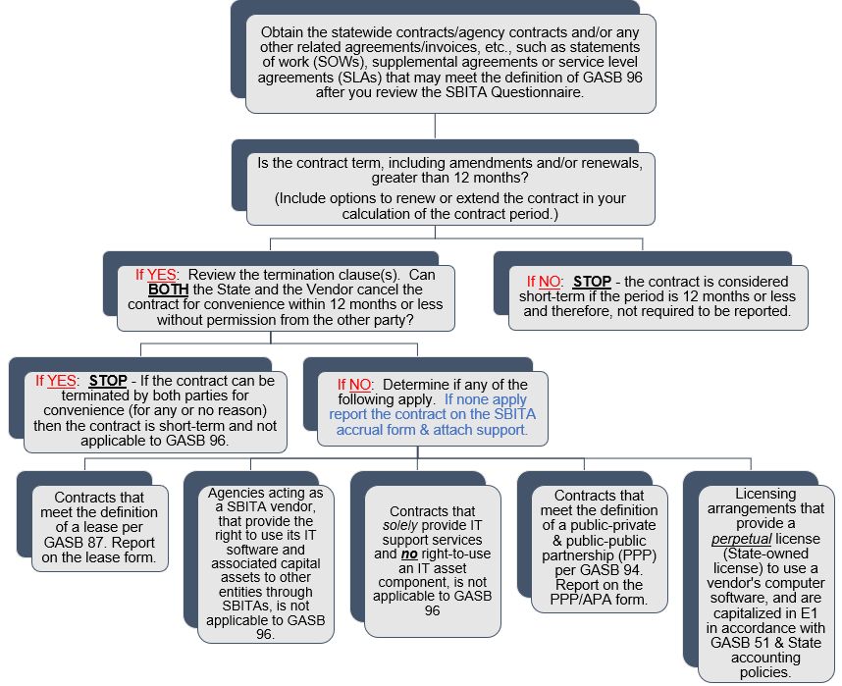
SBITA Flow Chart

Slide 73
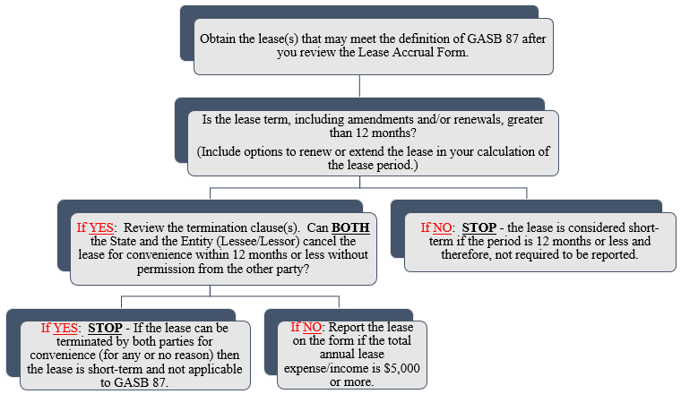
Lease Flow Chart

Slide 74
SBITA & Lease
Questions?

Slide 75
Questions?
Email: AS.StateAccounting@nebraska.gov in the subject include “BUG Question”
Contact Info
Philip.Olsen@nebraska.gov 402-471-0600
Krista.Davis@nebraska.gov 402-890-8253
Caleb.Witt@nebraska.gov 531-810-1956
Chad.Pinger@nebraska.gov 402-416-1535
Patrick.Trinh@nebraska.gov 531-530-9773
Shaun.McDonald@nebraska.gov 402-540-4987
Shabnam.Sultani@nebraska.gov 402-314-4353

