Slide 1
State Accounting Business User Group (BUG)
Friday, March 31, 2023
9:00 AM – 11:30 AM
1526 K Street basement, Training Room/Development Center

Slide 2
Agenda
Welcome
Announcements
O Batches & Received Not Vouchered (RNV)
Capital Assets, including CIP, & Integrity Reports
Business Unit Setup
ERDs
New GASB Statements

Slide 3
Announcements
Introduction of Accounting Staff
Bus Pass Program – Contact Annette Wilson at 471-2582
https://das.nebraska.gov/accounting/forms/bus_pass_brochure.pdf
Contact Us
Email links by subject matter
Online attendees enter questions in the chat
Next BUG Meeting – Late May
ACFR Accrual Response Package to come early July
ACFR In person review sessions

Slide 4
O Batches & RNVs

Slide 5
O Batches
Link User Guides – Procurement Lesson 8: Receipt Processing E1 Training Guides > Procurement > Lesson 8: Receipt Processing
Entering Receipts by PO
Reversing Receipts
Notes:
There are User Guides to help learn the process of how to do these two procedures.
Link.Nebraska.gov > Resources > LINK User Guides
Then scroll down to the System User Guides, and click on link for Payroll & Financial Center
Then scroll down to EnterpriseOne (Payroll and Financial Center) Training Guides,
click the Plus sign to open up the list of subject areas.
Click the Plus sign for PROCUREMENT
Scroll down to Lesson 8: Receipt Processing
This is where the two guides for receipting O batches is located.

Slide 6
O Batches - Receipts
When Receiving on Purchase Orders:
Review the Quantity Open listed on the PO prior to entering a receipt
After entering the receipt quantity, check the Amount field for the calculated total for the line. Is it for an appropriate amount?
O Batches need to POST prior to entering a Voucher
Notes:
When Receiving on O batches, there are some things that we need to watch out for to reduce the amount of errors or issues.
When we first bring up the purchase order and before clicking the Plus button to create a receipt, take a look at how the PO is written. Is it made out for Dollars or is it for Quantity of 1 or more?
After you enter a receipt quantity and move out of that field, the total $ amount will calculate the price x quantity for that PO line. You can glance at it to see if that is a reasonable number. If it is not, you can still change the receipt quantity. Once the screen is closed out, no changes can be made to the receipt.
When vouchering, it is important to make sure that the receipt has POSTED prior to creating a payment voucher. If it has not yet posted and payment voucher is created, the receipt cannot be fixed until the voucher has been voided or deleted. If a voucher has posted and paid, voucher cannot be voided.

Slide 8
Unposted O Batches
Unposted batches are any batches that are not in POSTED status
Approved – E1 default status when a new batch is created
Pending – manually set
In USE – E1 shows this batch currently being used. If after a day has passed and the batch is still In Use, notify State Accounting
Error
Do NOT reverse or voucher an unposted batch
Notes:
Batches in unposted

Slide 9
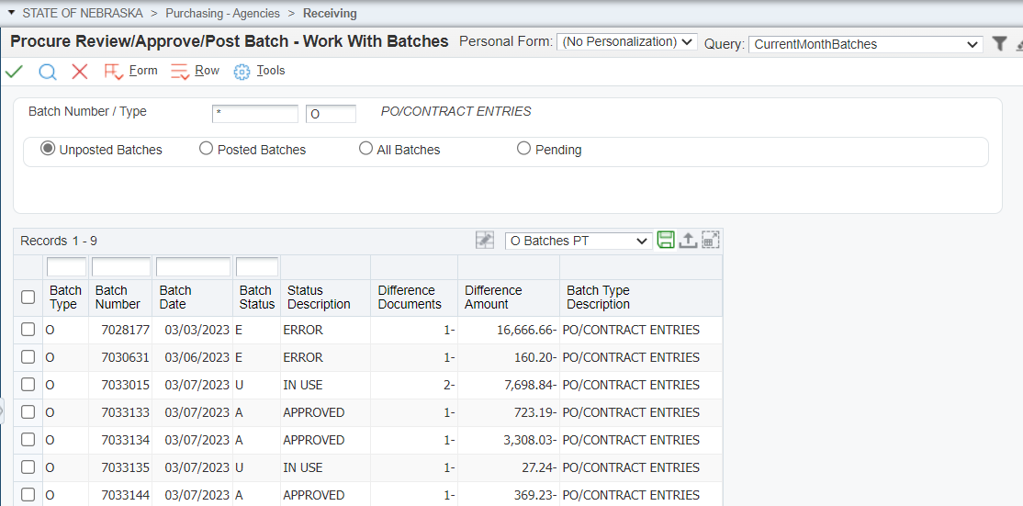

Slide 10
O Batches – Reversing
When Reversing an O batch:
Review the User Guide to determine the appropriate procedure for various scenarios
Allow time for the reversing receipt to POST before making any changes on the Purchase Order
Do NOT reverse an unposted batch

Slide 11
Batches in ERROR status
Report R5514001 ‘G/L Post Budget Failure Report’:
You should run this report before contacting State Accounting for assistance
The report provides the error code and explanation
E1 Menu path: Accounting > Manage Journal Entry > JE Review/Approve/Post
Review the Budget Failure Manual E1 Training Guides > Accounts Payable > Lesson 4 AP reports > GL Post Budget Failure Report
Monitor the report regularly. Errors must be resolved prior to month end.
Notes:
Batches in unposted

Slide 12
p
Batches with an error will show the:
Document Number, BU/Grant #
Budget Failure explanation
Amount holding up the transaction

Slide 13
Requests to State Accounting
Always send requests through as.stateaccounting@nebraska.gov
Put “Reversing PO” in the email subject line
O Batch number must be included.
PO number is helpful, but not required.
A link to email State Accounting is on the website under “Contact Us”
Notes:
There are User Guides to help learn the process of how to do these two procedures.
Link.Nebraska.gov > Resources > LINK User Guides
Then scroll down to the System User Guides, and click on link for Payroll & Financial Center
Then scroll down to EnterpriseOne (Payroll and Financial Center) Training Guides,
click the Plus sign to open up the list of subject areas.
Click the Plus sign for PROCUREMENT
Scroll down to Lesson 8: Receipt Processing
This is where the two guides for receipting O batches is located.

Slide 14
Received Not Vouchered (RNV)
When an agency receives against a purchase order, the debit is to the expense account (5xxxxx), and the credit is to the RNV account 211700 (liability account)
When the agency processes the payment voucher an automatic entry (AE) is created in E1 to debit account 211700 and the credit 211900 (Due To Vendor)
Problems can occur during both the receiving and payment processes within the RNV account
The Received Not Vouchered report is used to identify problems encountered that need to be addressed/fixed

Slide 15
Received Not Vouchered (RNV)
E1 Menu :
Accounting > Inquiries & Reports > Accounting Reports > Received-Vouchered Reports > Received Not Vouchered Report
Purchasing – Agencies > Inquiries & Reports > Accounts Payable Reports > Received Not Vouchered Report

Slide 16
Received Not Vouchered (RNV)
LINK User Guide:
Received Not Vouchered Report E1 Training Guides > Accounts Payable > Lesson 4 AP reports > Received Not Vouchered Report

Slide 17
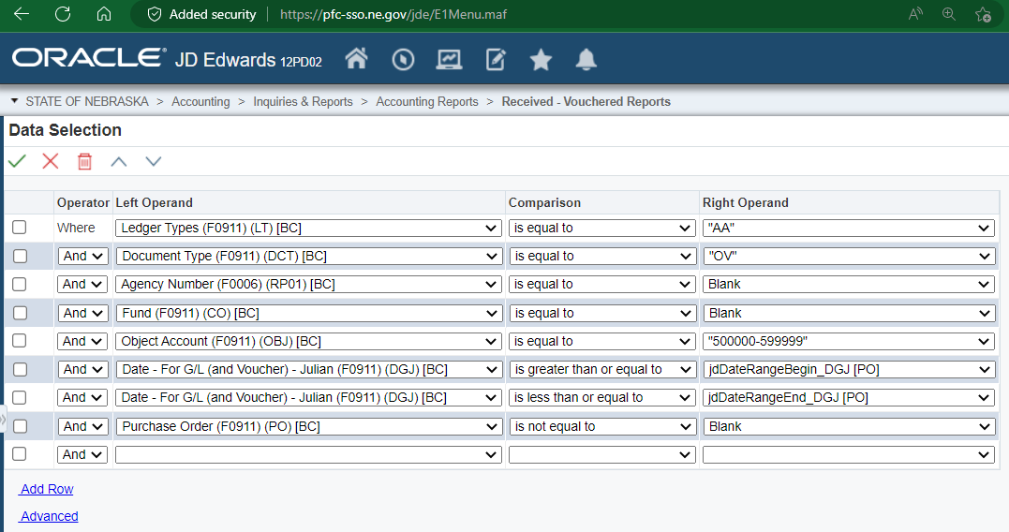
Received Not Vouchered (RNV)

Slide 18
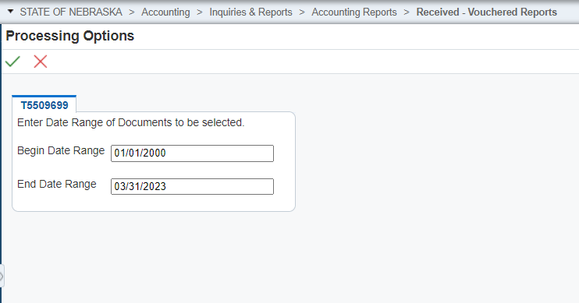
Make sure the
“Begin Date Range” is
ALWAYS 01/01/2000

Slide 19
Correcting RNV Issues
Expense Valid
Expense valid - Use in Voucher to pay Invoice
Expense No Longer Valid
Receipt entered in same Fiscal Year – Reverse receipt, allow reversal to Post, Close PO
Receipt entered in Prior Fiscal Year – Reach out to State Accounting for assistance

Slide 20
Correcting RNV Issues
If your agency’s Received Not Vouchered report shows small variances, which are often due to rounding differences or paying a different amount than the purchase order, contact State Accounting for assistance in the correction.
For any O batch or RNV issues, email Subject: Reversing PO to AS.StateAccounting@nebraska.gov

Slide 21
Correcting RNV Issues
System User Guides from the LINK User Guides website
Reverse Receipt the Purchase Order
E1 Training Guides > Procurement > Lesson 8: Receipt Processing > Revising a Procurement Document
Cancel the Purchase order
E1 Training Guides > Procurement > Lesson 1: Standard Process for Documents > Revising a Procurement Document

Slide 22
O Batches & RNVs
Questions?

Slide 23
Capital Assets, Construction-In-Progress (CIP), & Integrity Reports

Slide 24
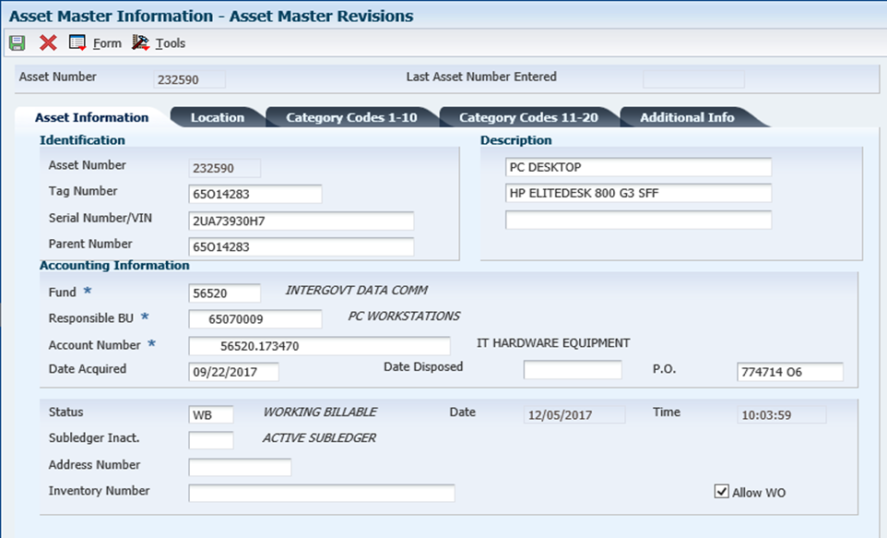
Creating an Asset Master
The Fixed Asset tag number should match the agency and division. The tag number should also match the responsible business unit.
(In this example, agency 65)
Fund:
Not sure? Skip to responsible BU, use magnify glass to search for fund paired to BU.
Remember to enter PO #
Account #: fund # and account 17xxxx
Account correlates to the expenditure account used.
Ex. 65070009.583470
Acct # for FA= 56520.173470
Date Acquired:
This should be the date you received the asset, date the asset was put into service, or substantially complete.
Notes:
Date Acquired: This field drives the depreciation calculation. When creating asset master records and dating assets for prior fiscal years, this creates issues with the depreciation calculation. State Accounting runs depreciation quarterly, E1 doesn’t calculate depreciation in real time.
Example: On July 14, 2023 (FY24) you add an asset with a date acquired of May 23, 2023 (FY23). Since depreciation was already run for all assets in the system as of June 30, 2023, if you run a report, the asset will not show any depreciation. It will have to be manually adjusted.

Slide 25
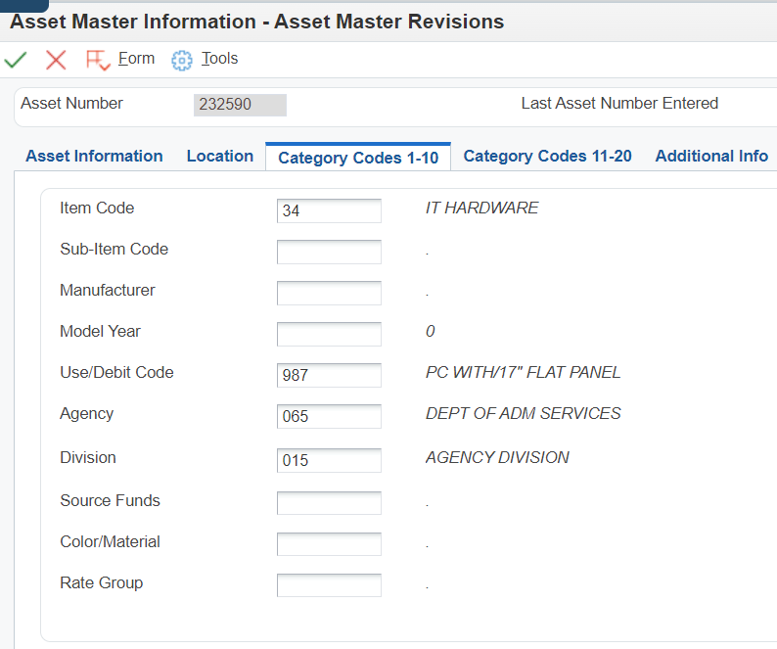
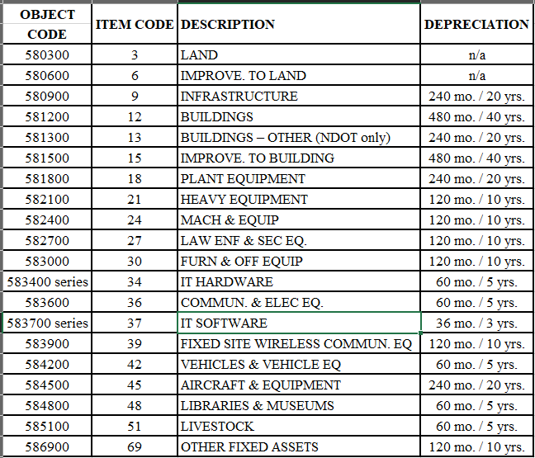
Item Code: auto filled from the Asset info tab
Both must be entered
Notes:
The item code should auto fill; base on the account code from the “Asset Information” screen. Notice there is no item code 33. Please use 5834xx. Review the chart of accounts for the proper sub account.
https://coabreakout.nebraska.gov/

Slide 26
FIXED ASSET REPORTS
Notes:
It is good practice to run these reports monthly. At least run them quarterly to ensure they are clean

Slide 27
Unposted Fixed Asset Report
This report shows expenses which have been posted to an object code beginning with “58”, but have not yet been posted to a fixed asset tag number
E1 Path: State of Nebraska > Fixed Assets > Inquiries & Reports > F/A Integrity Reports > Unposted F/As
Notes:
The Unposted fixed asset report should be cleared at end of every month.

Slide 28
Fixed Asset No Cost Integrity Report
This report shows the asset has been added to the system, has a tag number, and is a complete asset record, but the value is $0 because costs haven’t been attached.
The goal is to have this report blank, kept as short as possible, and with only recently acquired assets
E1 Path: State of Nebraska > Fixed Assets > Inquiries & Reports > F/A Integrity Reports > F/A No Cost Integrity
Notes:
If you discover that this report has multiple assets listed, it is possible that an error may have occurred such as: Cost might have been “passed” on, and not posted to the asset. Need to review the Asset Master Record, and purchase order to determine if costs need to be posted.
*The F/A No Cost Report & Unposted FA Report should be reviewed monthly.

Slide 29
G/L by Tag Number
This report shows any GL activity associated with a specific tag number
By running this report, you can see any costs posted to a tag number and assess whether additional costs need to be added or if costs are missing from the tag
E1 Path: State of Nebraska > Fixed Assets > Inquiries & Reports > F/A Reports > G/L by Tag Number

Slide 30
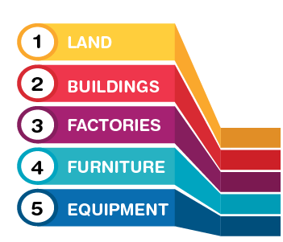
POSTING COSTS TO AN ASSET

Slide 31
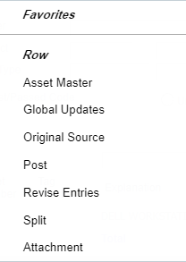
Posting Costs To An Existing Tag Number
3) Post and save the changes
1) Search the document number found on Unposted Fixed Asset Report
2) Add the tag number to asset by selecting “Row - Revise Entries”
E1 Path: State of Nebraska > Fixed Assets > Post Fixed Asset Transactions > Revise Unposted F/A Entries
Notes:
*Master Asset Record must be created before you can post the cost to the assets.
*Doc number from Unposted Fixed Asset report, will pull up receipt entry.
*Row, revise entries to add tag # to entry
**Row, Post, and Save.
Hit hourglass to refresh this screen, your unposted should disappear.

Slide 32
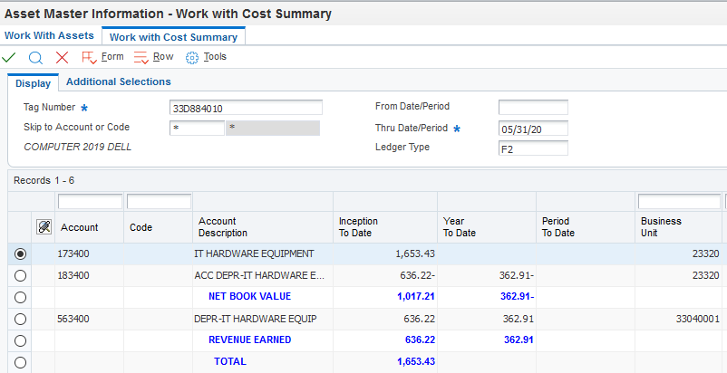
State of Nebraska > Fixed Assets > Add Fixed Asset > Cost Summary
Completed and Correct Asset Record
Asset & Depreciation accounts list the “34”
Value of asset posted
Notes:
This is what your asset should look like in E1 when costs are posted to the asset and depreciation has been run

Slide 33
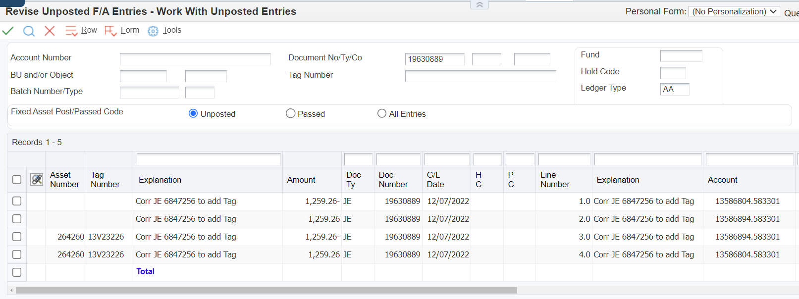
Fixed Assets: Prior Month Cost Posting
Step 1: Select all DR entries; these costs will be posted.
Step 2: Select CR entries and revise.
E1 Path: State of Nebraska > Fixed Assets > Post Fixed Asset Transactions > Revise unposted fixed asset entries
Notes:
Tag numbers should be listed on this screen, if not, verify that an Asset Master was created
Once the Dr have been posted, refresh screen. Only CR should show.

Slide 34
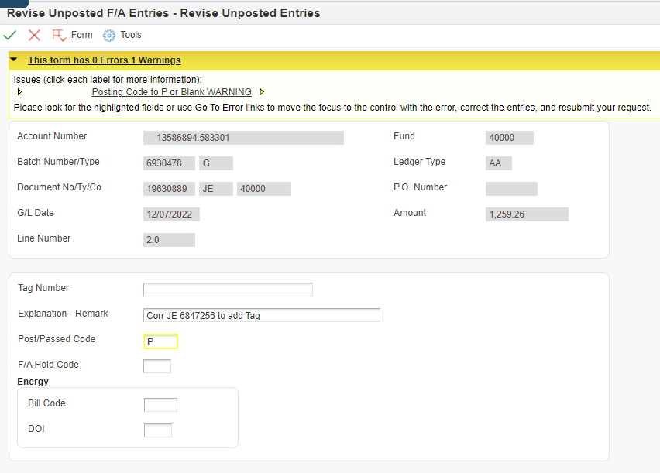
Passing on Credit Entries
Notes:
When passing on CR, yellow message box appears, this is okay. Changing from “blank” to “P” E1 will ignore this record. OK to hit OK again, this is what we want it to do.
Using the Revise Unposted FA Entries screen, pull up the original OV doc #. Pass on these costs. Notate in description reason for passing on costs.
This will remove the OV receipt entries items from the unposted FA report.
The JE that was created to post costs to the asset replaces the OV Receipt. This is why we are passing on the costs.

Slide 35
Oops! I posted both my DR and CR transactions, now what?
If you accidentally zero out the costs for your fixed asset, by selecting the debit and credit row, then you’ll need to create a new journal entry since the amounts are now zeroed out. State Accounting CANNOT undo this mistake if the costs are posted incorrectly. You will have to complete a NEW journal entry.

Slide 36
Split Asset Transaction
E1 Training Guide
Notes:
The system allows you to split the fixed asset costs to multiple business units utilizing the Voucher Entry without Purchase Order program and during the posting of the cost to the fixed asset process. During posting of the cost to fixed assets, you can split the cost of a fixed asset to multiple business units ONLY for costs entered using the Voucher Entry with Purchase Order program or the Journal Entry program.
This doesn’t happen often and there is a training guide on State Accounting’s website that can walk you through the process.

Slide 37
Fixed Asset Summary
Fixed Assets have a direct relationship with Procurement and Accounting functions
Asset Master must be created before costs posted to asset
If costs didn’t get posted to a fixed asset in the month of purchase, a journal entry must be done to post costs
Review the Unposted FA report & FA No cost integrity reports timely

Slide 38
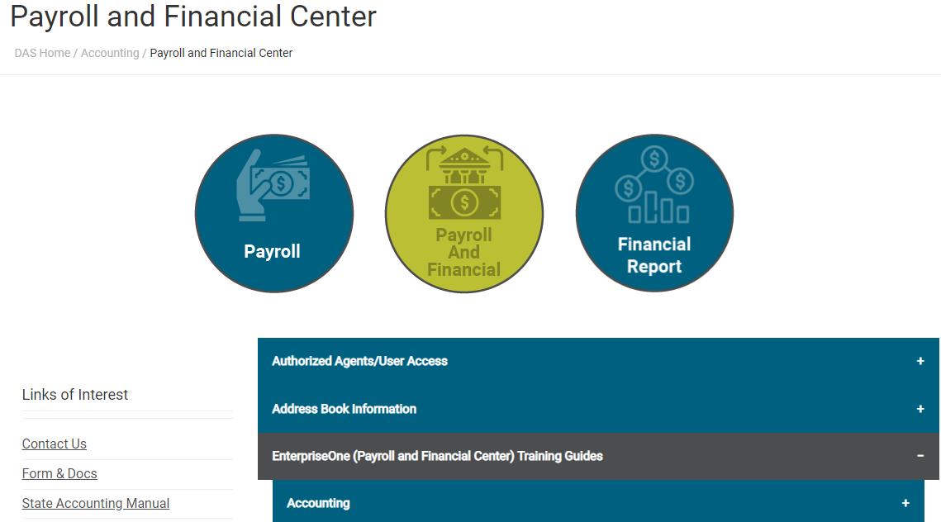
Asset Management Resources
State Accounting Manual Policy #28
Asset Management Manual
Entering an Asset Master
Fixed Asset Journal Entry
Post Costs To A Fixed Asset
Notes:
State Accounting Manual – Equipment, Land, Land Improvements, Buildings, Building Additions, Building Improvements, Infrastructure, CIP
Asset management manual contains the CAPITALIZATION THRESHOLD -- Items at $5,000 or more are required to be entered in the EnterpriseOne (E1) Fixed Assets Module. Please see the Capital Outlay section of the State Accounting Manual for additional guidance. Agencies may establish policies with capitalization thresholds lower than $5,000 per item at their own discretion. ($5,000 threshold effective 3/27/2019)
Entering an

Slide 39
Construction In Progress (CIP)
What is CIP?
Generally, projects of $100,000 or more with multiple progress payments in more than one fiscal year that need to be capitalized when the project is substantially complete
Why do we care about CIP?
It’s reported in the State’s Annual Comprehensive Financial Report (ACFR) and when the project is substantially complete, it will be capitalized and depreciated.

Slide 40
CIP Continued
Substantially Completed Examples
Buildings - when people are moving in and using the building.
IT projects - when production environment is being used.
Payment of final invoices and retainage can be added to the tag after the substantially completed date.
Retainage amount from June 2023 AIA Document
Amount usually not in E1
Include copy of AIA in supporting documents

Slide 41
Financial Reporting Package
Complete this form if your agency has projects that meet the reporting requirements for Construction-In-Progress
Agencies that have reported CIP from the previous year will receive the form with projects still in progress including a beginning balance
Include a GL Report with the detail of the payments to support the amount
When recording CIP expenses, use the following account codes:
587500 – CIP
587550 – IT Projects in Progress
Notes:
How do we account for CIP for the ACFR?

Slide 42
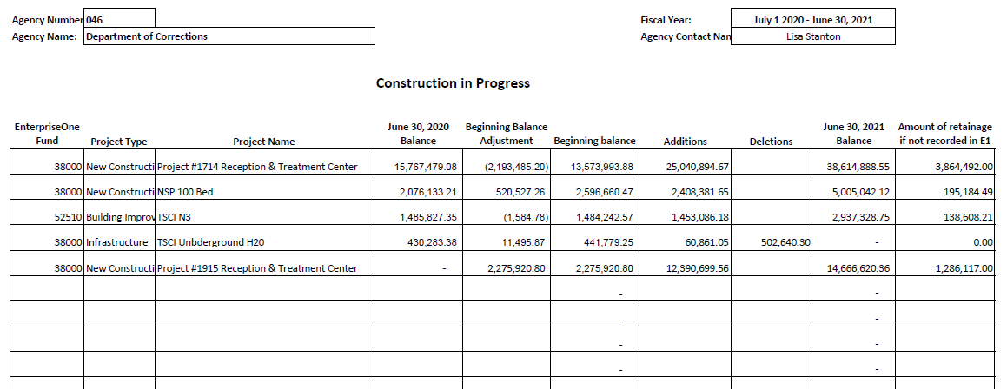
Beginning Balance - used to adjust previously capitalized costs that should have been expensed or add costs that should have been previously capitalized
Deletion - The deletion column should be used when the project is coming off of CIP and being added as a fixed asset.
Retainage – Provide support for this amount. Most commonly the amount from the AIA document
Notes:
- The E1 Fund is extremely important! If you’re using a specific BU to track project costs, that can be noted too.
- If you are adding as a fixed asset, provide the tag number.
Make sure the amounts cross foot (ie – PY Ending Bal + Beg Bal Adj = Beg Bal + Additions – Deletions = Ending Balance
PROVIDE SUPPORT FOR THE CAPITALIZED COSTS!!!!! MOST COMMONLY A GL.
We can provide the CIP form with prior year ending balance for you to start your reporting in the FY23 ACFR.

Slide 43
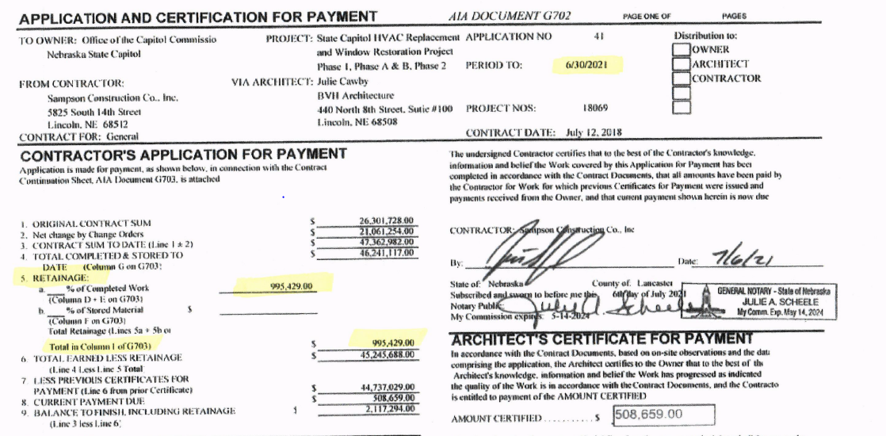

Slide 44
Construction Commitments
Include projects shown on the CIP form. If there isn’t a contract amount, include a note as to why
The contract amount can come from a contract or AIA document
Provide the percentage or dollar amount of remaining contract balance by funding source
Notes:
- This form is sent out with Financial Reporting package.
Projects of $100,000 and over, that are under contract
If you’re providing a dollar amount, it needs to add up to the remaining contract balance

Slide 45
Phases of an Application Software Project
Phases: General treatment of costs per GASB 51:
Preliminary Project Stage - Expensed
“Preliminary Project Stage” means the earliest stage of a software development or selection project, during which the alternatives are being evaluated but no decision has been made as to which strategy or vendor to use. Typical activities during this phase include assembling the evaluation team, evaluating proposals from vendors and the final selection of alternatives.
Application Development Stage - Capitalized
“Application Development Stage” means the stage of a software development or selection project during which the design, coding, installation and testing of new software occurs. The stage begins once management has authorized and committed to funding the project, and it is considered probable that the project will be completed and put to its intended use. The application development stage concludes when the software is complete and ready for use.
Post Implementation/Operation Stage - Expensed
“Post-Implementation/Operation Stage” means the stage that begins once the software is put into use. It includes training and subsequent maintenance of the software.
Notes:
From State Accounting Policies - AM-005 (Policy Number 28) & GASB 51

Slide 46
Questions?

Slide 47
Business Unit Setup

Slide 48
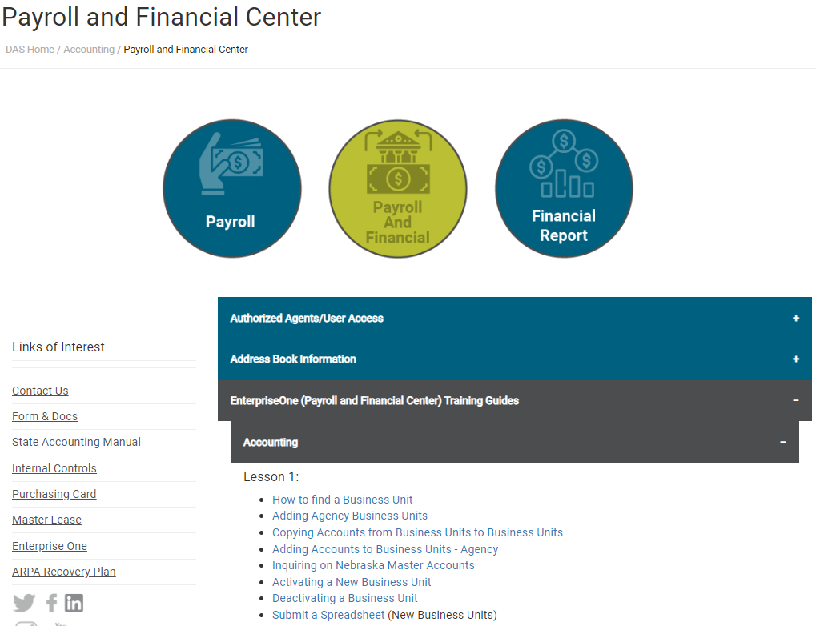
E1 Training Guides
Detailed training for business unit setup can be found on State Accounting’s webpage.
Notes:
https://das.nebraska.gov/accounting/pay-fin.html

Slide 49
Federal BU Types
Federal Funds
GB PARENT BUSINESS UNIT
GX FEDERAL GRANT-BUDGET CHECK
GY FEDERAL GRANT-NO BUDGET CHECK
GS STATE GRANT
Notes:
- The main business unit types used in Federal Funds. The first three types help track SEFA reporting and should be used with fund 40000.
- GS should be used if the funds are passing between State agencies

Slide 50
BU Inactivation
Before requesting a BU be inactivated, run the following report to verify it is able to be inactivated
E1 String:
State of Nebraska>Accounting>Inquiries & Reports>Accounting Reports>BU Check Before Inactivation
Report selection by BU or Grants
Email State Accounting request for inactivation
Notes:
When an agency sets the ‘Bus Unit Workflow’ field to 05 – Submitted for Approval, E1 does send State Accounting an email that the BU needs to be activated.
When an agency sets the ‘Bus Unit Workflow’ field to 30 – Submitted for Inactivation, E1 does not send State Accounting an email that the BU needs to be activated.

Slide 51
E1 Business Unit Workflow Screen
Notes:
Enter the business unit you are looking to deactivate. Check the box for that BU’s and select Row button and click Request Inactivate. The status code will change to “30”

Slide 52
Business Unit Setup
Questions?

Slide 53
Expense Reimbursement Documents (ERD)

Slide 54
New Versions of ERD
New Federal Per Diem Rates
Every October 1st
New Mileage Rates
Every January 1st

Slide 55
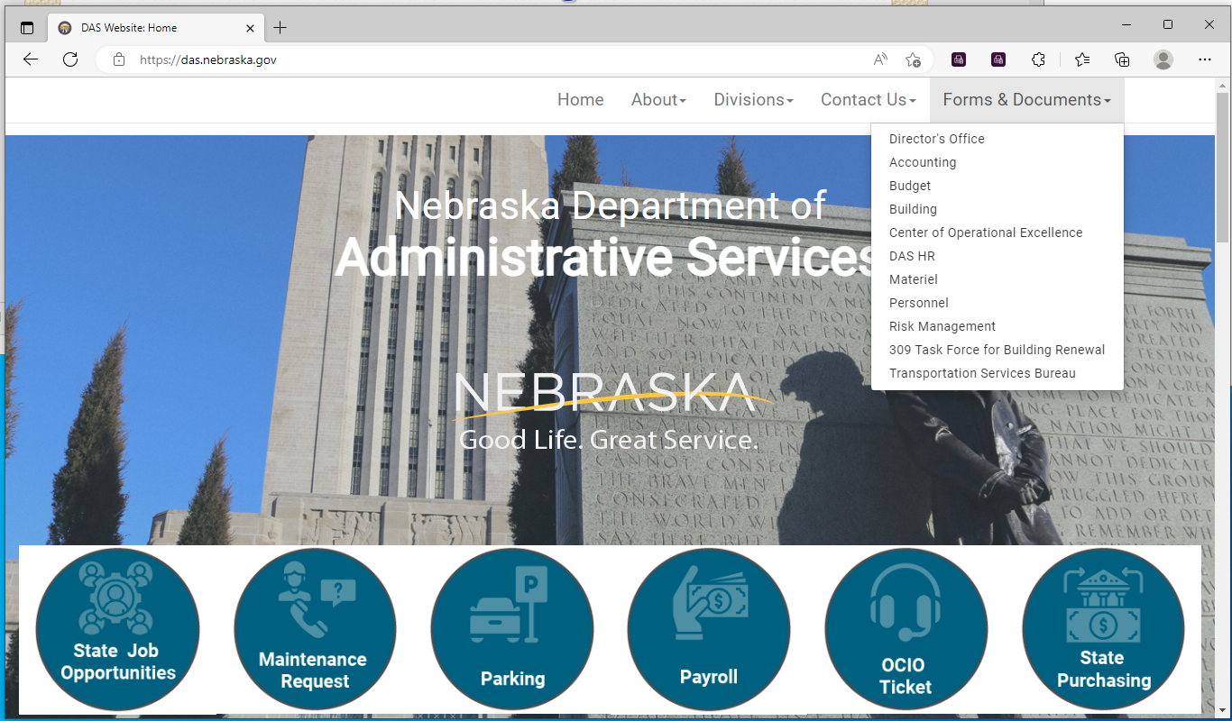
DAS Website

Slide 56
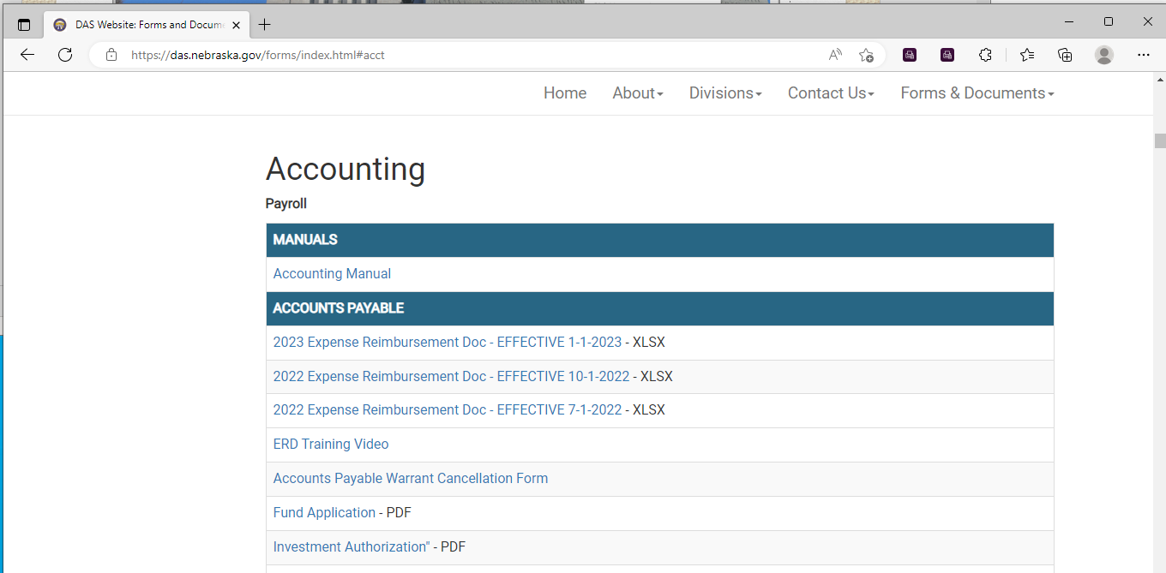
State Accounting Forms

Slide 57
ERD Training Video https://youtu.be/tQJmOdlF0iA
Travel Examples covered in training:
Out of State Conference (6:50)
Out of State Training (13:45)
Multiple Day Travel in Nebraska (16:55)
One Day Travel (19:30)
International Travel (21:15)

Slide 58
ERD Per Diem Refresher
Fill out the Travel Destination section only if approved for meal reimbursement
Check the “Trip 1st or Last Day” box for first and last day of travel, and one day travel
Object Codes for Travel Expenses

Slide 59
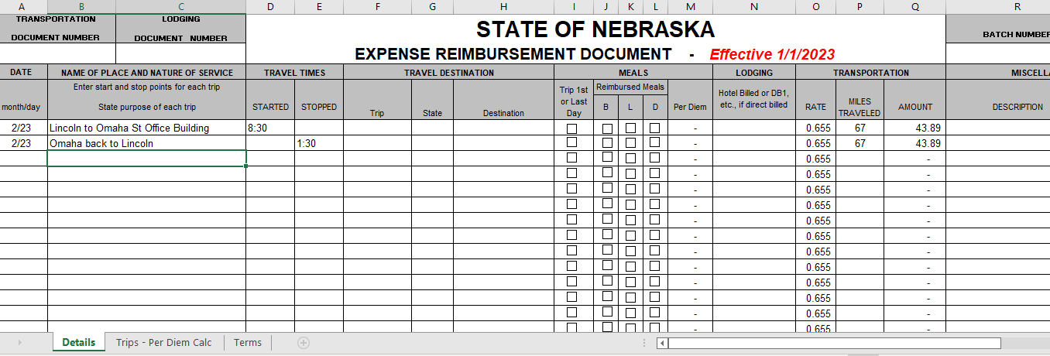
Mileage Reimbursement – No need to fill in Travel Destination or any check boxes

Slide 60
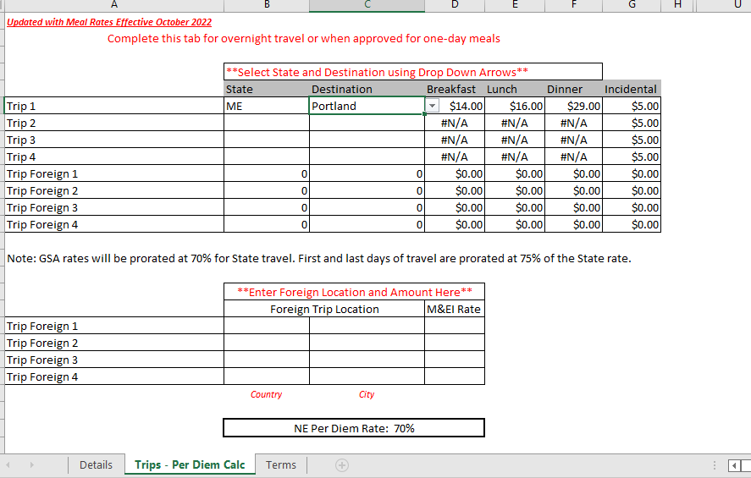

Slide 61
Start and Stop times on Multi-Day Travel doesn’t affect the Meals
3/21 - Check Trip 1st or Last Day box all meal boxes (unless one is provided)
3/22 – All meals provided by a conference, leave boxes blank
3/23 – Breakfast and Lunch provided by a conference, only check dinner
3/24 – Breakfast provided by a conference, check Trip 1st or Last Day box, lunch, and dinner

Slide 62
Travel Object Codes
571100 | LODGING | Costs of lodging accommodations incurred while in travel status for the State.
571600 | MEALS – TAXABLE | Expenses related to meals for individuals when not in travel status to attend official functions, conferences, hearings, and/or same day travel meal reimbursements. All are subject to being considered a taxable benefit when the value of meals received exceed $200 for a twelve-month period.
571800 | MEALS – TRAVEL STATUS | Meals reimbursed on a Per Diem basis while in travel status

Slide 63
ERDs
Questions?

Slide 64
New GASB Statements
Effective for fiscal year ending June 30, 2023

Slide 65
New GASB Statements
There are four new Governmental Accounting Standards Board (GASB) Statements that will be implemented for the fiscal year 2023 ACFR:
GASB Stmt. No. 91 – Conduit Debt Obligations
GASB Stmt. No. 94 – Public-Private & Public-Public (PPP or P3) and Availability Payment Arrangements (APA)
GASB Stmt. No. 96 – Subscription-Based Information Technology Arrangements (SBITAs)
GASB Stmt. No. 99 – Omnibus 2022 – Lease updates for GASB 87

Slide 66
GASB Stmt. No. 99 – Omnibus 2022 – Lease Updates (GASB Stmt. No. 87)
Paragraph 12 clarifies short-term leases with regard to GASB Stmt. No. 87, lease accounting. It requires a lease that was previously determined to be short-term, and that has since been modified to extend the initial maximum possible term under the lease contract, to be reassessed from the inception of the lease.
If the reassessed maximum possible term is greater than 12 months, the lease should no longer be considered a short-term lease.
For a lease that is reclassified from a short-term lease, the lease term should be reassessed beginning at the date of the modification for purposes of measuring the lease receivable or lease liability for the ACFR.

Slide 67
GASB Stmt. No. 99 – Omnibus 2022 – Lease Updates (GASB Stmt. No. 87)
An example of a situation requiring reassessment:
During implementation of the lease standard, a lease had a remaining term of 12 months, with no renewals. For fiscal year 2022, this lease was determined to be short-term and therefore, not reported in the ACFR.
During the following fiscal year, a renewal was signed extending the length of the lease by 12 months. This lease would no longer be considered a short-term lease. The lease term would need to be reassessed from the inception of the lease.

Slide 68
GASB Stmt. No. 96 - SBITA
A Subscription-Based Information Technology Arrangement (SBITA) is a contract that conveys control of the right to use another party’s (a SBITA vendor’s) IT software, alone or in combination with tangible capital assets (the underlying IT assets) as specified in the contract for a period of time in an exchange or exchange-like transaction.
In other words, a SBITA provides governments with access to a vendors' IT software and associated tangible capital assets for subscription payments without granting the government a perpetual license, or title, to the IT software and associated tangible capital assets. SBITAs allow for temporary use that ends when the subscription expires.

Slide 69
GASB Stmt. No. 96 - SBITA
Common examples of cloud computing SBITAs:
Software as a Service (Saas) – provides a customer with the ability to use a SBITA vendor’s application (software) through a cloud infrastructure, e.g., Cloud-based conferencing system such as Zoom or Teams.
Platform as a Service (PaaS) – allows a customer to use a SBITA vendor’s tools or coding language (software) to create applications that will run on the SBITA vendor’s cloud infrastructure, e.g., Environment for software development such as Azure.
Infrastructure as a Service (IaaS) – allows a customer to remotely access the SBITA vendor’s network, server, and other fundamental computing tools to process, store, and operate the customer’s data, e.g., Cloud-based storage such as One-Drive.

Slide 70
GASB Stmt. No. 96 - SBITA
If any of the following apply, the arrangement is NOT a SBITA:
Contracts that convey control of the right to use another party's combination of IT software and tangible capital assets that meet the definition of a lease (GASB Stmt. No. 87) in which the software component is insignificant when compared to the cost of the underlying capital asset.
For example, leasing a computer that has operating software installed or a smart copier that is connected to an IT system. The capital asset is the significant lease component not the IT software and is therefore, a lease not a SBITA.
Arrangements in which the State acts as a SBITA vendor, providing the right to use its IT software and associated capital assets to other entities through SBITAs.

Slide 71
GASB Stmt. No. 96 - SBITA
Contracts that meet the definition of a public-private and public-public partnership (PPP) in GASB Stmt. No. 94.
Licensing arrangements that provide a perpetual license, or title, to the State to use a vendor's computer software meet the requirements of GASB Stmt. No. 51, Accounting and Financial Reporting for Intangible Assets. See the State Accounting Manual for how to record these Computer Software arrangements as costs are incurred.
Contracts that solely provide IT support services and no right-to-use IT asset component. These costs should be expensed as incurred.

Slide 72
GASB Stmt. No. 96 - SBITA
A short-term SBITA, that at commencement of the subscription term, has a maximum possible term under the SBITA contract of 12 months (or less), including any options to extend, regardless of their probability of being exercised. The following should also be assessed:
Periods for which both the government and the SBITA vendor have an option to terminate the SBITA without permission from the other party (or if both parties have to agree to extend) are cancellable periods and should be excluded from the maximum possible term.
For a SBITA that has cancellable periods, such as a rolling month-to-month or a year-to-year SBITA, the maximum possible term of the SBITA is the noncancellable period, including any notice periods.
A SBITA that is determined to be short-term and is modified to extend the initial maximum possible term under the SBITA contract should be reassessed since inception of the SBITA. If the reassessed maximum possible term is greater than 12 months, the SBITA should no longer be considered short-term.

Slide 73
GASB Stmt. No. 96 - SBITA
A government can enter into an agreement with a vendor to implement a new SBITA. There are three stages to consider:
Preliminary Project Stage
(generally expensed)
Initial Implementation Stage
(generally capitalized)
Operation & Additional Implementation Stage
(generally expensed)
* Training costs, regardless of the stage they are in, should be expensed.

Slide 74
GASB Stmt. No. 96 - SBITA
Preliminary Project Stage:
Activities in this stage include the conceptual formulation and evaluation of alternatives, the determination of the existence of needed technology, and the final selection of alternatives for the SBITA.
Outlays associated with activities in this stage should be expensed as incurred.

Slide 75
GASB Stmt. No. 96 - SBITA
Initial Implementation Stage:
Activities in this stage include ancillary charges related to designing the chosen path, such as configuration, coding, testing, and installation associated with the State's access to the underlying IT asset(s). Other ancillary charges necessary to place the subscription asset into service should also be included in this stage.
Data conversion should be considered an activity of this stage when necessary to place the subscription asset into service for use, otherwise, data conversion should be considered an operation and additional implementation stage.
Costs can be part of the main contract with the SBITA vendor or a separate contract with another outside party unrelated to the SBITA vendor.
Additionally, implementation costs could include staff costs of the government.
The initial implementation stage for the SBITA is completed when the subscription asset is placed into service. Outlays associated with activities in this stage, generally should be included/capitalized as part of the subscription asset.

Slide 76
GASB Stmt. No. 96 - SBITA
Operation and Additional Implementation Stage:
Activities in this stage include maintenance, troubleshooting, and other activities associated with the government's ongoing access to the underlying IT assets.
Activities in this stage also may include additional implementation activities, such as those related to additional modules that occur after the subscription asset is placed into service.
Outlays associated with activities in this stage, generally should be expensed as incurred unless costs are a result of SBITA modifications.

Slide 77
GASB Stmt. No. 96 - SBITA
SBITA Modifications:
If costs are incurred as the result of SBITA modifications, such as:
Amendments to the contract that change the price;
Lengthening or shortening of the period;
Add or remove underlying IT assets;
Increase the functionality of the subscription asset (allows the government to perform tasks that it could not previously perform with the subscription asset); or
An increase in the efficiency of the subscription asset (increases the level of service provided by the subscription asset without the ability to perform additional tasks).
The costs should be included/capitalized as part of the subscription asset.

Slide 78
GASB Stmt. No. 91 – Conduit Debt Obligations
A conduit debt obligation is defined as a debt instrument having all of the following characteristics:
There are at least three parties involved: (1) a government-issuer, (2) a third-party obligor (borrower), and (3) a debt holder or a debt trustee;
The issuer and the third-party obligor are not within the same financial reporting entity;
The debt obligation is not a parity bond of the issuer, nor is it cross-collateralized with other debt of the issuer;
The third-party obligor or its agent, not the issuer, ultimately receives the proceeds from the debt issuance;
The third-party obligor, not the issuer, is primarily obligated for the payment of all amounts associated with the debt obligation (debt service payments).
All conduit debt obligations involve the issuer making a limited commitment. Some issuers extend additional commitments or voluntary commitments to support debt service in the event the third party is, or will be, unable to do so.

Slide 79
GASB Stmt. No. 91 – Conduit Debt Obligations
Common types of conduit financing include revenue bonds or private activity bonds.
Proceeds of conduit debt are used to construct or acquire capital assets. The issuer retains title of the capital assets. The payments from the third-party obligor are to cover the debt service payments.
If you have conduit debt obligations, please contact State Accounting for further guidance on how to report.

Slide 80
GASB Stmt. No. 94 – PPP & APA
A Public-Private & Public-Public (PPP) arrangement, sometimes referred to as P3, is defined as an arrangement in which a government (the transferor) contracts with an operator (another government or nongovernment entity) to provide public services by conveying control of the right to operate a nonfinancial asset, such as infrastructure or other capital asset (the underlying PPP asset), for a period of time in an exchange or exchange-like transaction.
In other words, a government (the State) contracts with another entity to provide services to customers of the government and those customers pay the entity for those related services.
* The State could be either the transferor or the operator depending on the arrangement. (It is more common that the State would be the transferor.)

Slide 81
GASB Stmt. No. 94 – PPP & APA
Common Examples of PPPs:
Roads
Bridges
Airport Terminals
Public Transit
Museums
Hospitals
Student Services
Sports Facilities
Jails
Wastewater Treatment Facilities

Slide 82
GASB Stmt. No. 94 – PPP & APA
If the arrangement meets the definition of a lease, then GASB Stmt. No. 87 should be applied, not Stmt. No. 94. The following is a lease:
The existing assets of the transferor are the only underlying assets;
Improvements are not required to be made by the operator to those existing assets as part of the arrangement; and
The agreement does not meet the definition of a Service Concession Arrangement (SCA).

Slide 83
GASB Stmt. No. 94 – PPP & APA
An arrangement is considered an SCA if all of the following criteria is met:
The transferor conveys to the operator the right and related obligation to provide public services through the use and operation of an underlying asset in exchange for significant consideration, such as an up-front payment, installment payments, a new facility, or improvements to existing facility.
The operator collects and is compensated by fees from third parties.
The transferor determines or has the ability to modify or approve which services the operator is required to provide, to whom the operator is required to provide the services, and the prices or rates that can be charged for the services.
The transferor is entitled to significant residual interest in the service utility of the underlying asset at the end of the arrangement.

Slide 84
GASB Stmt. No. 94 – PPP & APA
Examples of SCA agreements:
An arrangement in which the operator will design and build a facility and will obtain the right to collect fees from third parties. Such as the construction of a municipal complex.
An arrangement in which the operator will provide significant consideration in exchange for the right to access an existing facility, such as a parking garage, and collect fees from third parties for its usage.
An arrangement in which the operator will design and build a facility for the transferor, (such as a new toll bridge), finance the construction costs, provide the associated services, and collect fees.

Slide 85
GASB Stmt. No. 94 – PPP & APA
An Availability Payment Arrangement (APA) is an arrangement in which a government compensates an operator for services that may include designing, constructing, financing, maintaining, and/or operating an underlying nonfinancial asset for a period of time in an exchange or exchange-like transaction.
An APA differs from a PPP in that the government pays the operator in an APA instead of the customer paying the operator in a PPP.
An example of an APA: The State enters into an agreement with an operator to design, construct, operate, and maintain a public toll road for fixed payments to compensate the operator and/or variable payments based on certain measurements related to availability being met.

Slide 86
New GASB Statements
Questions?

Slide 87
Questions?
Email: AS.StateAccounting@nebraska.gov in the subject include “BUG Question”
Contact Info
Philip.Olsen@nebraska.gov 402-471-0600
Krista.Davis@nebraska.gov 402-890-8253
Caleb.Witt@nebraska.gov 531-810-1956
Kevin.Le@nebraska.gov 402-432-3784
Chad.Pinger@nebraska.gov 402-416-1535
Patrick.Trinh@nebraska.gov 531-530-9773
Raiatea.Arcuri@nebraska.gov 402-314-4353

