Slide 1

State Accounting
Business User Group (BUG)
May 2025

Slide 2
Training Slide Content
Fiscal Year End Closing Schedule
Biennial Carryover Reports
SEFA (Schedule of Expenditures of Federal Awards)
ACFR Completion & Financial Reporting Package
‘O’ Batches
Batch Management clean up for terminated employees

Slide 3
Fiscal Year End
Closing Schedule

Slide 4
Monday, June 2, 2025
Review open manual encumbrances established on June 30, 2024. If you had a lapse of an encumbrance and have not sent the information to DAS State Budget, this needs to be completed.
Review Service Purchase Orders (O9, Z8, or X6) for services that will not be received by June 30, 2025. These must be closed out or cancelled prior to June 25th at 5:00 PM.
Review of Received not Vouchered, object account 211700, verify the balance is correct and supported. The balance should be supported by purchase orders received but not yet paid.

Slide 5
Monday, June 2, 2025
Review of Open Purchase Orders to ensure they are still valid. These will be rolled over to July 1, 2025. If there are any issues, contact State Accounting.
Replenish petty cash funds and vendor deposit accounts to authorized levels.
Review balance sheet accounts, object accounts 100000-399999, to ensure balances are proper and supported before fiscal year end. Please pay particular attention to Accounts Receivable and Accounts Payable balances, including due to/from funds.

Slide 6
Thursday, June 5, 2025
Bi-weekly payroll (B-12) due for certification by 3:00 P.M.

Slide 7
Friday, June 20, 2025
Bi-weekly payroll (B-13) due for certification by 1:00 P.M.

Slide 8
Wednesday, June 25, 2025
LAST DAY TO POST FISCAL YEAR END 6/30/25 TRANSACTIONS
This includes PO’s and PO receipts, fixed assets, voucher processing, journal entry activity, etc. Agencies that require access to the system thereafter please contact Krista Davis at krista.davis@nebraska.gov or at (402) 890-8253. State Accounting will be monitoring the queues the remainder of the fiscal year.
June monthly payroll is due for certification by 1:00 P.M.

Slide 9
Wednesday, June 25, 2025
Procurement roles will be taken away at 5:00 P.M.
All Service PO’s (regardless of PO type) should be closed out or cancelled if not received by June 30. You can do this by adding a line to the PO with a negative amount to offset the remaining balance. The line can then be cancelled in July 2025 to restore the PO. A service not received by June 30 should not be encumbered.
Manual Encumbrances from prior year should be liquidated by voiding or crediting journal entry. If it is still outstanding you can re-enter in July 2025.

Slide 10
Wednesday, June 25, 2025
Reconcile encumbrances on the Allotment Status Report to support.
Review any outstanding cash transactions related to the Treasurer’s office to ensure it has cleared or paperwork has been processed.
Unposted Fixed Asset Report must be blank. Either post or pass on all items.
Fixed Asset No Cost Integrity Report must be blank, with the exception of items not yet received.

Slide 11
Thursday & Friday, June 26 & 27, 2025
Treasurer’s Office opens for normal business transactions.
No purchasing activity without authorization from DAS - Materiel. Do not perform a receipt function against an outstanding purchase order for current period or a future period unless authorized since these must be posted before year-end.
Only volume voucher payments and emergency payments will be processed.
For three-way match vouchers, Line Type 4, with July 2025 GL dates, do not adjust voucher amount until July.
Legally required expenditures for E1 Fiscal Year 24 (July 1, 2024 to June 30, 2025) will be allowed to post only with prior notification and approval by State Accounting.

Slide 12
Monday, June 30, 2025
Treasurer’s Office cut off for deposits is at 9:00 A.M. Deposits after 9:00 A.M. must have a 7/1/25 GL date.
No purchasing or posting activities allowed without authorization.
All Bi-weekly, E1 timesheet approvals need to be completed by 10:00 A.M.
If there are outstanding issues for your agency that will have a financial impact, contact Krista Davis at (402) 890-8253 by 12:00 P.M.
E1 will be shut down for all agencies at 3:00 P.M.
Outstanding purchase orders (not received) will be rolled over to the new fiscal year by State Accounting.

Slide 13
Tuesday, July 1, 2025
NO POSTING UNTIL FLASH MEMO IS RECEIVED THAT YEAR END CLOSE IS COMPLETE – THIS WILL BE COMPLETED BEFORE JULY 1, 2025, AT 7:00 A.M.
First allotment of new fiscal year appropriations provided by Budget Division.
Use prior year voucher processing menus when appropriate.
Allotment Status Report will be available on MREPORT.
Review open purchase orders to determine year end rollover is correct.

Slide 14
Beginning Thursday, July 3, 2025
Prior year manual encumbrances that were voided may be re-entered if necessary.
Start entering valid manual encumbrances.
Run the Encumbrance Detail Report (R5509594A) after encumbrances are entered to ensure they were recorded correctly.

Slide 15
Monday, July 21, 2025
State Accounting will calculate accrued payroll manual encumbrance based on the BW-15, July 18th biweekly payroll, which is 10% June hours.
Agencies with 24-hour facilities, agencies that need to use a different method, or if you have questions regarding the calculation State Accounting will calculate, please contact State Accounting to discuss your situation.

Slide 16
Thursday, July 31, 2025
Deadline to complete entry of E1 Fiscal Year 25 (July 1, 2025 to June 30, 2026) budgeted amounts for the Budget Status Report.

Slide 17
Biennial Carryover Reports
Review the following reports and make corrections as necessary:
First draft as of 7/31/25 – run on Friday, August 1, 2025
Second draft as of 8/14/25 – run on Friday, August 15, 2025
Certified report as of 8/31/25 – run on Monday, September 1, 2025
The Certified Biennial Carryover Report (signed copy) is due to State Accounting by Monday, September 15, 2025. Print the report for the Director’s signature, even if it is blank. Keep a copy for your records.

Slide 18
Tuesday, September 30, 2025
State Budget division completes review of certified encumbrances.
Re-appropriation provided as appropriate.
After certification process is completed, State Accounting will liquidate payroll encumbrances.

Slide 19
Schedule of Expenditures of Federal Awards (SEFA)

Slide 20
SEFA
The Schedule of Expenditures of Federal Awards (SEFA) is part of the Annual Statewide Single Audit.
The SEFA tracks expenditures by Federal AL (Assistance Listing) or Grant Numbers. (Formerly known as CFDA #.)
Expenditures made to sub-recipients should be recorded in E1 to Object Account Code 594100.
Pass through funds received from another agency should be recorded in E1 to Object Account Code 461500.

Slide 21
SEFA
Please refer to the State Accounting BUG training held on March 27th, 2025, for detailed information regarding subrecipient reporting on the SEFA:
Spring 2025 BUG Presentation Slides or
Spring 2025 BUG Presentation Recording

Slide 22
SEFA
Agencies who record Federal expenditures will receive an email from State Accounting in July with Federal expenditures recorded in E1.
Verify the amount of Federal and sub-recipient expenditures for each federal award (AL #).
Amounts reported that differ from the Federal expenditures in E1 need to be supported with documentation, such as accounting reports, federal reports, etc. This documentation will also be provided to the auditors.
Responses are due back to State Accounting by Monday August 4th, 2025.

Slide 23
SEFA
The email from State Accounting will also include Federal expenditures recorded to business units with no Federal AL # assigned.
All Federal expenditures will need to be reviewed and support provided in order to ensure these are or are not to be included in the SEFA.
We perform a reconciliation of E1 Federal expenditures to the final SEFA to ensure all Federal expenditures are accounted for and properly reported. Your assistance in explaining and supporting Federal expenditures not included in the SEFA is necessary to complete this procedure.

Slide 24
ACFR Completion
& Financial Reporting Package

Slide 25
ACFR Completion
State statute drives the required submission of the ACFR report to the Governor’s office and the Legislature. Due dates set by DAS and the Auditor’s Office need to be adhered to ensure the timely completion. One major milestone is the mid-August financial reporting package deadline.
We need, and greatly appreciate, the assistance of all agency staff to ensure this deadline is adhered to. This includes not only the proper reporting of accruals, but the timely response to all auditor inquiries and requests.

Slide 26
Financial Reporting Package
You will receive the financial reporting package, via email, the first week of July.
Responses and supporting documentation are due by August 15, 2025.
Send your forms and support to: as.stateaccounting@nebraska.gov with the subject line ‘Financial Reporting Package’.
Agency Directors are required to certify the financial reporting package, similar to last year. The certification letter is included in the package.

Slide 27
Financial Reporting Package
If you would like to discuss your accruals, please contact Krista Davis at krista.davis@nebraska.gov or Caleb Witt at caleb.witt@nebraska.gov, prior to August 15th to schedule a time.
The reporting package includes Financial Reporting Package Instructions to assist you in completing the various forms.

Slide 28
Financial Reporting Package
The forms to be reviewed and completed by all agencies:
  Accrual Response
  Capital Grants
  Cash & Investments
  Non-Monetary Transactions
  Irrevocable Split Interest Agreements
  Construction-In-Progress (CIP) and Capital Construction & IT Commitments
  Leases
  Public-Private & Public-Public Partnerships (PPP) & Availability Payment Arrangements (APA)
  Subscription-Based Information Technology Arrangements (SBITA)

Slide 29

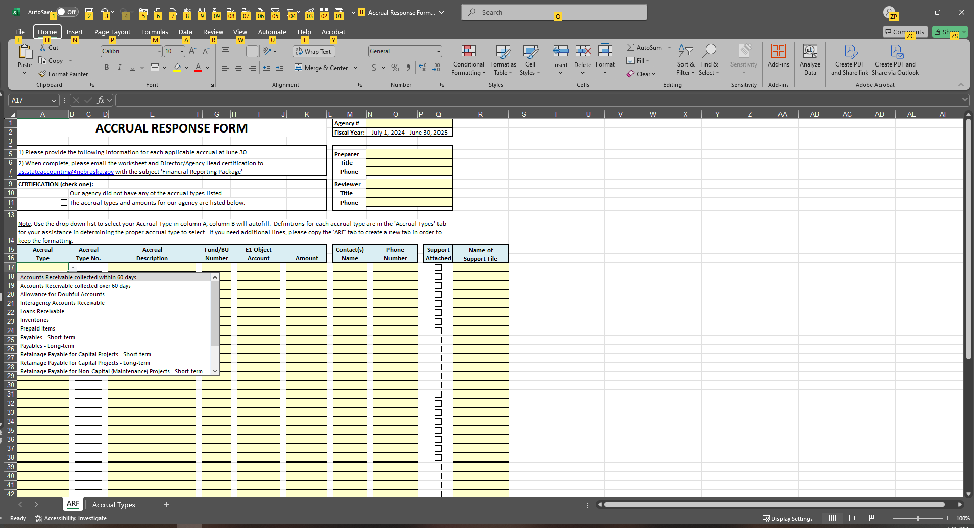

Financial Reporting Package
In our continued goal of improvement in financial reporting you will see several changes to ACFR accrual forms sent in July. Please use the new forms!
You will see new drop downs with definitions contained in the FY25 accrual form along with a new column to report the object account you use to record the activity in E1.

Slide 30
Financial Reporting Package
Please refer to the State Accounting BUG training held on March 27th, 2025, for detailed information regarding changes to the accrual forms on our website at:
Spring 2025 BUG Presentation Slides or
Spring 2025 BUG Presentation Recording

Slide 31
Financial Reporting Package
If you completed a CIP and Capital Construction & IT Commitments form last year we have sent your agency contact a prefilled form to start with for beginning balances. Add all new activity and new projects to the form as necessary.
All agencies should have submitted the Lease and SBITA accrual forms in April 2025. Please update that submitted form with any changes, including new, amended, or terminated Leases/SBITAs, final GL detail coding, etc. from April to June 30, 2025.

Slide 32
‘O’ Batches

Slide 33
‘O’ Batch Clean Up
If an ‘O’ batch is in error status, only State Accounting can reverse and delete the batch. Email as.stateaccounting@nebraska.gov
If an ‘O’ batch has posted by mistake the agency can post a reversal.
  Remember that a reversal creates a new batch and needs to be posted as well.
  Do NOT voucher unless the ‘O’ batch has posted.

Slide 34
‘O’ Batch Clean Up
Please refer to the State Accounting BUG training held on March 27th, 2025, for more information regarding Procurement/OV document clean up:
Spring 2025 BUG Presentation Slides or
Spring 2025 BUG Presentation Recording

Slide 35
Batch Management
Clean Up

Slide 36
Batch Management Clean Up
As a reminder, please review your Batch Management setup for all employees, of importance is cleaning up access for terminated employees.
DAS performs a monthly review and sends out notifications to Authorized Agents for removals. Please ensure these notifications are addressed and a review is performed by your agency Authorized Agent for any additional revisions that need to be made. DAS may not catch all necessary adjustments; it is the agency Authorized Agent’s responsibility to ensure access is removed timely.

Slide 37
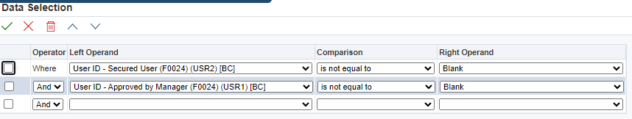
Batch Management Clean Up
You can run reports in E1 for batch management access:
  E1 > Authorized Agents > Batch Management Report – Approver and Batch Management – Preparers
  Leave the data selection as is and run the report for your agency. Open the report in CSV to review for clean up.

Slide 38
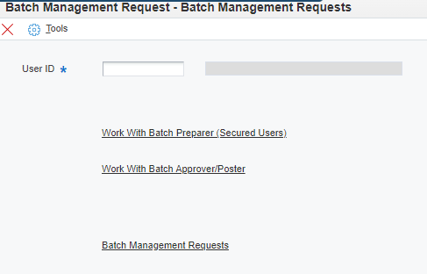
Batch Management Clean Up
To submit changes to batch management access, go to: E1 > Authorized Agents > Batch Management Request and enter the User ID and walk through the process to make the change.

Slide 39

For Questions:
Email: AS.StateAccounting@nebraska.gov in the subject include “BUG Question”
Contact Info
  Philip.Olsen@nebraska.gov 402-471-0600
  Krista.Davis@nebraska.gov 402-890-8253
  Caleb.Witt@nebraska.gov 531-810-1956
  Chad.Pinger@nebraska.gov 402-416-1535
  Patrick.Trinh@nebraska.gov 531-530-9773
  Shaun.McDonald@nebraska.gov 402-540-4987
  Shabnam.Sultani@nebraska.gov 402-314-4353
  Van.Truong@nebraska.gov 402-471-5259

