Slide 1

STATE ACCOUNTING BUSINESS USER GROUP (BUG)
Tuesday, April 7, 2026
9:00 AM – 11:30 AM
1526 K Street basement, Training Room/Development Center

Slide 2
AGENDA
State Accounting Website Navigation
Where to find reports, email contacts, Chart Of Accounts (COA), forms
Back to Basics
E1 Tips & Tricks
COA and Object Account Refresher
Month End Close Process
What needs to be done by agencies prior to the end of the month
Year end reminders
Surplus Process
Equipment status meaning
Cleaning up surplus items in E1
Fixed Assets
Integrity Reports & Asset Transfers
Procurement / OV docs / Vouchers
Overview Procurement to Payment
Unposted O batches
Vouchers

Slide 3
STATE ACCOUNTING WEBSITE NAVIGATION

Slide 4
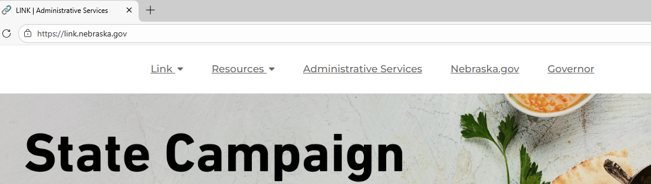
STATE ACCOUNTING WEBSITE
Link.Nebraska.gov > Administrative Services > Divisions > State Accounting
Payroll
Address Book
Financial Reports
Chart of Accounts
E1 Training Guides
Other forms and documents
Contact information

Slide 5
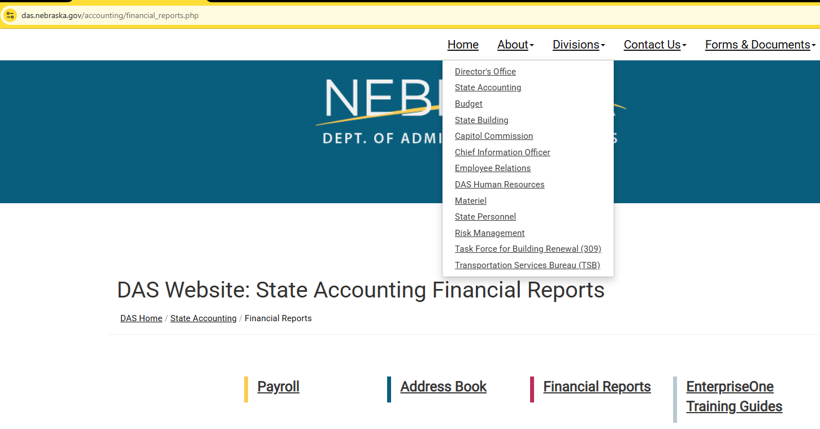
ACCESSING THE REPORTS SECTION

Slide 6
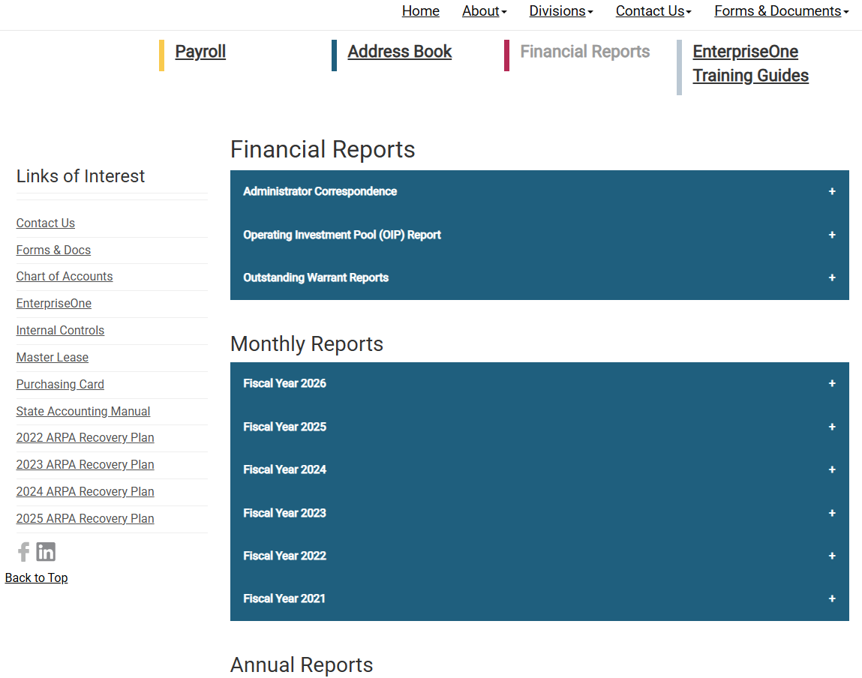
ACCESSING THE REPORTS SECTION (continued)
Reports available:
Monthly reports like OIP, Allotment Status, Budget Status, Fund summary by Fund, Grant Projects and PSL
Annual reports like Annual Budgetary Report, ACFR, SWCAP, Statewide Single Audit
Outstanding Warrants
BUG Slides and Recording

Slide 7
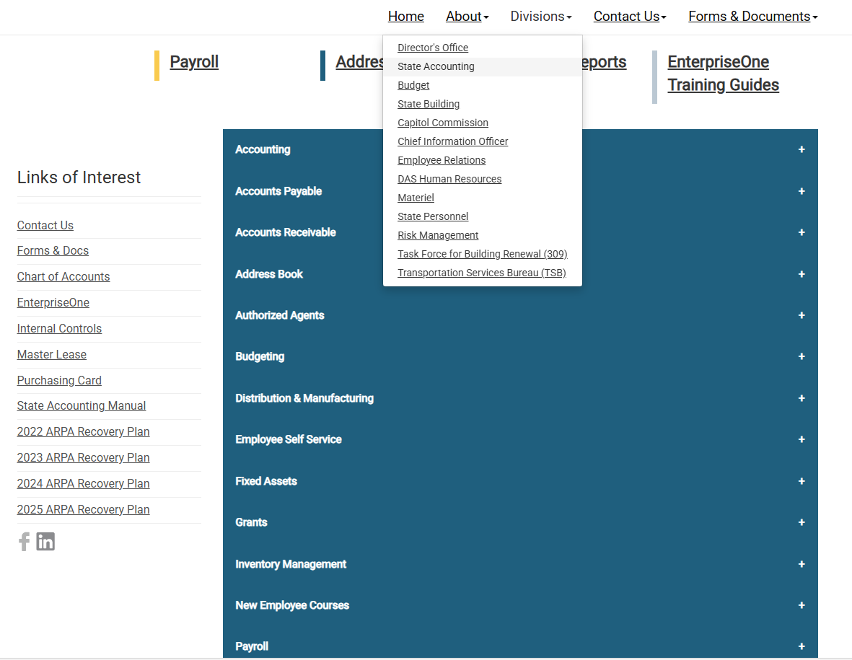




TRAINING GUIDES
Training Guides:
Step by step lessons on how to perform tasks on E1
Self-paced learning
Access at any time
Bookmark or download a guide for quick access
Topics organized into sub-categories of how to perform a specific task and run inquiries/reports

Slide 8
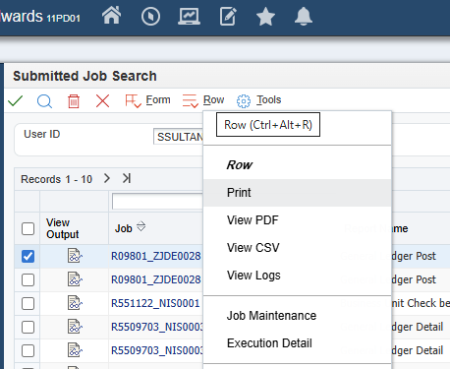
TRAINING GUIDES (continued)
System Basics:
Accounting:
Logging into E1, password resetting
Customizing fields, creating queries and favorites
Running and accessing reports
Execution detail
Timecards, Leave Submission, Paystub and W4 review
Business Units
Creating, finding, copying BU to BU
Journal Entries
Entering, changing, posting, voiding, printing JE by batch
Inquiries and Reports

Slide 9
CHART OF ACCOUNTS
Organized by Balance Sheet and Income Statement Object Codes
Balance Sheet:
Assets 1xxxxx
Liabilities 2xxxxx
Equity 3xxxxx
Income Statement:
Revenues 4xxxxx
Expenditures 5xxxxx
Chart of Accounts
Balance Sheet
Income Statement
Assets
Liabilities
Equity
Revenue
Expenditures
110000 Cash & Cash Equivalents
120000 Investments
130000 Receivables
140000 Inventories
150000 Prepaid Expenses
170000 Fixed Asset Cost
180000 F/A Acc. Dep.
190000 Other Assets
210000 Accounts Payable
System generated transactions only
450000 Taxes
460000 Intergovernmental
470000 Sales & Charges
480000 Misc.
510000 Personal Services
520000 Operating
560000 Depreciation
570000 Travel
580000 Capital Outlay
590000 Government Aid

Slide 10
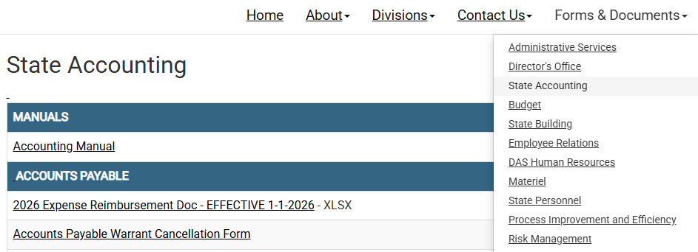
FORMS AND DOCUMENTS
Accounting Manual:
Policies that govern the work we do in the accounting department for the State of Nebraska
Good first reference if you have a question
Reviewed and updated on a rotational basis, and as needed
Policy statements are divided into two sections:
General Policies: pertain to accounting related transactions of the State
Travel Policies: pertain to reimbursement of employees for expenses incurred by them on behalf of the State

Slide 11

FORMS AND DOCUMENTS (continued)
Other documents on this tab:
ERD form and training video
Fund Application
Warrant Cancellation
Payroll processing Schedules
Internal Control Tools
Leases, P-Card, Budget etc

Slide 12
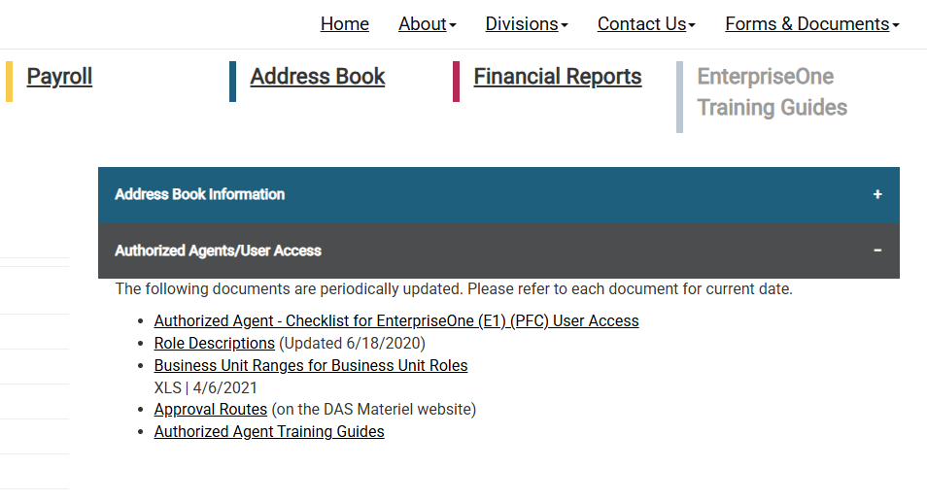
Address Book
ACH W9 Form
Authorized Agent
Maintaining user roles and access
Employee offboarding checklist
Role Descriptions
View role descriptions in different areas of E1

Slide 13
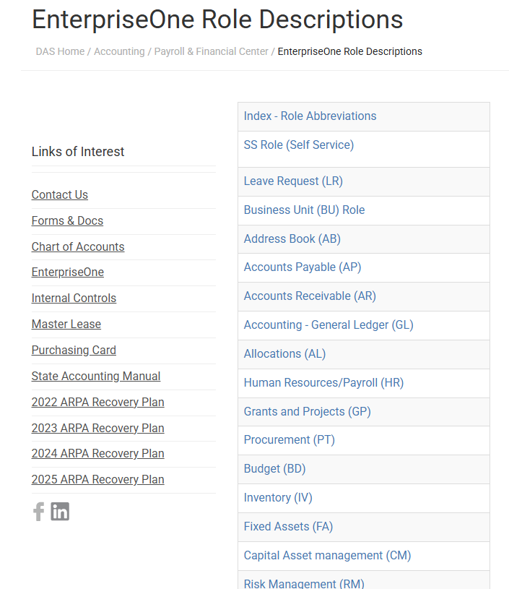
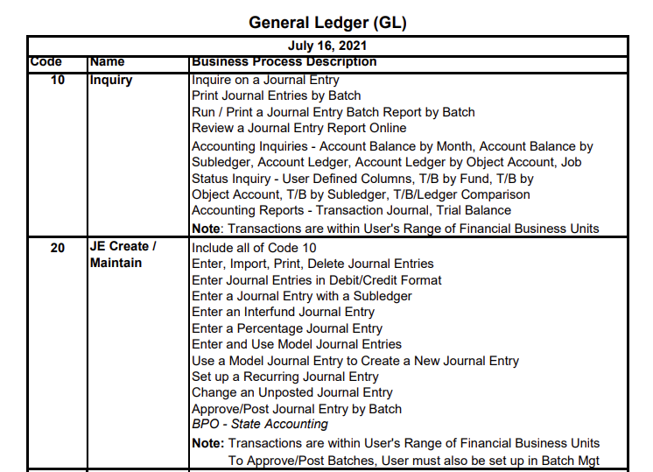
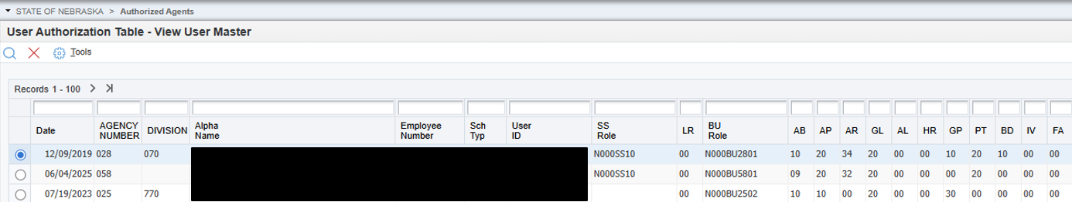
Role Descriptions example
Example: GL20

Slide 14
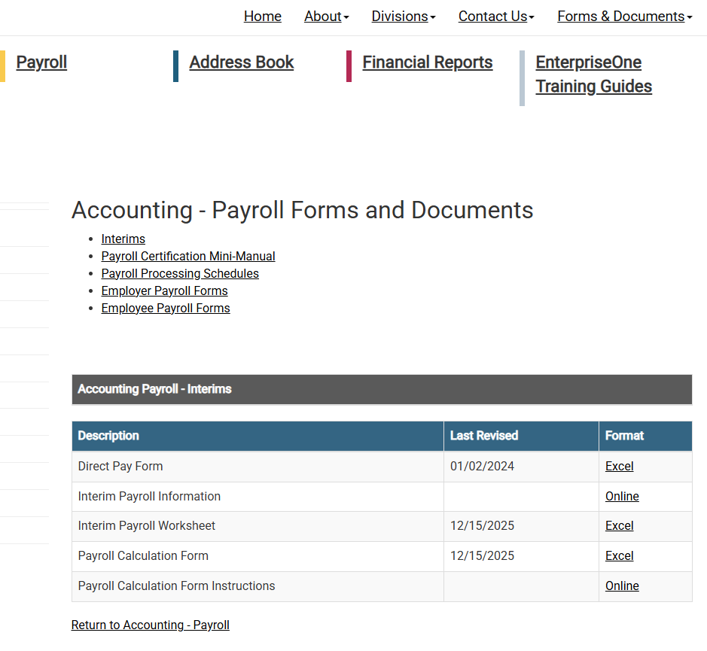
Payroll
Interim Payroll Worksheet
Payroll Calculation Form and Instructions
Monthly and Biweekly payroll processing schedules

Slide 15

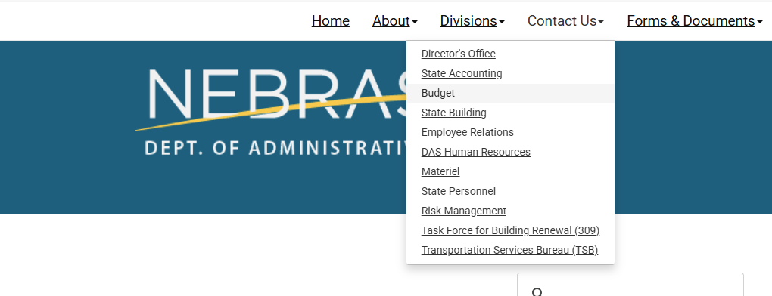
CONTACT US
Contact Us:
State Accounting email mailbox: as.stateaccounting@nebraska.gov
Subject line will help guide the email to the appropriate folder

Slide 16
BACK TO BASICS

Slide 17
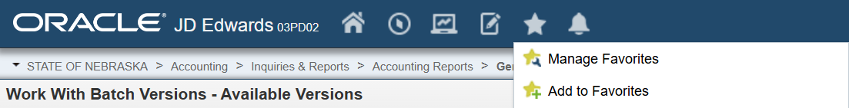
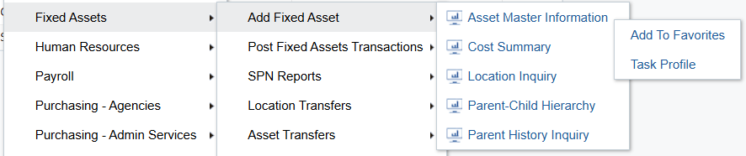
CREATING A FAVORITES MENU
Frequently used reports and screens can be added to your favorites menu two different ways.
With the screen or report open, select the ★, on the drop-down menu then “Add to Favorites”.
From the menu, right click on the screen or report and select “Add to Favorites”.
The name can be changed or left as is. After clicking “Create Favorite”, the report will now show up in your favorite menu in the far-left hand column.

Slide 18
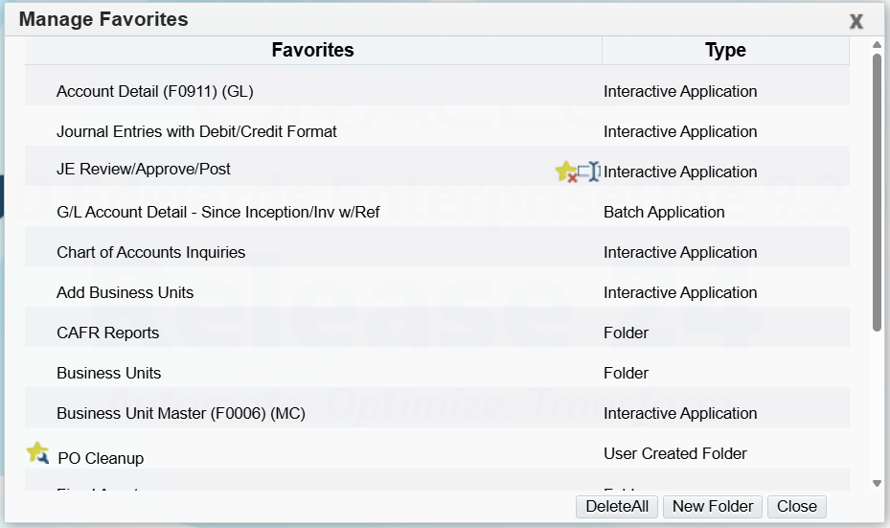


MANAGING FAVORITES MENU
At any point, a user can edit their favorites list by clicking on the ★ and selecting “Manage Favorites”. Items can be renamed, deleted and folders can be created.
Note: To delete a single item the user will select the application in this window and then a delete command will prompt , then the user can simply select this icon to delete.

Slide 19



USING THE GRID FORMAT MANAGER
The Grid Format Manager has 3 methods for personalizing your grid view
Display & Order
Column Format
Data Sequencing
Used to shift the order of columns or add/remove fields if allowed.
Used to format different columns based on your team’s criteria of importance or relevance.
System displays data ascending or descending order based on sequenced fields/columns.

Slide 20
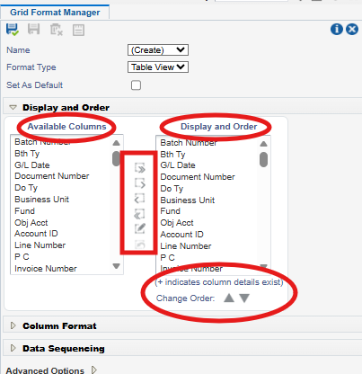


CUSTOMIZING GRID DISPLAY & ORDER
For simple column customization, columns can be reorganized by dragging and dropping using the left mouse button. When this is done, the save icon will illuminate green to indicate the grid is changed and can be saved.
For more advanced formatting, a user could select the Personalize Grid icon located at the top right corner of any application. This brings up the Grid Format Manager in table view, pictured on the right.

Slide 21
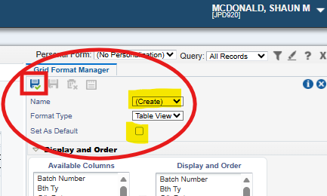
SAVING UPDATED GRID FORMATS
Make sure to save any grid you want to keep before closing, update name and determine if you want this new format to be your default report, if so, check default and select save by clicking the blue floppy disk icon in the red square.

Slide 22
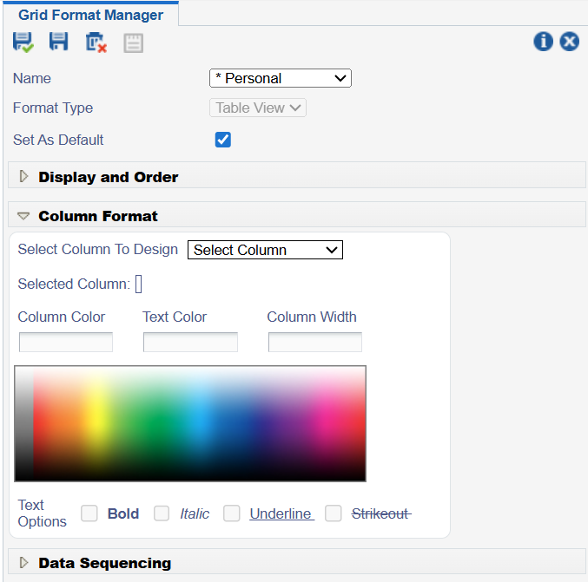
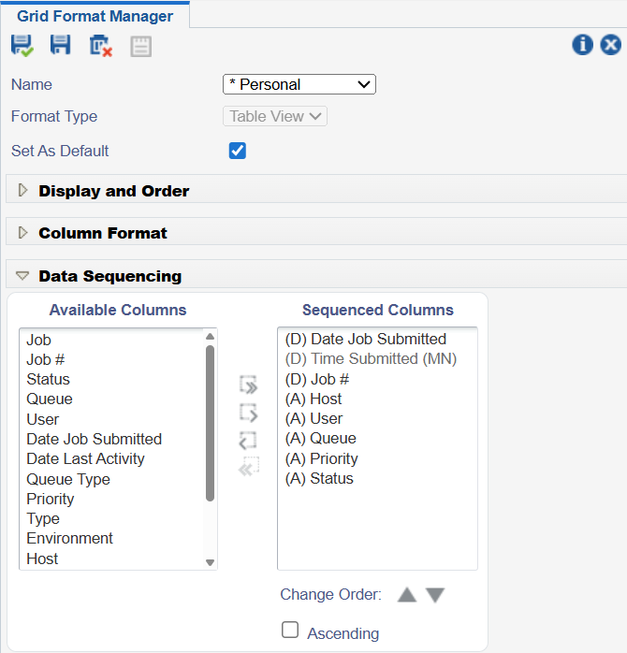
CUSTOMIZING COLUMN FORMAT & DATA SEQUENCING

Slide 23
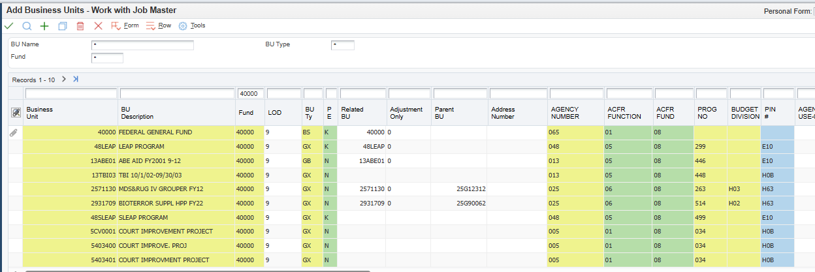

Slide 24

USING AN ASTERISK (*) IN QUERIES
The asterisk (*) symbol is referred to as a “wildcard” and can be used to expand searches. It can be used before and/or after search criteria.
For example, if you want to query for payments to a vendor and don’t know their address book number, you could use the following searches to find payments to JEO CONSULTING GROUP:
JEO*
*CONSULTING*
*GROUP

Slide 25
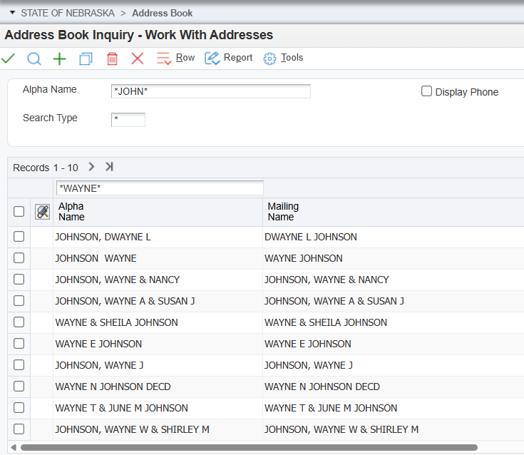

Slide 26
EXCLAMATION MARK (!) IN QUERIES
An exclamation mark (!) means “does not” and is used to exclude values from a query.
Example: Entering !=D in the Posted Code (PC) field will return all results not equal to D.

Slide 27
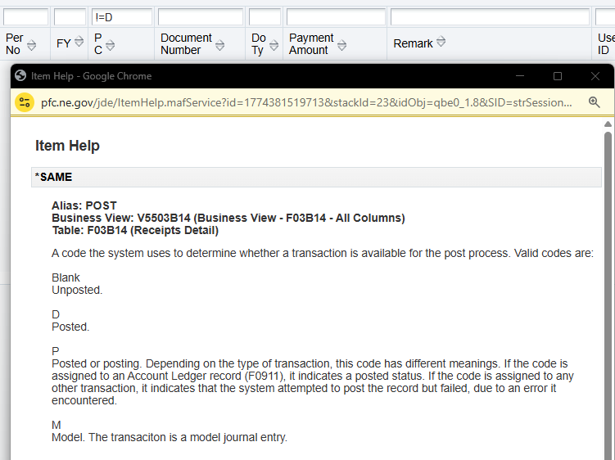
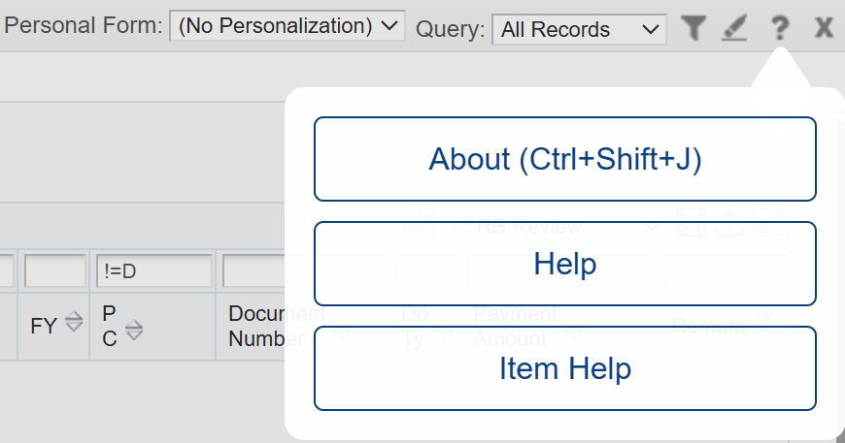
EXCLAMATION MARK (!) (continued)
Where did “D” come from? For this example, we are using the PC field and D means Posted.
To view the Item Help, you can do the following:
Place your cursor in the field you want to see details and press the F1 key to bring up the item help dialogue box and show valid codes for the specific field you are wanting to use.
You can turn on item help by selecting the “?” located at the top right-hand side of the screen then Item Help. Once Item Help is enabled, you can select any field to bring up the detail. To turn off Item Help, repeat the steps.

Slide 28
GREATER THAN (>) Or (<) LESS THAN SYMBOLS
These symbols can be used for querying dates, amounts, and other statuses
This symbol is commonly used in fields with dates.
Example: <03/26/2026

Slide 29
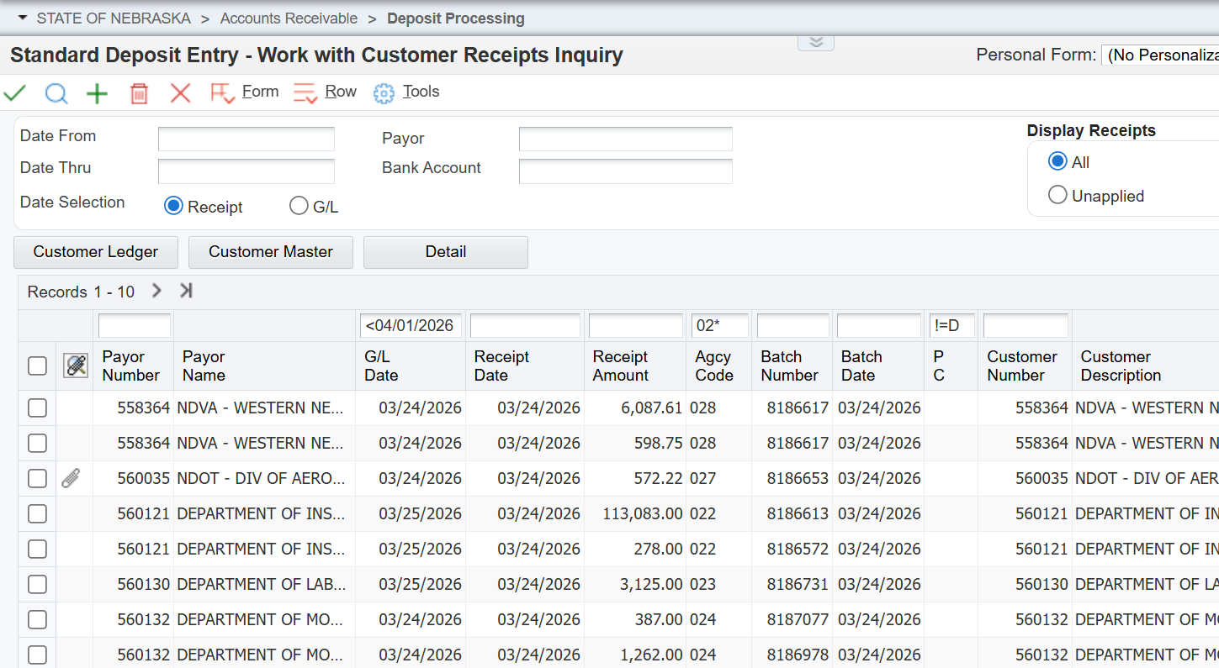
APPLYING THESE SYMBOLS
Prior to closing a month, State Accounting deletes all unposted RB batches with a G/L Date in the month being closed. This is because they cannot be posted or deleted after the month is closed. Agencies can utilize a similar query to check for unposted RB batches.
This query will display all unposted deposit batches for agencies 20-29 with a G/L Date prior to April 1st 2026.

Slide 30
Recognize the difference between Income Statement & Balance Sheet business units.
1
What object codes are acceptable for each type of business unit.
2
Object account refresher for (due to/due from, transfers, subrecipient payments & 1099’s)
3
CHART OF ACCOUNTS ENTERPRISE ONE
STATE OF NEBRASKA > Accounting > Chart of Accounts > Chart of Accounts Inquiries - Work With Accounts

Slide 31
BALANCE SHEET BUSINESS UNITS VS. INCOME STATEMENT BUSINESS UNITS
(BS) Balance Sheet
(IS) Income Statement
Also known as statement of financial position and is a summary of financial balances.
5-digit business units (fund number)
Object Code Range 100000’s to 349100
Also known as profit & loss statement, it calculates net income by listing all revenues and subtracting all expenses.
7 to 8-digit business units or more, depending on agency number
Object Code Range 400000’s to 599999 and 800000’s

Slide 32
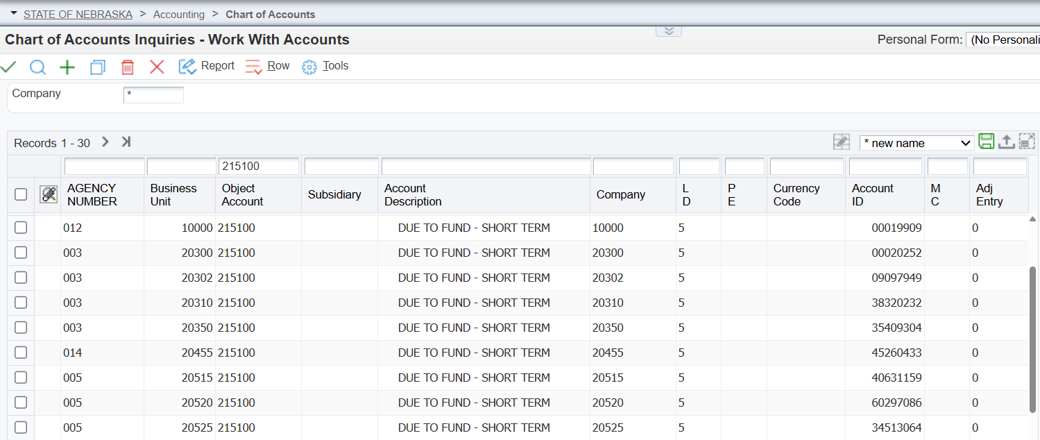

Slide 33
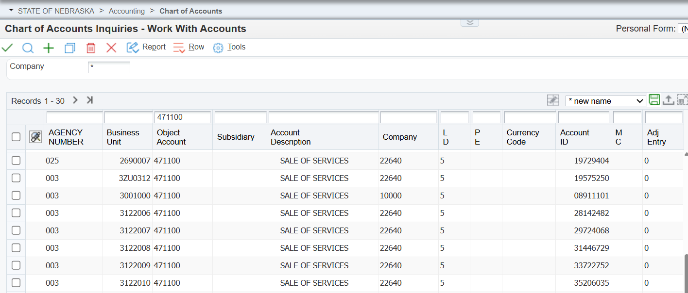

Slide 34

INCOME STATEMENT BUSINESS UNIT & OBJECT ACCOUNT QUIZ QUESTION #1
Which of the following would be a correct Income Statement business unit & object code combination?
a) 10000.521100
b) 10000.454800
c) 10000.511100
d) 18569548.511100
e) Both (c) & (d) are correct

Slide 35
BALANCE SHEET BUSINESS UNIT & OBJECT ACCOUNT QUIZ QUESTION #2
Which of the following would be a correct Balance Sheet business unit & object code combination?
a) 18569548.454800
b) 18569548.211200
c) 10000.211200
d) 10000.511100
e) Both (a) & (b) are correct

Slide 36
OBJECT CODES TO KEEP IN MIND

Slide 37
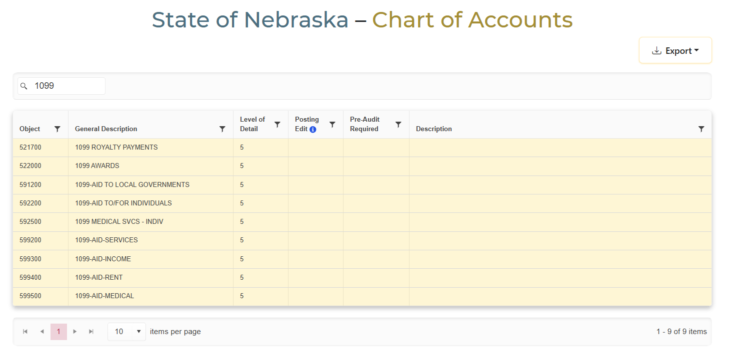
1099 OBJECT CODES
Note: When using these object codes, non-corporate vendors will receive a 1099

Slide 38
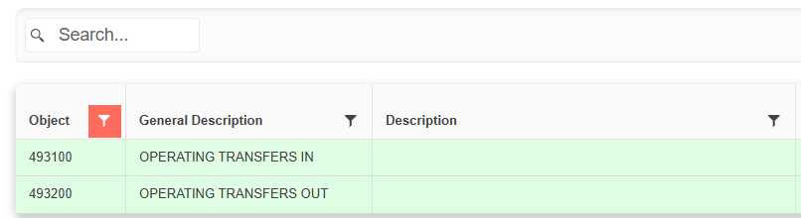
TRANSFER ACCOUNT CODE ALTERNATIVE
Transfer account codes are primarily used by the State Treasurer and are directed by a legislative bill or State statute. Contact State Accounting who can advise on alternatives to transfers.

Slide 39
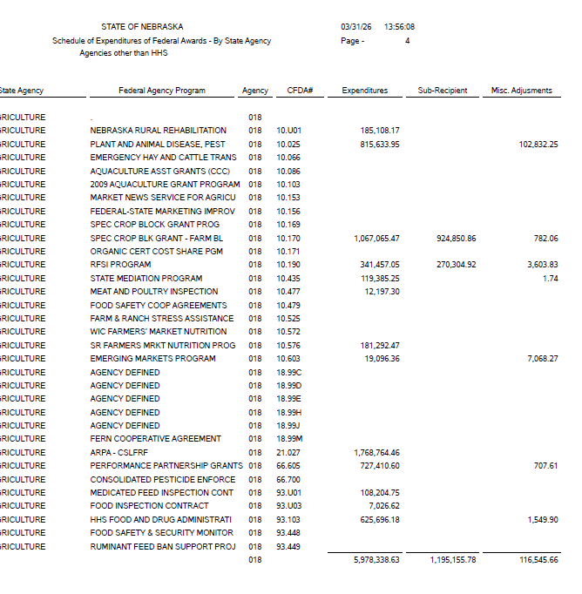
SUB-RECIPIENT PAYMENTS
594100
Use account 594100 to record federal grant payments to sub recipients.
Doing this will accumulate the total on the E1 SEFA (Schedule of Expenditures of Federal Awards) and require fewer adjustments when reporting.

Slide 40
MONTH END CLOSE PROCESS

Slide 41
MONTH END CLOSE PROCESS
All E1 batches with a current month GL date must be posted
A few exceptions
Update each fund to the new month (period in E1)
System wide update for all funds
System creates new reports on Sunday after the close
Added to State Accounting website the next week

Slide 42
AGENCY MONTHLY REMINDERS
Post voided batches promptly
Clear Payroll batch issues and post ASAP
Review unposted batches periodically
Review and post unposted batches.
Delete unposted batches with prior month’s G/L date
Post Purchase Order Receipt, type “O”, batches before creating vouchers
Make sure IB (IBTs) batches are posted
Review Unposted Fixed Assets
Purchase Card (PCARD) batch must be posted prior to month end

Slide 43
DELETING VS VOIDING A BATCH
Deleting is for transactions that have not been posted
Once deleted, it cannot be recovered
Voiding is for transactions that have been posted
If you void a transaction, the original batch MUST be approved and posted again

Slide 44
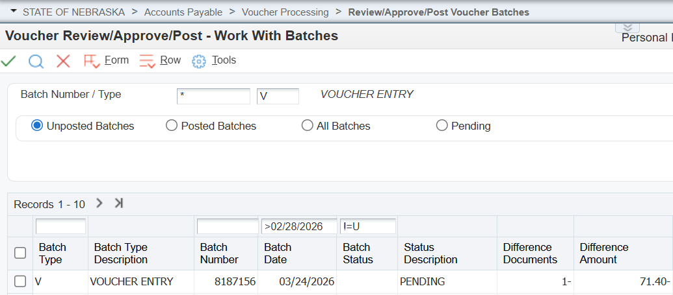
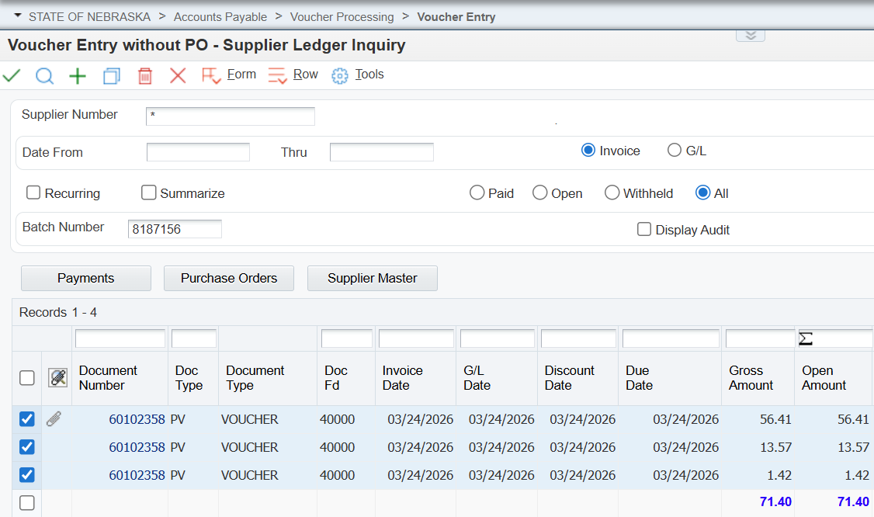
DELETING A VOUCHER BATCH

Slide 45
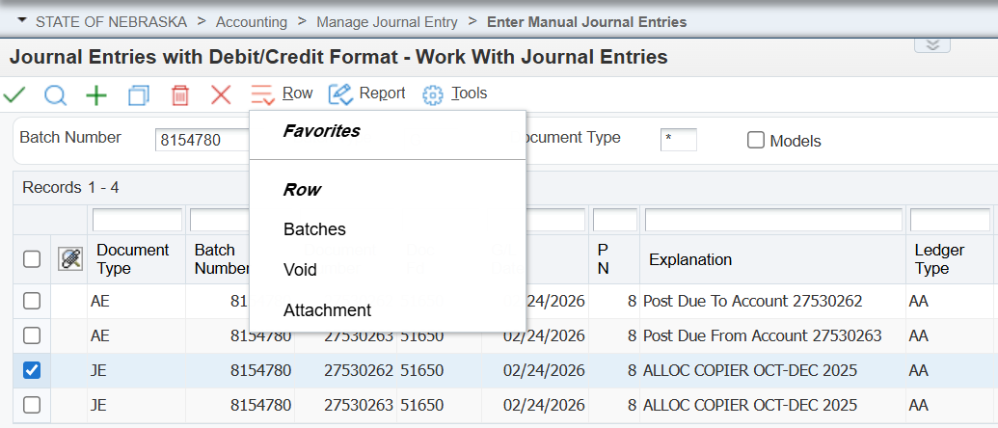
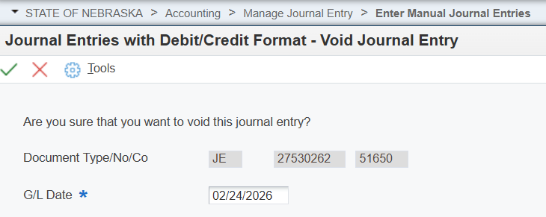
VOIDING A BATCH
Voiding a Journal Entry Batch
G/L Date change to Current Date
**Must post same batch again**

Slide 46
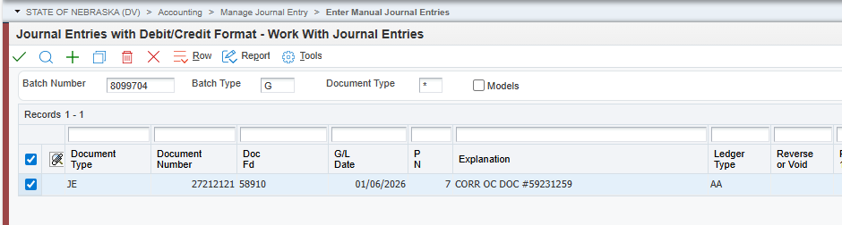
JOURNAL ENTRY EXAMPLE

Slide 47
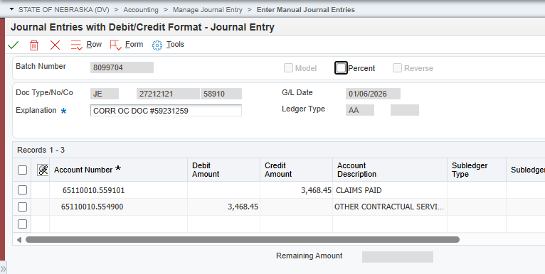
JOURNAL ENTRY DETAILS

Slide 48
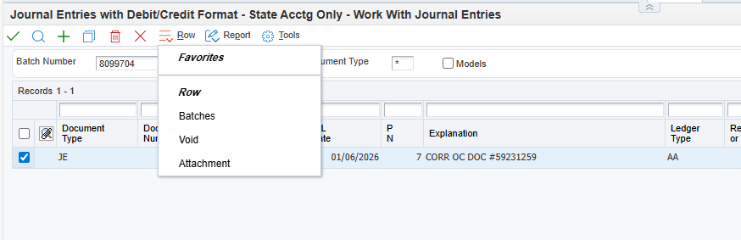
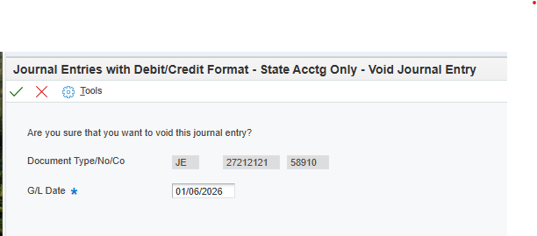



VOIDING JOURNAL ENTRY

Slide 49
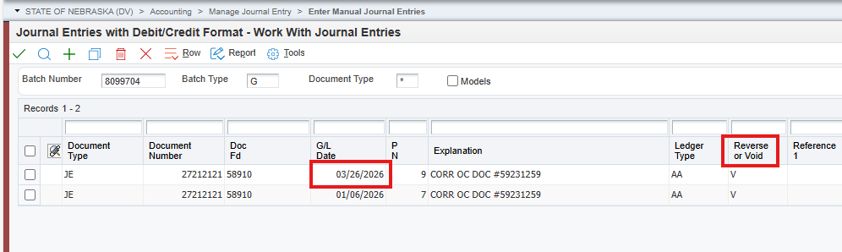
VOIDED JOURNAL ENTRY

Slide 50
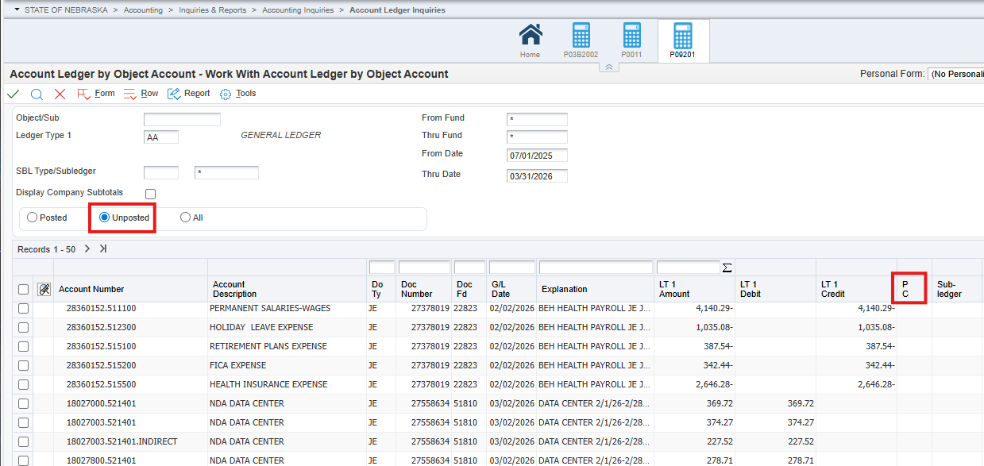
FINDING UNPOSTED BATCHES

Slide 51
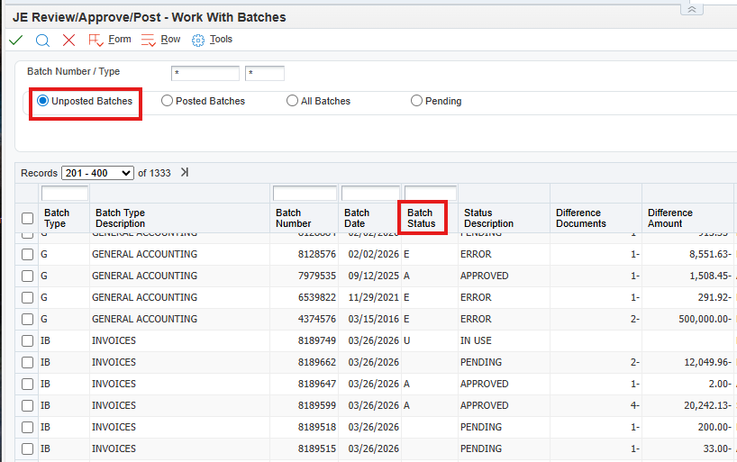
FINDING UNPOSTED BATCHES

Slide 52
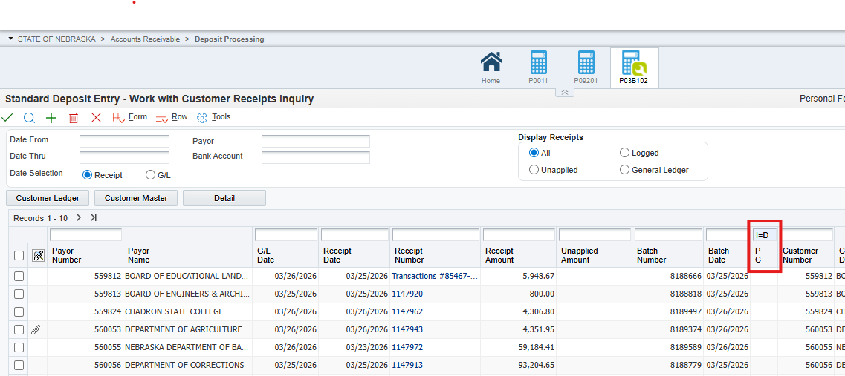
DEPOSIT BATCHES NOT POSTED

Slide 53
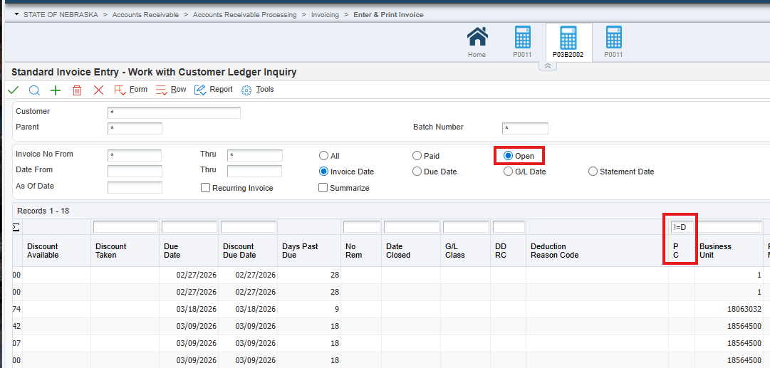
IBT BATCHES NOT POSTED

Slide 54
VARIOUS BATCHES POSTED MONTHLY
O – PO/Contract Receipt Entries
7 – Actual Payroll Period Entries
# - Payroll Vouchers
N – Inventory
0 (Zero) – Manufacturing
G – General Accounting with fund type 99990
G – General Accounting with document type J1 (PCARD)
E – Asset Transfers
X – Depreciation Journal Entries
W – Manual Payments w/o match
K – AP Payments
Unposted Voids (all batch types)

Slide 55
VARIOUS BATCHES TO BE DELETED
IB – settled invoice batches and unposted invoice batches - will be deleted before closing
RB – unposted cash receipt batches - will be deleted before closing
G – journal entries - deleted anytime after closing
V – voucher payments - deleted anytime after closing

Slide 56
LOOKING AHEAD – YEAR END REMINDERS
Review
Received not Vouchered Report
Open Purchase Orders and Service Purchase Orders
Manual Encumbrances
Update your preliminary ACFR Forms (including pre-filled forms):
Lease & SBITA
Construction In Progress (CIP) & Commitments
Fiscal Year End Close – Tuesday June 30th

Slide 57
SURPLUS PROCESS

Slide 58
DEFINITIONS
Asset Coordinator – Agency teammate responsible for managing assets and surplus property processes in ECM
E1 – EnterpriseOne – State’s financial system of record
Fixed Asset –typically $5,000 or more; entered in E1
Non-Fixed Asset – typically < $5,000 and not entered in E1
SPN Number – a unique 10-digit number assigned by the Agency used to identify asset(s) going through a particular disposal process
2-digit agency / 2-digit division / 2-digit year / 4-digit sequential number starting with 0001 each year
Example: 6505230001
ECM – Hyland OnBase’s Enterprise Content Management software platform

Slide 59
SURPLUS LIFECYCLE
Identification
Agency identifies items not needed
Information
Agency gathers necessary information
Communication
Agency submits information to Surplus Property
Determination
Surplus Property assesses, advises, and schedules drop-off/pick-up
Preparation
Agency prepares items for sale/disposal
Disposition
Items are auctioned or disposed of by destruction or recycling

Slide 60
Identification
Have unneeded items? Contact your agency Asset Coordinator to begin the surplus process
Once items are identified as no longer needed (Surplus):
Reach out to your agency Asset Coordinator
Don’t know who? Contact us – we can help!
The Asset Coordinator will:
prepare SPN forms
communicate with Surplus Property
Upload & manage disposal requests through DASSurplus ECM solution’s workflow.
ECM houses all surplus property records. All disposal processes other than auction/sale go through ECM workflow for approval. All auction documentation and SPN’s are uploaded by Surplus Property.

Slide 61
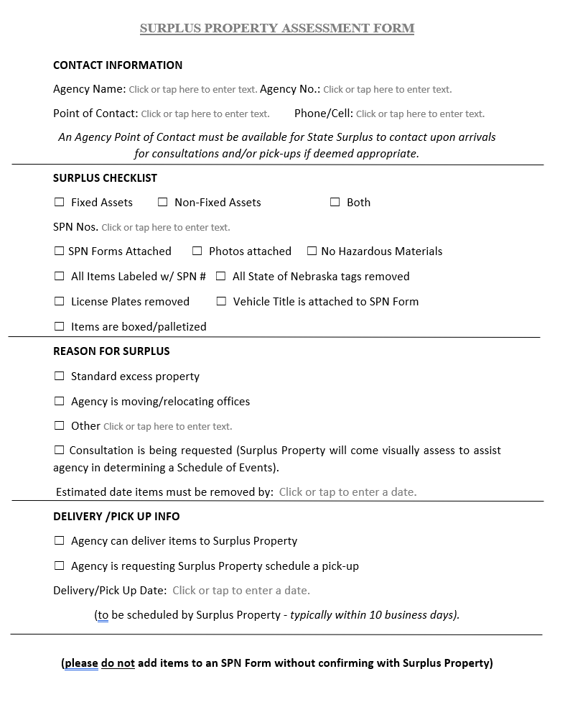
Information
The Agency Asset Coordinator will gather the necessary information
(Assessment Form, SPN Form, Photos)
Assessment Form
Contact Information
Preparation Checklist (for agency’s use)
Reason for Surplus (helpful in scheduling)
Delivery/Pick-up Info
Once submitted, DO NOT add/remove items without confirmation

Slide 62
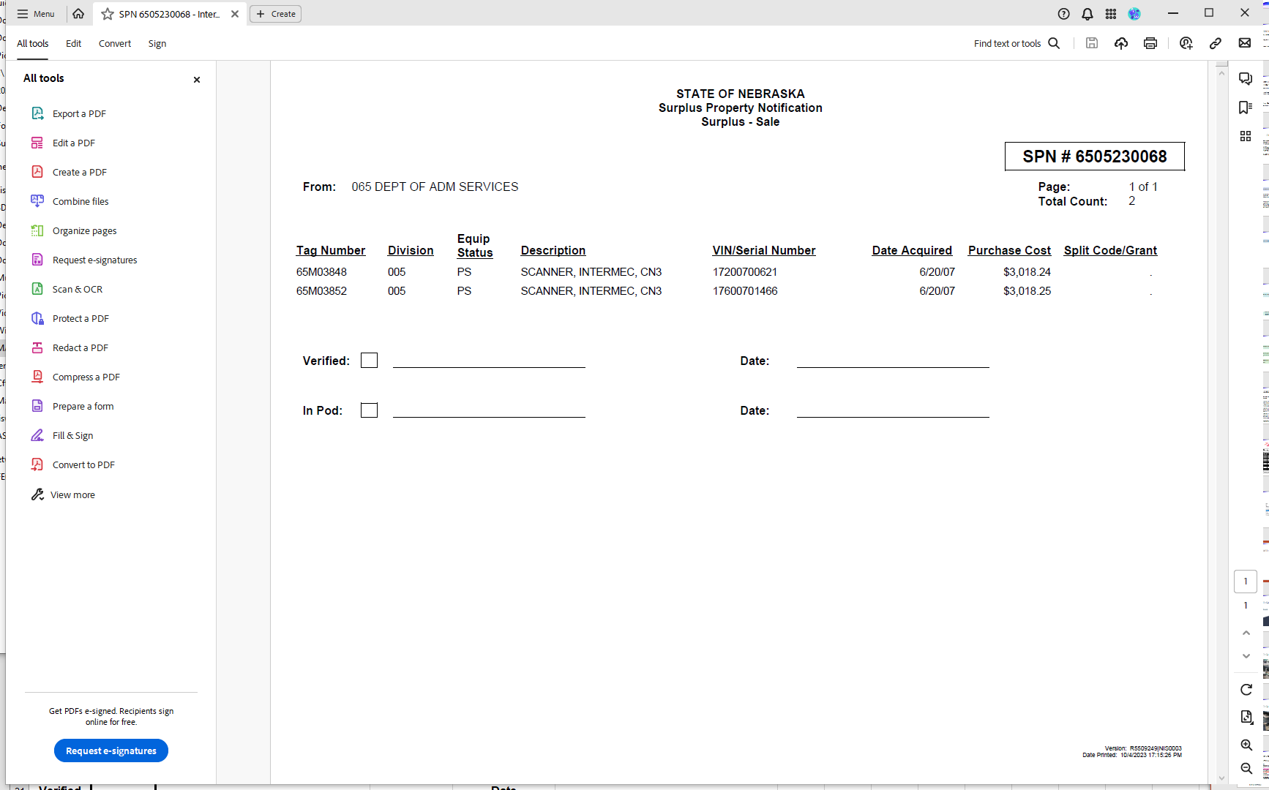
Fixed Asset SPN (generated from E1)

Slide 63
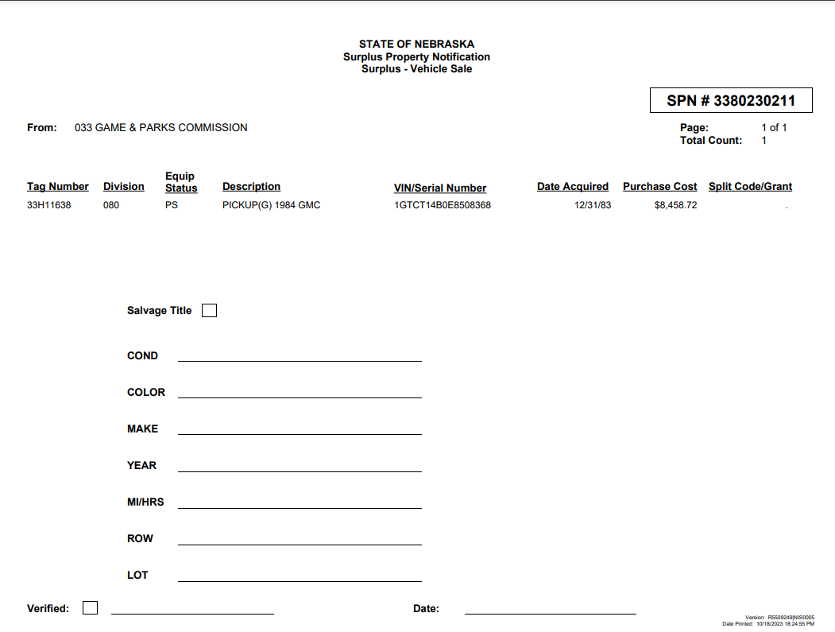
Vehicle SPN & placard (generated from E1)

Slide 64
Communication
Submit information to Surplus Property (as.materielsurplusproperty@nebraska.gov)
When all the information is gathered:
Assessment Form
SPN Form
Photos
Attach to an email and submit it to:
as.materielsurplusproperty@nebraska.gov
This Mailbox is accessible by multiple teammates and will ensure access and a timely response with any feedback.

Slide 65
Determination
Surplus Property will assess and advise as to the best disposal method and schedule a drop-off or pick-up date
Surplus Property will review the information submitted.
If any items are unsellable, Surplus will reply to the Agency’s email to adjust SPN’s and possibly submit a destruction request.
Destruction SPN’s will be submitted through ECM/Hyland OnBase, as discussed later.
If adjustments are necessary, the Agency will need to adjust and resubmit.
Once SPN’s are finalized, Surplus will provide the Agency with a date and time for drop-off or pick-up.

Slide 66
Preparation
The Agency prepares the items for drop-off or pick-up as determined
PRIOR to delivery, be sure:
Items are clean of all dirt, dust, grime, grease, etc.
Each item is labeled with SPN number
Label should be visible (tape and markers OK)
Label should NOT be placed on laptop or monitor screens
ALL state identification tags are removed
Small items are bundled & labeled with SPN number and quantity in the bundle
A copy of the SPN form is included with items
For vehicles – license plates are removed (can remove at Surplus location) and title, SPN Form, & keys are delivered with vehicle

Slide 67
Disposition
The items are auctioned through GovDeals or identified for disposal through the destruction/recycling process
SALES/AUCTION Disposal
PRE-AUCTION Sales:
Contact Surplus Property regarding availability when looking for a particular item.
Items can be viewed Tues – Thurs, 9:00 AM to 3:30 PM (closed 12PM – 1PM for lunch)
AUCTION on GovDeals.com:
Items are available online at GovDeals.com/nesurplus
If an Agency or Political Subdivision wishes to purchase an item posted for auction, it will be removed from auction.
Bill of Sale:
For all items sold, Surplus Property will provide a Bill of Sale to be signed by the purchaser.
Pick-up should take place within 5 business days for agencies and 10 business days for GovDeals sales.

Slide 68
DESTRUCTION
Prior Authorization Required:
Items cannot be destroyed, scrapped, cannibalized or recycled without authorization.
Destruction requests (SPNs) are submitted through ECM to request destruction authorization.
(See Asset Management Manual for additional information)
Destruction Types:
Destroy and Dispose (DND)
Destroy by Recycling (DNR)
Cannibalize for Parts (PRT)
Hazardous Materials (HAZ)
NOTE: If items do not sell, Agency may be asked to process items as a Destruction which may require SPN adjustment

Slide 69
DESTRUCTION WORKFLOW
Destruct – Agency Begin
Destruct – Surplus Process
Destruct – Agency Review
Destruct – Surplus Review
Agency uploads SPN & photo(s) to ECM/Hyland OnBase
Agency forwards SPN to Destruct Surplus Process queue
Surplus reviews
Surplus approves or rejects;
if approved – Surplus will note in Discussion “Approved” with any additional directives as appropriate.
If rejected, Surplus will add note as to why with additional instruction as appropriate.
SPN moves to Destruct – Agency Review queue for Agency action
If approved, the Agency can now dispose of item(s)
Add “Discussion” in ECM to note:
Date, Who, How and Witness of disposal
Upload any applicable supporting documents
Reminders are scheduled until disposal is complete (30, 60, 90, then daily)
Agency forwards SPN to Destruct Document – Surplus Review queue
Surplus reviews
If Discussion is missing is incomplete, Surplus will Return to Agency Review with note
If Discussion looks good, Surplus will move SPN to Mark Completed / Send Document to Admin for Disposal queue
Materiel Administration processes any fixed assets through disposal process to remove item(s) from E1

Slide 70
DESTRUCTION BY DISPOSING
ECM Discussion documents the Agency’s final disposition step:
Include who completed the disposal & witness;
Include date;
Include where or how item(s) are disposed
SAMPLE DISCUSSION LANGUAGE:
“Disposed by John Doe on 10/23/23 by placing in dumpster. Witnessed by Mary Smith.”
“Picked up by American Recycling on 9/15/23 – witnessed by Mary Smith and John Doe.”
“Taken to Alter Metal on 10/5/23 by John Smith, witnessed by Jane Doe. See attached ticket.”
Attach any ticket/disposal documentation and forward to Surplus for final approval and removal from E1

Slide 71
DESTRUCTION BY RECYCLING
ECM Discussion documents the Agency’s final disposition step:
Include who completed the disposal & witness;
Include date;
Include where or how item(s) are disposed
SAMPLE DISCUSSION LANGUAGE:
“Disposed by John Doe on 10/23/23 by placing in dumpster. Witnessed by Mary Smith.”
“Picked up by American Recycling on 9/15/23 – witnessed by Mary Smith and John Doe.”
“Taken to Alter Metal on 10/5/23 by John Smith, witnessed by Jane Doe. See attached ticket.”
Attach any ticket/disposal documentation and forward to Surplus for final approval and removal from E1

Slide 72
Completion
Agency will receive the proceeds for items sold, less the administrative fees
Payment/Funds
Report of Sale (ROS) created & sent to DAS–Central Finance
Funds moved through Journal Entries
Agencies receive proceeds, less administrative fee
GovDeals Sales:
Payment not released to State until picked up
Requirement is 10 business days
E1 Disposal Process:
Fixed assets must be processed for disposal to be removed from E1 inventory.
DO NOT change status to “disposed” in E1 – The disposal process takes care of this.

Slide 73
TRADE-IN PROCESS
Procurement + Asset Mgmt = SUCCESSFUL TEAMWORK
Identify item for trade-in
Obtain vendor quote
Obtain SPN Form
Submit OW requisition (trade-ins are an exception type of procurement; routes to SPB). Attach SPN & Quote.
Asset Coordinators uploads SPN, requisition & quote to ECM and forwards for approval
Surplus Property Manager approves ALL trade-in requests PRIOR to purchase to ensure proper value is being given for item.
Once approved, SPB is notified to move procurement forward.

Slide 74
RESOURCES
DAS Website: Forms and Documents (nebraska.gov)
Surplus Property Manual
Surplus Property Assessment Form
Non-Fixed Asset SPN Form
Surplus Photo Guidebook
Asset Management Manual
ECM Instructions
Annual Fixed Asset/Annual Inventory Letter
Barcoding Manual
Surplus Property Training presentation (posted to Workday)

Slide 75
CONTACT INFORMATION FOR QUESTIONS
Shannon Morris, Surplus Property Manager, 402-471-3030
James ByBee, Surplus Programs Officer, 402-471-3896
as.materielsurplusproperty@nebraska.gov
For questions regarding asset management, trade-ins, adjustments, E1 removal, and annual inventory contact:
Jennifer Sommars-Link, 402-471-1405
as.materielfixedassets@nebraska.gov

Slide 76

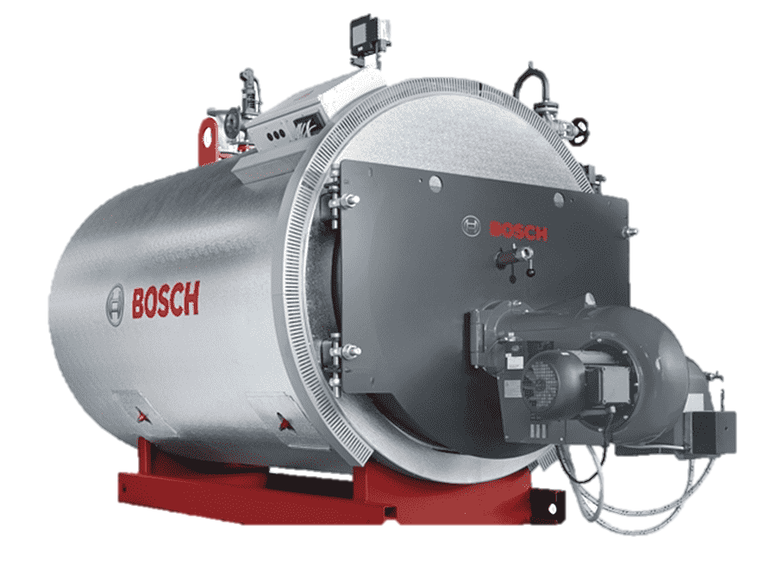



FIXED ASSETS

Slide 77

ACCOUNTING POLICY #28: CAPITAL OUTLAY
Equipment - The DAS Materiel Administrator has established an equipment capitalization threshold of $5,000. Agencies have the option to capitalize items under $5,000 if they so desire, as stated in the Asset Management Memo. View the Asset Management Manual for more information.
To determine if an item should be a capital outlay, the item should have an expected useful life of two or more years and the total costs for the item should be $5,000 or greater. Capitalized equipment must be coded to object codes 581800 - 586900. Costs incurred in preparing the item for service and freight should be included in the amount capitalized. Fixed assets should be recorded to the appropriate object code and item code to ensure appropriate depreciation lives are utilized.
Computer Software Capitalization: Computer software that is internally developed, or commercially available software that is modified using more than minimal incremental effort before being put into operation, shall be capitalized as a separate asset if the cost is $100,000 or more and has a life greater than one year. During the application development stage (as defined below) the costs should be accumulated in object account 587550 – IT Projects in Progress. Once the project is complete the costs are moved to 583720 or 583770 – COTS Development or Customized Development.

Slide 78
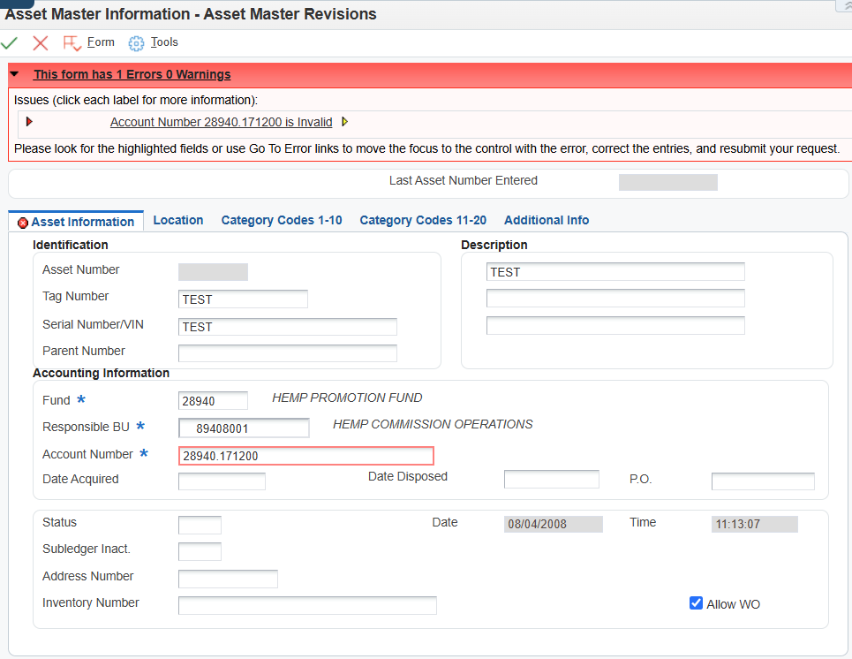
COMMON ERROR WHEN CREATING AN ASSET MASTER
This error is generally due to either depreciation expense (56xxxx) or accumulated depreciation (18xxxx) needing to be attached to the business unit.
The following accounts must be set up to creating an asset record:
5 digit BU and 17xx00
5 digit BU and 18xx00
8 digit BU and 56xx00
8 digit BU and 58xx00

Slide 79
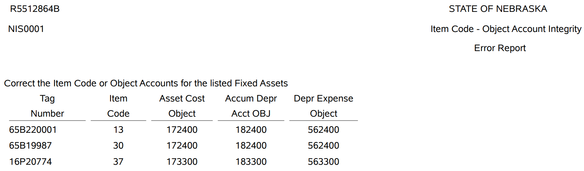
ITEM CODE – OBJECT ACCOUNT INTEGRITY REPORT
This report shows asset tags where the item code and related object accounts aren’t in agreement which can cause system issues, depreciation issues, and impact financial reporting.
To fix this, either the Item Code needs to be changed, or an asset transfer must be done to correct the object codes, whichever is proper.

Slide 80
Are costs posted to the asset?
YES
NO
Is the item code correct?
NO
YES
Delete the asset record and re-enter it with correct object codes.
Revise the asset’s item code by drilling into the asset record.
Are the object codes correct?
YES
NO
Process an asset transfer to correct the object codes.
No asset transfer is required.
WHEN IS AN ASSET TRANSFER NECESSARY?

Slide 81
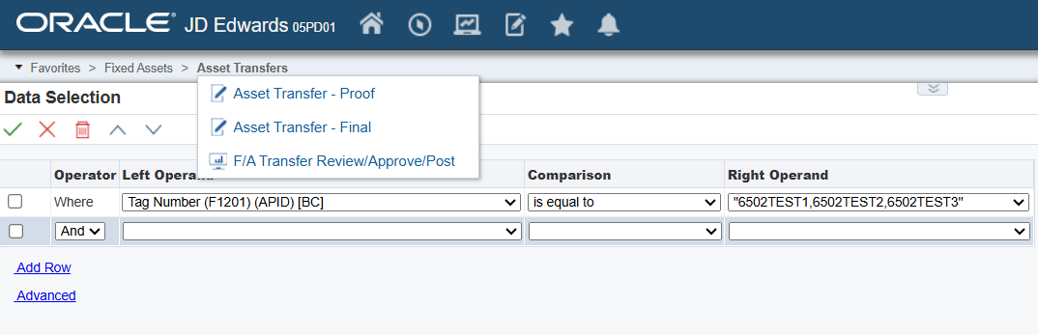
PROCESSING AN ASSET TRANSFER
First run the “Proof” report to ensure the transaction created is proper. Then run the “Final” report to run.
If you have multiple assets that need to be transferred to the same fund, business unit, or object, you can enter multiple tags at one time.

Slide 82
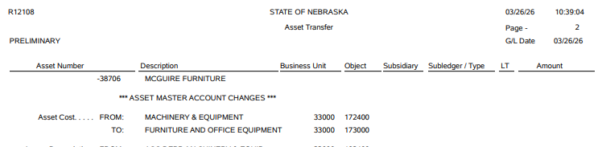



PROCESSING AN ASSET TRANSFER (continued)
After running the “Final”, E1 will create an entry that will need to be approved & posted. This is a batch type “E” and posts to the F1 & F2 Ledgers.

Slide 83


ITEM CODES AND HOW THEY’RE USED IN THE ACFR

Slide 84

ITEM CODES AND HOW THEY’RE USED IN THE ACFR

Slide 85

ITEM CODE REVIEW AND CLEANUP
Review asset records for software systems not recorded to item code 37 by using wildcards such as:
*SOFTWARE*
*SYSTEM*
*LICENSE*
*APP*
If asset item codes or object codes need to be corrected, an asset transfer likely needs to be completed

Slide 86
PROCUREMENT - OV DOCS VOUCHERS

Slide 87
GENERAL OVERVIEW OF PROCUREMENT TO PAYMENT WORKFLOW
Procurement -Create PO
Procurement – Receiving
Accounting – Enter Voucher
Payment
Agency follows policies set by SPB and State Statute to create a purchase order
PO is reviewed and goes through Approvals
Encumbrance is created
Document Type “OV”
Batch Type “O”
After posting: - Encumbrance reduced - Creates RNV - Can enter Voucher - Can reverse receipt
Receipts can be Reversed but not Voided
*Y5/Z8/Z9 type POs do not need to be received
Use Prior Year menu options for all payments not for the current FY and reference the related FY
Pay Invoices, not Statement totals *exceptions like utilities
Remarks – Include Agency phone # and Account # for Vendor’s reference or if they have questions
Pre-Audit then Post
After posting: - RNV reduced - Create Payable to Vendor
Daily Process, early afternoon by State Accounting Payment can include other state agencies To ensure timely processing, emergency pulled warrants need to be requested before 3pm the day before
Agency must request approval of all warrants over $25,000 from ST Treasurer

Slide 88
GENERAL OVERVIEW (continued)
Each step needs to be completed prior to proceeding to the subsequent steps. (Approving / Posting)
The job for the auto posting is added to the queue every 20 minutes.
Fixing issues – all steps need to be done in the reverse order, also posting needs to happen where necessary.
Vouchers that are voided need to be Approved and Posted
Only posted O batches can be reversed. (do NOT void)
Regular review/checks
Unposted O Batches
Unpaid Vouchers
Uncashed warrants
Received Not Vouchered
Notes:
Purchase orders need to be approved prior to Receiving.
Receipts need to Post prior to entering Vouchers.

Slide 89
REVIEW - UNPOSTED ‘O’ BATCHES
Unposted batches are any batches that are not in POSTED status
Approved – E1 default status when a new batch is created
Pending – manually set
In USE – E1 shows this batch currently being used. If after a day has passed and the batch is still In Use, notify State Accounting
Error – This can be set back to “Pending” status to correct any budget issues by the agency before Approving for E1 to post
Do NOT reverse or voucher an unposted batch
When agency cannot resolve budget issues - Contact State Accounting

Slide 90

REVIEW - UNPOSTED O BATCHES (cont’d)
Common issues with O Batches (not budget related):
Quantity entered does not match the PO – causing excessively large $ amount.
Vouchers entered before receipt batch posting
Changing purchase orders before receipt reversal posts
Batches stuck in “In Use”.

Slide 91

GENERAL JOURNAL FOR ‘O’ BATCHES
Column PC shows Posted status
Blank = Unposted
“P” = Posted
*Note* Document total is total for each of the Debit/Credit columns. It does not mean the Net Receipt amount.

Slide 92
BATCHES IN ERROR STATUS
Monitor the O batches regularly. All errors must be resolved prior to month end.
Run the G/L Post Budget Failure Report for the batch. This will provide account coding information and explanation. You should run this report before contacting State Accounting for assistance
E1 Menu path: Accounting > Manage Journal Entry > JE Review/Approve/Post
Report R5514001 ‘G/L Post Budget Failure Report’:
Review the Budget Failure Manual E1 Training Guides > Accounts Payable > Lesson 4 AP reports > GL Post Budget Failure Report

Slide 93

GL POST BUDGET EXCEPTION
Batches with an error will show the:
Document Number, BU/Grant #
Budget Failure explanation
Amount holding up the transaction

Slide 94
O BATCHES – REVERSING
When Reversing an O batch:
Review the User Guide to determine the appropriate procedure for various scenarios
Allow time for the reversing receipt to POST before making any changes on the Purchase Order. You can also manually post the batch.
Do NOT reverse an unposted batch
Do NOT void an O batch
Do use the direct path to Reversals (not through the nested menu shortcuts)

Slide 95


PROCUREMENT/OV DOCUMENTS
Link User Guides Procurement-> Requisitions, Contracts and Purchase Order -> Receiving.
LINK.nebraska.gov Resources > E1/JDE User Guides > Procurement section.
Note: Entering receipts by PO and Reversing receipts lessons have been combined into “Receiving” lesson.
Notes:
If a mistake is made during the receipt or voucher process, please refer to the Reverse Receipt training guide

Slide 96

A P – VOUCHER/INVOICE ENTRY (with PO)
Link User Guides – Accounts Payable Lesson 3: Entering Vouchers…Three-Way Match
on LINK.nebraska.gov web page go to Resources > E1/JDE User Guides
Then click EnterpriseOne Training Guides
Accounts Payable > Lesson 3: Other Voucher Processing Inquiries
Entering Vouchers using Three-Way Match

Slide 97

VOUCHER / INVOICE ENTRY
General Guidelines:
One voucher per invoice
Invoice Number/Date = Invoice Number/Date on the invoice, do not leave blank
Remark => Enter your agency’s phone # for Payment Inquiry, account number with the supplier

Slide 98


A P – SPECIAL HANDLING A VOUCHER
Accounts Payable Lesson 2: Special Handling of a Voucher
Revise payment date
Have warrant returned to the agency
Place on hold or release hold, prevent payment from being generated

Slide 99

EMERGENCY PULL WARRANT
Returned warrants should be held utilizing the Payment Handling Code in Special Handling…
Emergency pull warrant need to be requested before 3pm the day before the warrant is to be issued
Use the link from “Contact Us”

Slide 100

VOUCHER - PAID
Pay Stat = “P”
Gross Amount has an Amount
Open Amount is blank
Notes:
Sample voucher screenshot – Void / Paid / Unpaid

Slide 101

VOUCHER – VOIDED
Pay Stat = “P”
Gross Amount is blank
Open Amount is blank
Notes:
Sample voucher screenshot – Void / Paid / Unpaid

Slide 102

VOUCHER – UNPAID
Pay Stat = “A”
Gross Amount has an amount
Open Amount has an amount
Notes:
Sample voucher screenshot – Void / Paid / Unpaid

Slide 103
VOUCHERS – other issues
Vouchers missing detail or listing 211700 on the Pre-Audit report – Review Account coding from the receipt OV document - Approve and Post voucher if it looks correct and correct vendor being paid - this is for Vouchers with PO
When Voiding or Deleting a voucher, be sure to change the GL date to “today”.

Slide 104

RECEIVED NOT VOUCHERED
This should be reviewed regularly, especially before year end
Run the report from 01/01/2000 through last day of current month
If the expense is no longer valid - Current FY: reverse the receipt and cancel the order - Prior FY: submit JE to State Accounting to debit 211700 & credit 486500, include the associated FY in the remarks
*** if Reverse & Cancel PO is done in the same FY as the expense, you receive your allotment back by reducing expense, otherwise it is lost ***

Slide 105
REQUESTS TO STATE ACCOUNTING
Always send requests through as.stateaccounting@nebraska.gov
Put “Reversing PO” in the email subject line
O Batch number must be included.
PO number is helpful, but not required.
A link to email State Accounting is on the website under “Contact Us”

Slide 106
THANK YOU!
Email: AS.StateAccounting@nebraska.gov in the subject include “BUG Question”
Contact Info
Philip.Olsen@nebraska.gov 402-471-0600
Krista.Davis@nebraska.gov 402-890-8253
Caleb.Witt@nebraska.gov 531-810-1956
Chad.Pinger@nebraska.gov 402-416-1535
Patrick.Trinh@nebraska.gov 531-530-9773
Shaun.McDonald@nebraska.gov 402-540-4987
Shabnam.Sultani@nebraska.gov 402-314-4353
Van.Truong@nebraska.gov 402-471-5259

