Slide 1
Understanding the effects of Workday events
And how Workday communicates them to JD Edwards (Payroll and Financial Center) and the Insurance vendors.
Presented by:
Quincey Stohs, Benefits Specialist

Slide 2
Focus points
How changes in Workday interact with each other
How changes in Workday affect payroll processes
How changes in Workday affect insurance vendor records

Slide 3
How processed changes interact with each other
Workday changes only update when processed in the same order they occurred in life.
Your workload timeline
Job change process
10/21/20 event
Benefit change process
10/21/20 event date
start
finished
start
finished
From Subject Received Size Categories
Epperly, Loraine Printer Logic printers Tue 10/20 1 MB

Slide 4
How processed changes interact with each other
Starting the Benefit event before the Job Change process is finished causes the benefit event to apply the old job details.
Once the Benefit event is launched, it will not automatically update once the Job change is completed.
Your workload timeline
Job change process
10/21/20 event
Benefit change process
10/21/20 event date
start
start
finished
finished

Slide 5
How processed changes interact with each other
Once the Benefit event is launched, it will not automatically update once the Job change is completed.
Benefit change process
10/21/20 event date
Job change process
10/21/20 event
Your workload timeline
start
finished
start
finished

Slide 6
How changes in Workday affect payroll processes
Workday sends all updates to JD Edwards (Payroll & Financial Center) 2 times each weekday – around 11:45am & around 2:30am.
All finalized changes in place before these times, will start transferring at these times.

Slide 7
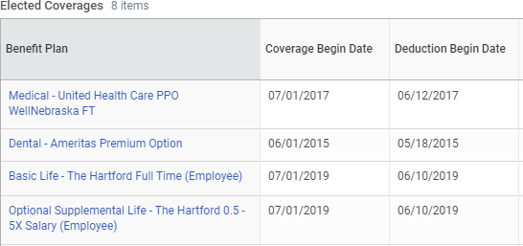
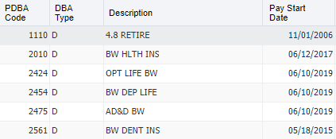
How changes in Workday affect payroll processes
Workday calculates the appropriate pay period on the Confirmation page.
There are a couple pay periods each year that calculate the wrong Deduction Begin Date in Workday, but JDE corrects the calculation when the updates feed over.

Slide 8
How changes in Workday affect Insurance Vendor records
Finalized changes affecting the Medical plan are sent to the Medical vendor at about 6:00am every Thursday morning.
Finalized changes for all other insurance plans are sent to their respective vendors at about 6:00am every Friday morning.
If a Change request is not submitted to the Benefits team and approved by a Benefits Partner before these deadlines, the vendors will not know about the updates until the following week.

Slide 9
The Benefits team is available to help you.
Email us at AS.EmployeeBenefits@Nebraksa.gov
Leave a voicemail at 402-471-4443. We will get back to you as soon as possible.
We are also individually available through email, phone, or Skype

