Slide 1
Surplus property
Surplus Training
November 8, 2023
10:00 a.m. – 12:00 p.m.

Slide 2
Team Introductions
Shannon N. Morris
Surplus Property Manager
James A. ByBee
Administrative Program Officer I
Jennifer Sommars-Link
Materiel Administrative & Legal Services Manager

Slide 3
Surplus Property Functions/Responsibilities
Appraise & make items available for sale to other agencies
Sell or dispose of items by any method most advantageous to the State, which include:
Sales
Trade-Ins
Destructions
Adjustments
Auctions typically handled online - GovDeals
Livestock Auction – Held in Crawford, Nebraska

Slide 4
definitions
Asset Coordinator – Agency teammate responsible for managing assets and surplus property processes in ECM
E1 – EnterpriseOne – State’s financial system of record
Fixed Asset –typically $5,000 or more; entered in E1
Non-Fixed Asset – typically < $5,000 and not entered in E1
SPN Number – a unique 10-digit number assigned by the Agency used to identify asset(s) going through a particular disposal process
2-digit agency / 2-digit division / 2-digit year / 4-digit sequential number starting with 0001 each year
Example: 6505230001
ECM – Hyland OnBase’s Enterprise Content Management software platform

Slide 5
LIFECYCLE
Identification
Identify that items are not needed
Information
Agency gathers necessary information
Communication
Submits information to Surplus Property
Determination
Surplus Property will assess, advise, and schedule
Preparation
The Agency prepares items
Disposition
The items are auctioned or disposed of by destruction or recycling
Notes:
Added a high level overview so the audience knows what will be covered.

Slide 6
Identification
Have unneeded items? Contact your agency Asset Coordinator to begin the surplus process
Items no longer needed are identified as Surplus
Reach out to your agency Asset Coordinator
Don’t know who? Contact us – we can help!
Asset Coordinator will prepare SPN forms, communicate with Surplus Property and manage processes going through DASSurplus ECM solution.
ECM houses all surplus property records. All disposal processes other than auction/sale go through ECM workflow for approval. All auction documentation and SPN’s are uploaded by Surplus Property.

Slide 7
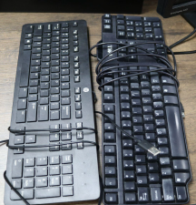
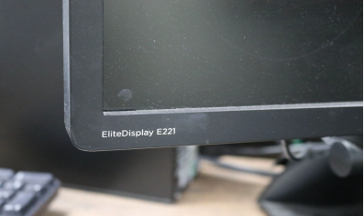
Information
The Agency Asset Coordinator will gather the necessary information (Assessment Forms, SPN Forms, Photos)
Assessment Forms
SPN Forms
Photos

Slide 8
New ASSESSMENT FORM
Used to provide correct/updated contact information
Used as a general checklist to ensure items are ready to be surplused prior to notifying Surplus Property
Used to assist the Agency & Surplus Property in scheduling the removal of items
Informs Surplus Property of the Agency’s needs and/or ability regarding delivery/pick-up
It is important to not adjust after submission as adding items after submission can cause errors in the disposal process. Use a new SPN if necessary.

Slide 9
New SPN FORM
Division
Calendar Year
1st SPN # of the Year
65
09
23
Agency
0001
Total Number of EACH
Item

Slide 10
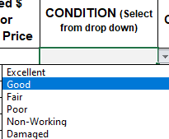
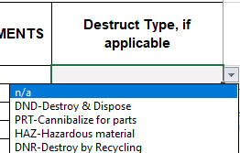
Options made simple

Slide 11
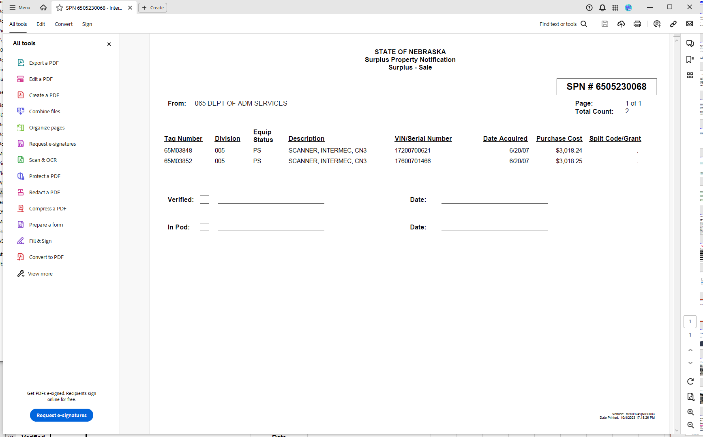
Fixed Asset SPN (generated from E1)

Slide 12
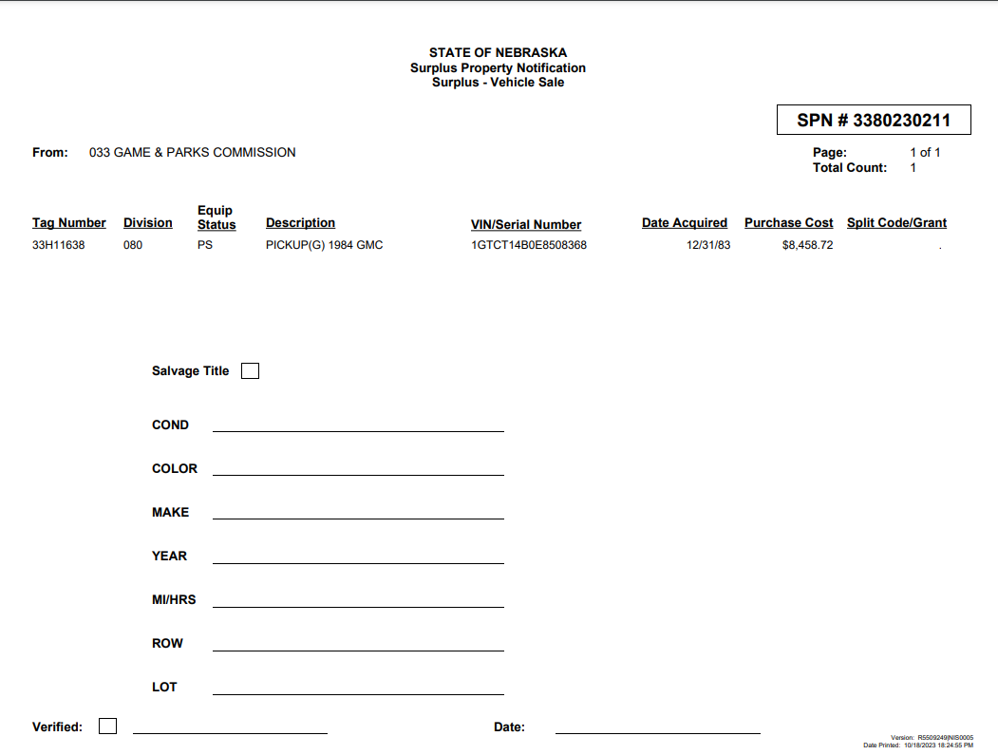
Vehicle SPN & placard (generated from E1)
SIMPLIFIED PROCESS!
The SPN Form for vehicles will replace the formerly required “placard” to be placed in the vehicle window

Slide 13
New PhOTO GUIDEBOOK

Slide 16
Communication
Submit information to Surplus Property (as.materielsurplusproperty@nebraska.gov)
When all of the information is gathered:
Assessment Form
SPN Form
Photos
Attach to an email and submit it to:
as.materielsurplusproperty@nebraska.gov
This Mailbox is accessible by multiple teammates and will ensure access and a timely response with any feedback.

Slide 17
Determination
Surplus Property will assess and advise as to the best disposal method and schedule a drop-off or pick-up date
Surplus Property will review the information submitted.
If any items are unsellable, Surplus will reply to the Agency’s email to adjust SPN’s and possibly submit a destruction request.
Destruction SPN’s will be submitted through ECM/Hyland OnBase, as discussed later.
If adjustments are necessary, the Agency will need to adjust and resubmit.
Once SPN’s are finalized, Surplus will provide the Agency with a date and time for drop-off or pick-up.

Slide 18
Preparation
The Agency prepares the items for drop-off or pick-up as determined
PRIOR to delivery, be sure:
Items are clean of all dirt, dust, grime, grease, etc.
Each item is labeled with SPN number
Label should be visible (tape and markers OK)
Label should NOT be placed on laptop or monitor screens
ALL state identification tags are removed
Small items are bundled & labeled with SPN number and quantity in the bundle
A copy of the SPN form is included with items
For vehicles – license plates are removed (can remove at Surplus location) and title, SPN Form, & keys are delivered with vehicle

Slide 19
Examples of PROPERLY Prepared Items
Box or palletize Pallets no larger than 40” x 48”
Written SPN numbers are Acceptable
Shrink-Wrapped for safety

Slide 20
Disposition
The items are auctioned through GovDeals or identified for disposal through the destruction/recycling process
SALES/AUCTION Disposal
PRE-AUCTION Sales:
Contact Surplus Property regarding availability when looking for a particular item.
Items can be viewed Tues – Thurs, 9:00 AM to 3:30 PM (closed 12PM – 1PM for lunch)
AUCTION on GovDeals.com:
Items are available online at GovDeals.com/nesurplus
If an Agency or Political Subdivision wishes to purchase an item posted for auction, it will be removed from auction.
Bill of Sale:
For all items sold, Surplus Property will provide a Bill of Sale to be signed by the purchaser.
Pick-up should take place within 5 business days for agencies and 10 business days for GovDeals sales.

Slide 21
Bill of Sale

Slide 22
Destruction
Prior Authorization Required:
Items cannot be destroyed, scrapped, cannibalized or recycled without authorization.
Destruction requests (SPNs) are submitted through ECM to request destruction authorization.
(See Asset Management Manual for additional information)
Destruction Types:
Destroy and Dispose (DND)
Destroy by Recycling (DNR)
Cannibalize for Parts (PRT)
Hazardous Materials (HAZ)
NOTE: If items do not sell, Agency may be asked to process items as a Destruction which may require SPN adjustment

Slide 23
Destruction workflow
Destruct – Agency Begin
Destruct – Surplus Process
Destruct – Agency Review
Destruct – Surplus Review
Agency uploads SPN & photo(s) to ECM/Hyland OnBase
Agency forwards SPN to Destruct Surplus Process queue
Surplus reviews
Surplus approves or rejects;
if approved – Surplus will note in Discussion “Approved” with any additional directives as appropriate.
If rejected, Surplus will add note as to why with additional instruction as appropriate.
SPN moves to Destruct – Agency Review queue for Agency action
If approved, the Agency can now dispose of item(s)
Add “Discussion” in ECM to note:
Date, Who, How and Witness of disposal
Upload any applicable supporting documents
Reminders are scheduled until disposal is complete (30, 60, 90, then daily)
Agency forwards SPN to Destruct Document – Surplus Review queue
Surplus reviews
If Discussion is missing is incomplete, Surplus will Return to Agency Review with note
If Discussion looks good, Surplus will move SPN to Mark Completed / Send Document to Admin for Disposal queue
Materiel Administration processes any fixed assets through disposal process to remove item(s) from E1

Slide 24
destruction
by DISPOSING
ECM Discussion documents the Agency’s final disposition step:
Include who completed the disposal & witness;
Include date;
Include where or how item(s) are disposed
SAMPLE DISCUSSION LANGUAGE:
“Disposed by John Doe on 10/23/23 by placing in dumpster. Witnessed by Mary Smith.”
“Picked up by American Recycling on 9/15/23 – witnessed by Mary Smith and John Doe.”
“Taken to Alter Metal on 10/5/23 by John Smith, witnessed by Jane Doe. See attached ticket.”
Attach any ticket/disposal documentation and forward to Surplus for final approval and removal from E1

Slide 25
destruction
by recycling
Metal Recycling:
PRIOR SPN approval required
Provide vendor with copy of SPN Form or SPN #
Upload ticket to ECM – this is the Proof of Destruction
Electronic Recycling:
PRIOR SPN approval required
American Recycling contract
Can take items to NSOB dock (Mail Center), Surplus Property, or direct to vendor
Large quantity, call first 402-805-4985 – vendor can pick-up
Cell Phones:
Deliver to Surplus Property or to Jennifer Sommars-Link @ 1526 K Street Building

Slide 26
Completion
Agency will receive the proceeds for items sold, less the administrative fees
Payment/Funds
Report of Sale (ROS) created & sent to DAS–Central Finance
Funds moved through Journal Entries
Agencies receive proceeds, less administrative fee
GovDeals Sales:
Payment not released to State until picked up
Requirement is 10 business days
E1 Disposal Process:
Fixed assets must be processed for disposal to be removed from E1 inventory.
DO NOT change status to “disposed” in E1 – The disposal process takes care of this.

Slide 27
Trade-In Process
Procurement + Asset Mgmt = SUCCESSFUL TEAMWORK
Identify item for trade-in
Obtain vendor quote
Obtain SPN Form
Submit OW requisition (trade-ins are an exception type of procurement; routes to SPB). Attach SPN & Quote.
Asset Coordinators uploads SPN, requisition & quote to ECM and forwards for approval
Surplus Property Manager approves ALL trade-in requests PRIOR to purchase to ensure proper value is being given for item.
Once approved, SPB is notified to move procurement forward.

Slide 28
Service expectations
Deliveries
Schedule appointment in advance
Tues – Thurs, 9:00 AM to 3:30 PM (closed 12PM – 1PM for lunch)
Unscheduled deliveries may be turned away
IMPORTANT! Please keep to scheduled time. If unforeseeable delay, call to confirm whether the delivery can still be accommodated. Rescheduling may be necessary.
Pick-Ups
Contact Surplus Property to see if this is an option and to schedule
Moving Services
Cornhusker State Industries (CSI) offers moving services for a fee
Contact State Purchasing Bureau for other moving service vendors
Viewing
Items are available for viewing
Tues – Thurs, 9:00 AM to 3:30 PM (closed 12PM – 1PM for lunch)

Slide 29
RESOURCES
DAS Website: Forms and Documents (nebraska.gov)
Surplus Property Manual
Surplus Property Assessment Form
Non-Fixed Asset SPN Form
Surplus Photo Guidebook
Asset Management Manual
ECM Instructions
Annual Fixed Asset/Annual Inventory Letter
Barcoding Manual
Surplus Property Training presentation (posted soon)

Slide 30
CONTACT INFORMATION and for questions
Shannon Morris, Surplus Property Manager, 402-471-3030
James ByBee, Surplus Programs Officer, 402-471-3896
as.materielsurplusproperty@nebraska.gov
For questions regarding asset management, trade-ins, adjustments, E1 removal, and annual inventory contact:
Jennifer Sommars-Link, 402-471-1405
as.materielfixedassets@nebraska.gov

Slide 31
THANK YOU!
We open the floor to any questions.

