Slide 1
State of Nebraska
Mid-Biennium Budget Adjustments 2019-2021 Biennium Executive Budget Presentation
Pete Ricketts
Governor
January 15, 2020

Slide 2
Gov. Ricketts’ Keep Nebraska Strong Initiatives
Provide Additional Property Tax Relief
Assist Communities Devastated by Recent Disasters
Connect Nebraskans to Great Job Opportunities
Address Mid-Biennium Budget Adjustment Requests
Improve the State Cash Reserve Fund Balance
Maintain Structural Balance in State Budget

Slide 3
Tax Relief
Increased Property Tax Relief
New Property Tax Relief—About $500 million over next three years
Homestead Exemption—Additional $9.1 million in direct property tax relief to eligible Nebraskans this biennium
LB 153: Income Tax Relief for Veterans
Covering over 13,000 military veterans, we will exempt 50% of military retirement pay from NE income tax
$14 million in annual tax relief for our veterans when fully implemented

Slide 4
Disaster Relief
Governor’s Emergency Fund
$50 million—State cost share for federal disaster relief
$9.2 million—Assist most severely impacted counties with their local cost share for federal disaster relief
$3 million—Provide funding for possible winter and spring emergency events
Critical Infrastructure Fund
$3.8 million—Tunnel repair for Fort Laramie Canal
Missouri River Basin—Flood Management Studies
$250,000—Finance studies to improve flood control of the Missouri River Basin

Slide 5
Great Job Opportunities
Developing Careers
Provide $16 Million for a new Nebraska Career Scholarship Program funding 2,280 scholarships by FY 24
LB 720: ImagiNE Nebraska Act
Refines current tax incentives to make them more transparent, focus on higher wage careers, and easier to use
Ensures Nebraska remains competitive on the national stage in attracting and retaining businesses

Slide 6
Specific Budget Adjustments
Investing in Public Safety
Pay increases totaling $8 million to attract and retain quality Corrections teammates
Provide $1 million for a Workforce Development Partnership with Peru State College and Tecumseh State Correctional Institution for careers in correctional services
Fully Funding TEEOSA School Aid
Provide an additional $12.5 million in education aid to fully fund TEEOSA school aid
Providing Resources to Health and Human Services
Finance $8.6 million to meet the needs of individual clients of the Division of Development Disabilities
Provide $18.8 million for improved staffing and facilities to enhance patient safety (ligature mitigation) at the Lincoln Regional Center (LRC)

Slide 7
Summary of Mid-Biennium Budget Recommendations
Governor recommends using $109.4 million of $337 million in excess receipts from FY 2018-19 and FY 2019-20 for one-time disaster related costs, State Capitol Building repairs, and patient safety at LRC
Governor’s Emergency Cash Fund—$62.2 million
Nebraska Capital Construction Fund (NCCF)—$43.4 million
Critical Infrastructure Cash Fund—$3.8 million
State Cash Reserve Fund improves by $185 million to $507 million from the enacted 2019-2021 Biennial Budget estimate of $322 million
Governor’s General Fund Mid-Biennium Budget Adjustments:
FY 2019-20: Net increase of $216,449 General Funds
Reduce 2019 Carryover by $10.7 million General Funds
FY 2020-21: Net reduction of $1.7 million General Funds

Slide 9
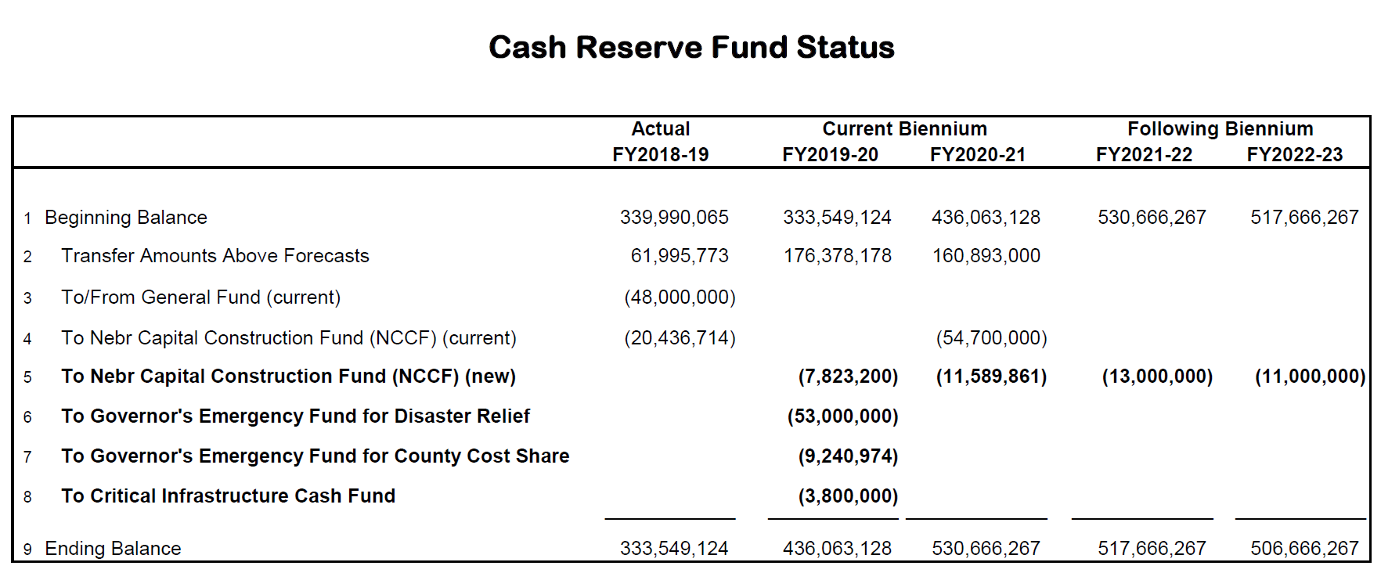

Slide 10
State of Nebraska
Mid-Biennium Budget Adjustments 2019-2021 Biennium Executive Budget Presentation
Questions and Answers?

